Slide 1
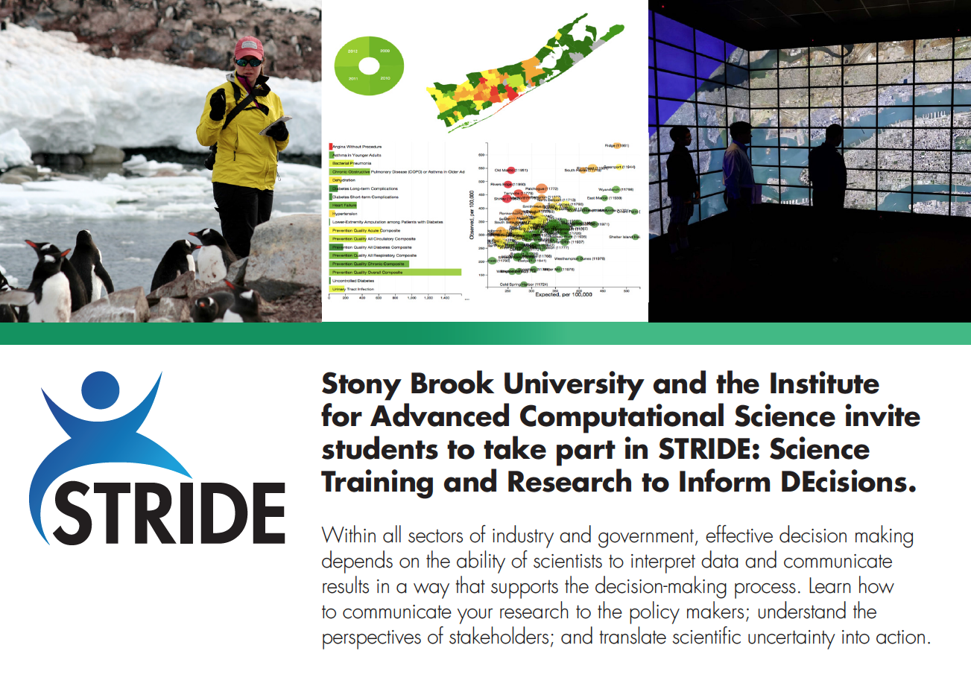
STRIDE
Science Training and Research to Inform DEcisions

Slide 2
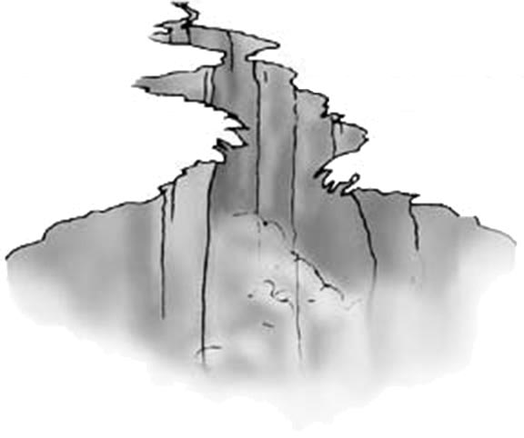

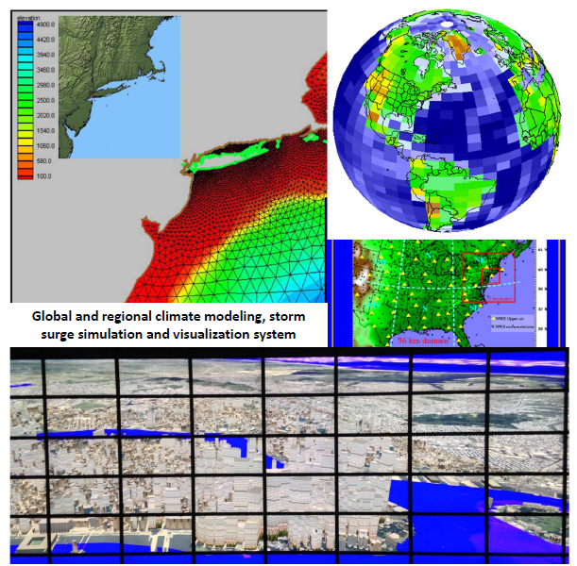
Science Training & Research to Inform DEcisions (STRIDE)
“data-focused” skills:
- modeling
statistics
computation
visualization
Decision-making requires a rapid response ➤ Need experts that straddle the traditional divide between data-science and policy

Slide 3
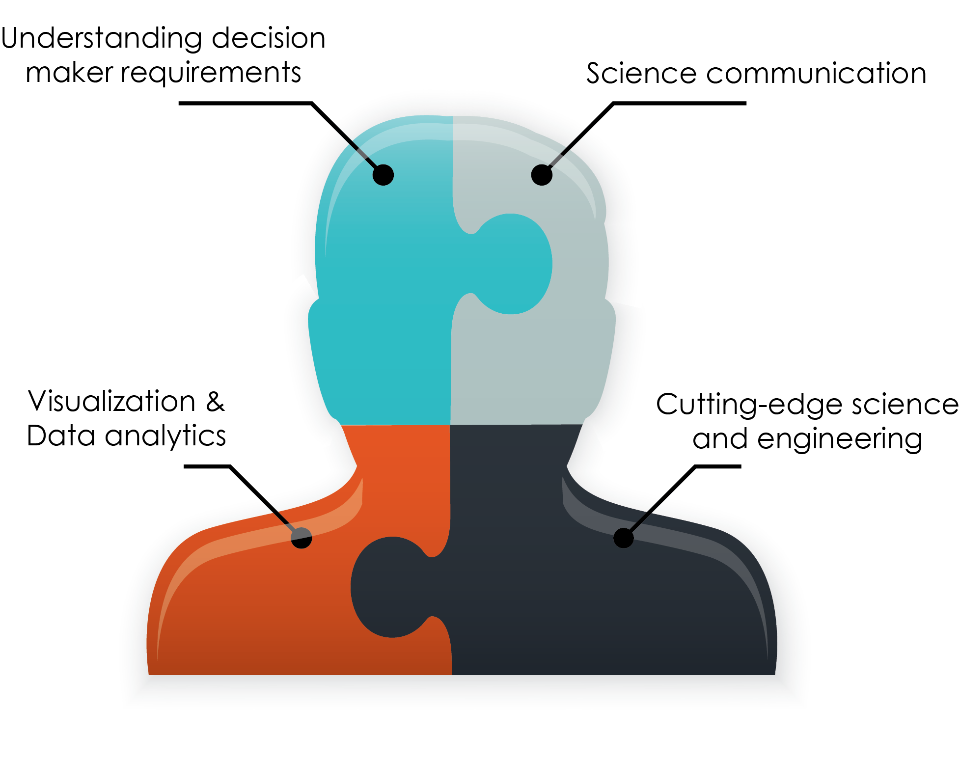
Science Training & Research to Inform DEcisions (STRIDE)
Vertically-integrated graduate training:
Connects scientific and computational research to decision support
Preparation for high-impact careers (academic, industrial, government, and non-profit settings)
Connects science to real-world applications

Slide 4

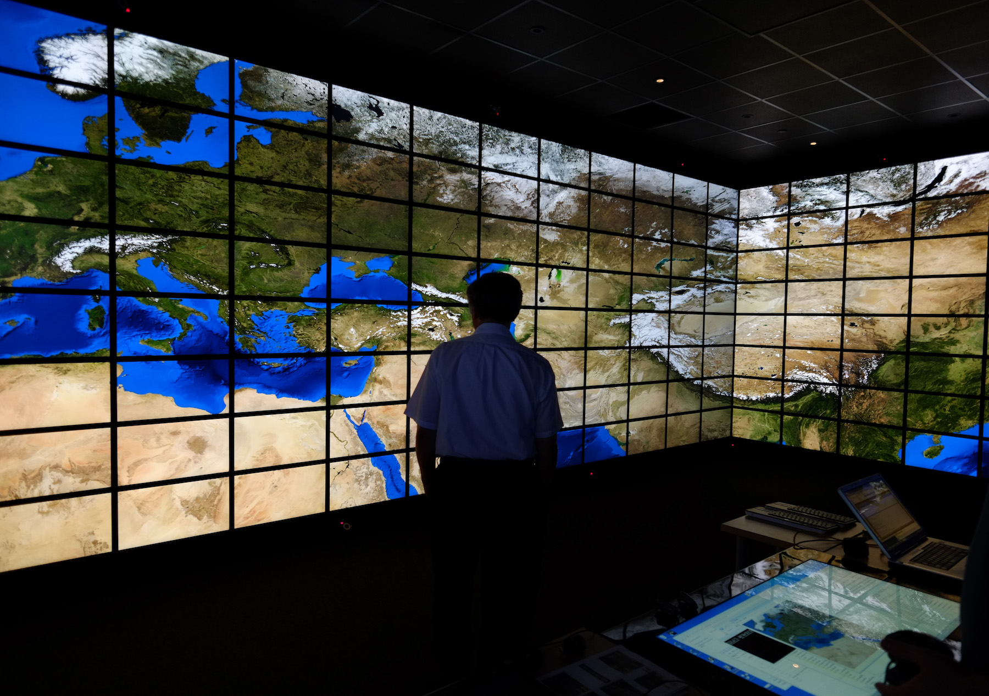

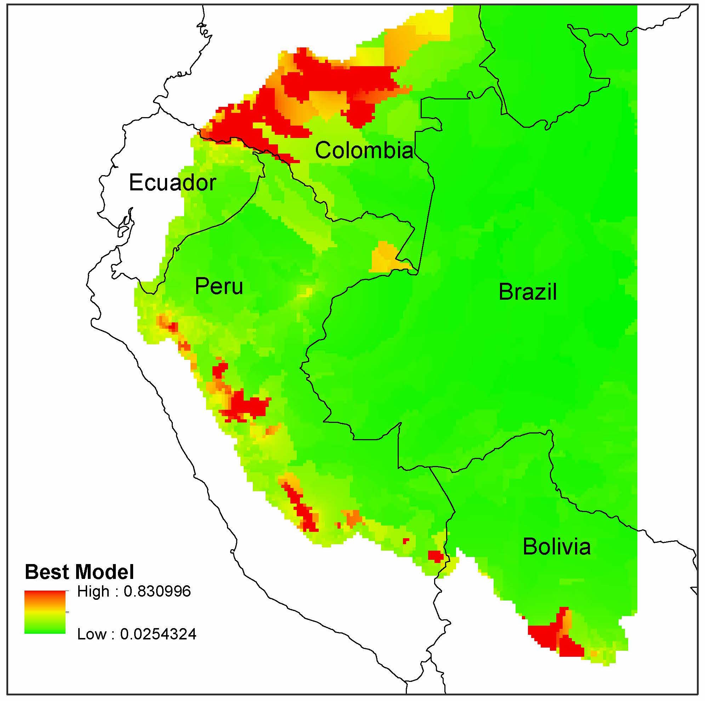
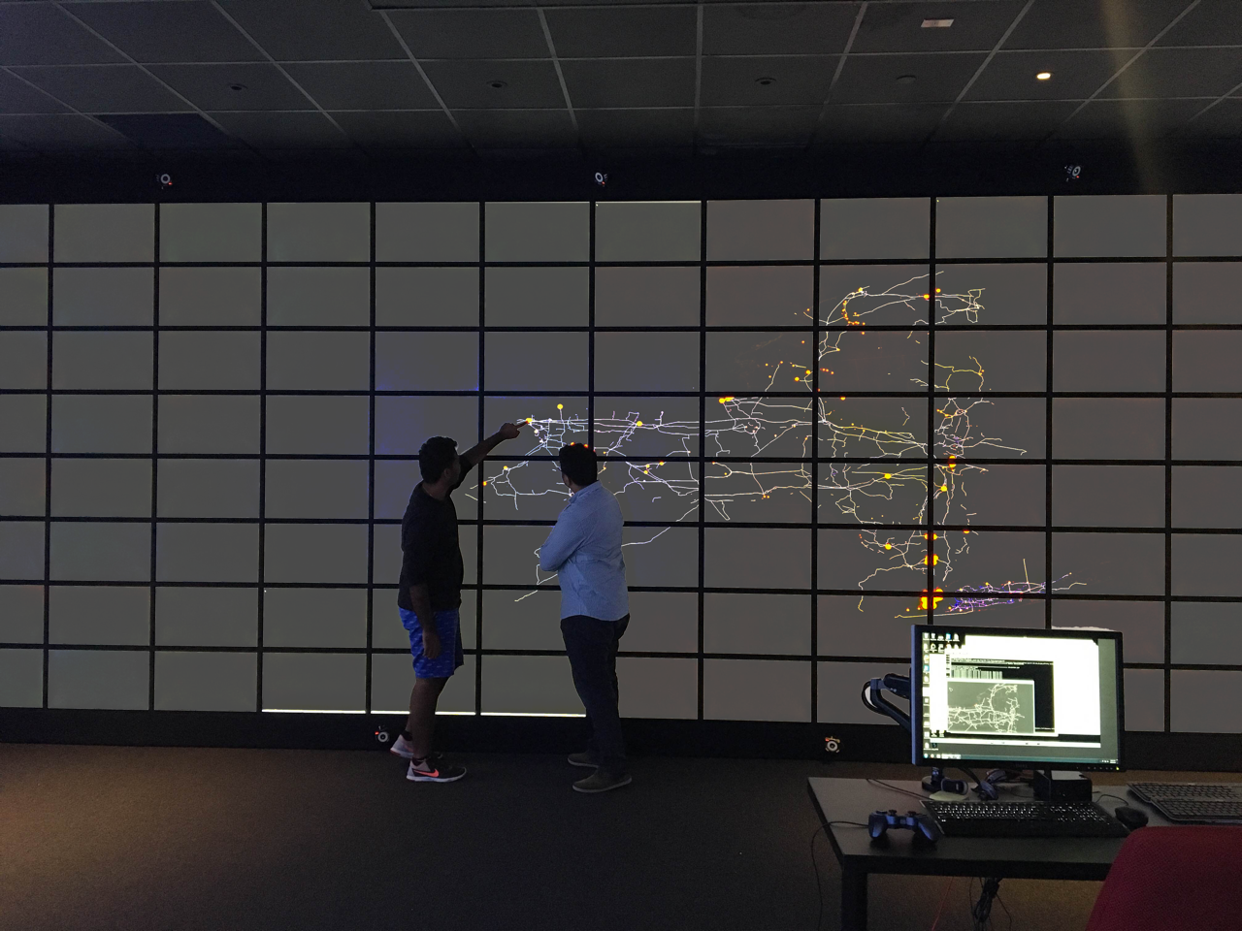
Research Themes
Climate Change and Coastal Resilience
Marine Resource Management
Tracking and Targeting Illegal Deforestation
Powering the Smart Grid Through Data Infrastructure

Slide 5

Departments
Applied Math & Statistics
Biomedical Informatics
Computer Science
Ecology & Evolution
Electrical & Computer Engineering
Journalism
Marine and Atmospheric Sciences
Public Health (pending)
Technology & Society
Internship Partners
  National Oceanic & Atmospheric Administration (NOAA)
  Antarctic Southern Ocean Coalition (ASOC)
  Brookhaven National Laboratory (BNL)
Notes:
Robert to open with Slide 1 - 5

Slide 6

STRIDE Mentoring Model
Program Faculty
Research Advisor
Referral to appropriate resources
Trainee
STRIDE Mentor
Guiding research progress
Connecting student with career appropriate academic networks
Outside Faculty
Student Co-mentor
Peer Mentoring
Conduit for connecting student to STRIDE specific resources and networks
Communication and decision support

Slide 7
STRIDE Fellowships
Domestic STRIDE trainees working with participating faculty
are eligible for a limited number of paid fellowships:
Stipend of $34K
Tuition, health insurance fully covered
$200/year for books
STRIDE Internships
Internships are available to all STRIDE trainees
  National Oceanic & Atmospheric Administration, Antarcic and Southern Ocean Coalition, Brookhaven National Laboratory, etc.
  Fully funded by STRIDE
  Internships will run 6-8 weeks

Slide 8
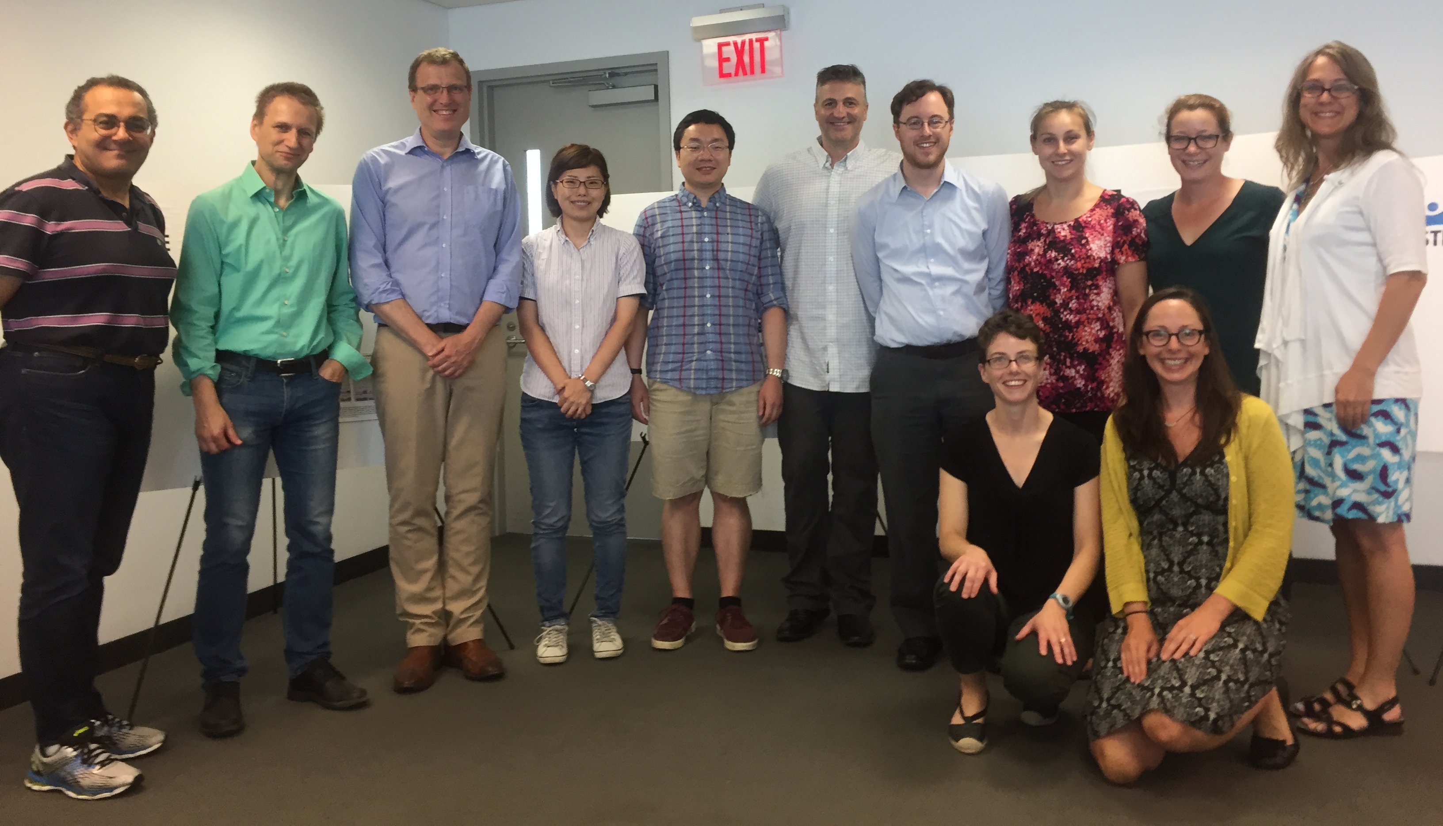
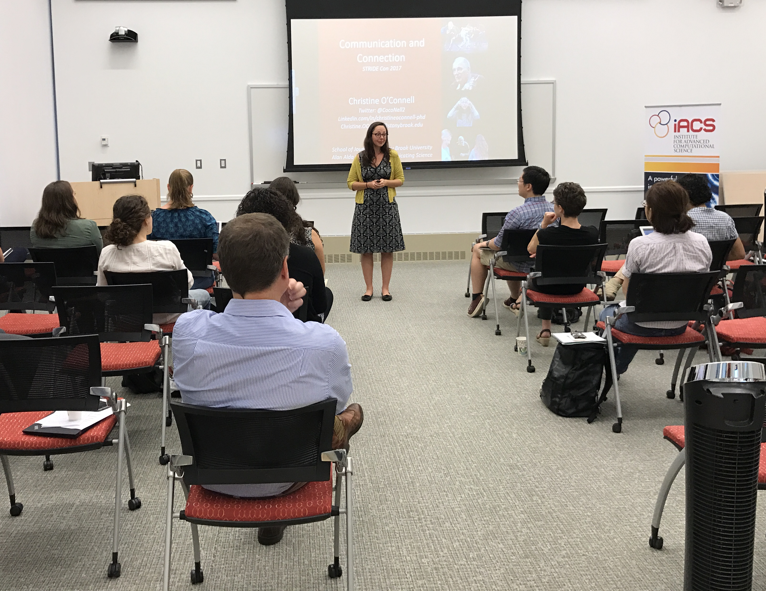
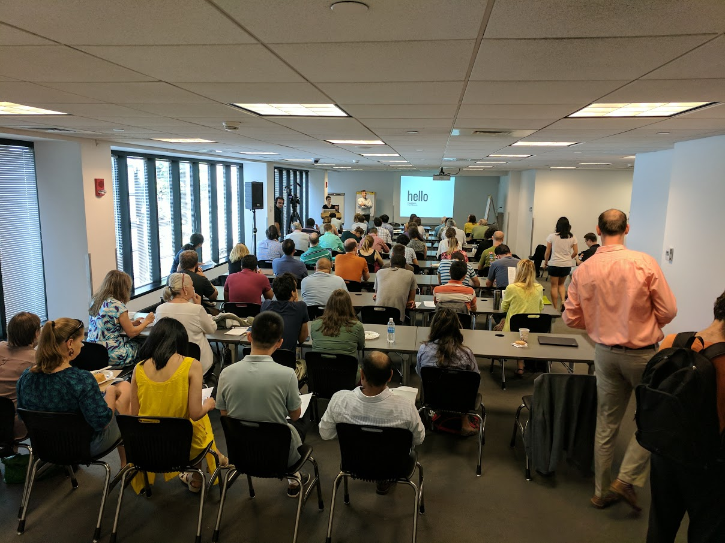
Seminars
STRIDE-Con
Many Paths to Science
Monthly Brown Bag Lunches
Data-visualization contest
Notes:
Every year at the end of August STRIDE will participate in
STRIDE-Con, a community-building event meant to:
Introduce students to the overall details of the STRIDE program
Introduce students to IACS and its resources
Review admission and curriculum requirements for both the STRIDE Advanced Graduate Certificate and the IACS CDCSE (Certificate in Data and Computation for Scientists and Engineers)
Familiarize students with on-campus community-building resources available to them – Center for Inclusive Education (CIE); Women in Science and Engineering (WISE); Office for the Integration of Research, Education & Professional Development (IREP); IACS Student Association
Provide an opportunity for new trainees to network with more senior trainees and faculty
Provide an opportunity for more senior trainees to present their research to the group
Feature expert speakers in the fields of data visualization and science communication
Data-visualization contest component

