Slide 1
FAR
BEYOND
--------------------------------------------------------------------------------------------------------------------------------------------
Research Foundation Appointments and Payroll Information
Notes:
This presentation will provide an overview of forms and additional documents that are used for RF Payroll.

Slide 2
RF PAYROLL FORMS
AND
ADDITIONAL INFORMATION
  RF Employee Appointment Form - TMS
  RF Employee Change Form – TMS
  E-Verify Request Letter
  RF Employee Appointment Form
  RF Employee Change Form
  DocuSign –Research Project Assistant – Appointment Form
  DocuSign –Research Project Assistant – Change Form
  Grad Student Min/Max. Salary By Effort and Hours
  RF Academic Fellowship Form
  Fellowship Key Points
  Payroll Calendar
  RF Paperwork Submission Schedule
  Additional Information
  Payroll Contact List / OGM Contact List
Notes:
This presentation will provide an overview of forms and additional documents that are used for RF Payroll.

Slide 3
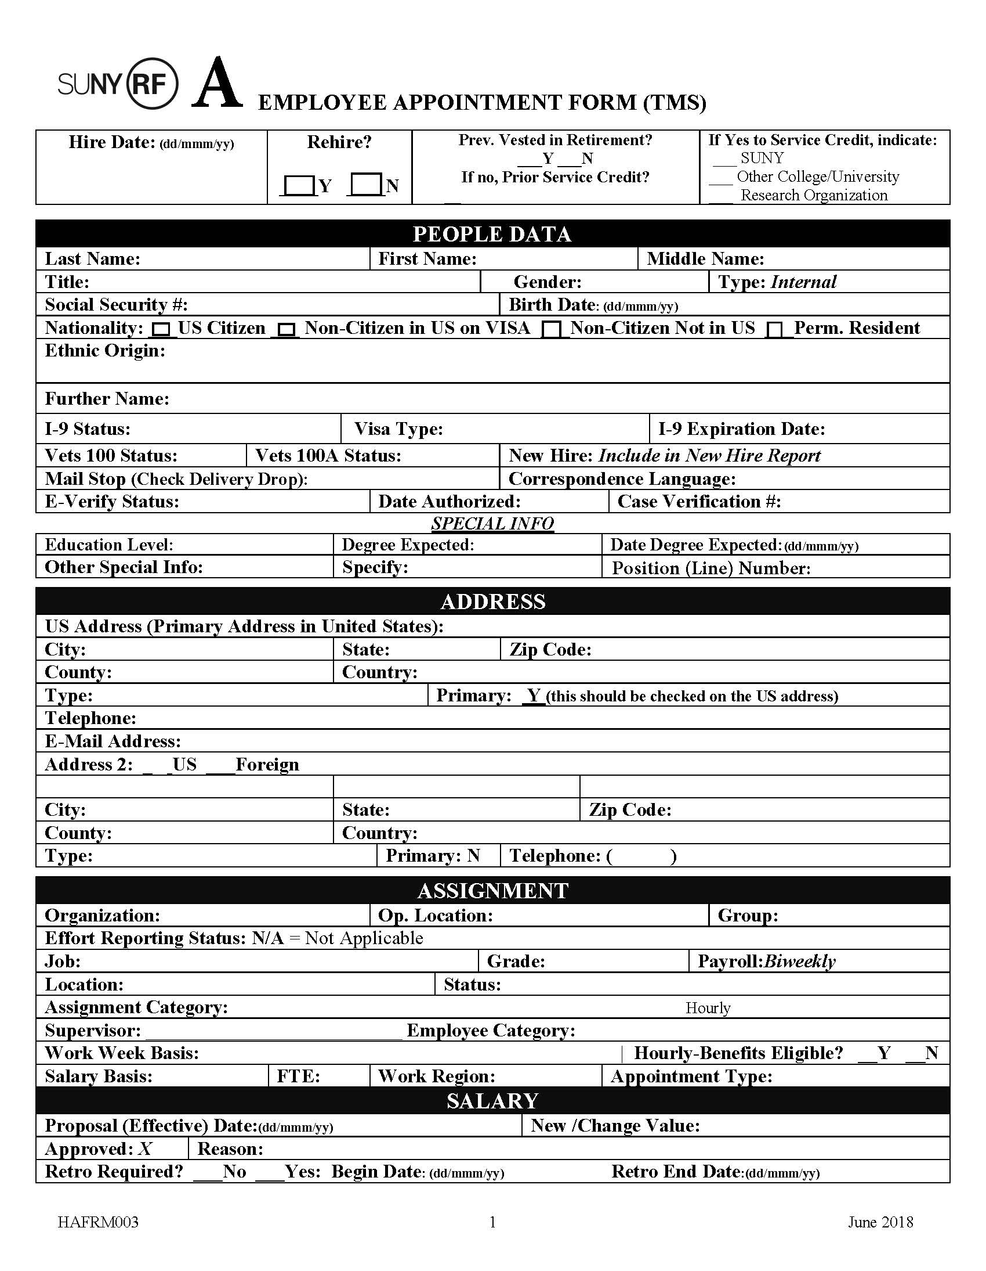
RF EMPLOYEE APPOINTMENT FORM (TMS)
Information on this form is pulled from the requisition in TMS.
If there is a change in the start date after the offer has been accepted, the requisition must be updated. In addition, a new offer letter with the new start date must be created in the offer grid.
Notes:
This presentation will provide an overview of forms and additional documents that are used for RF Payroll.

Slide 4
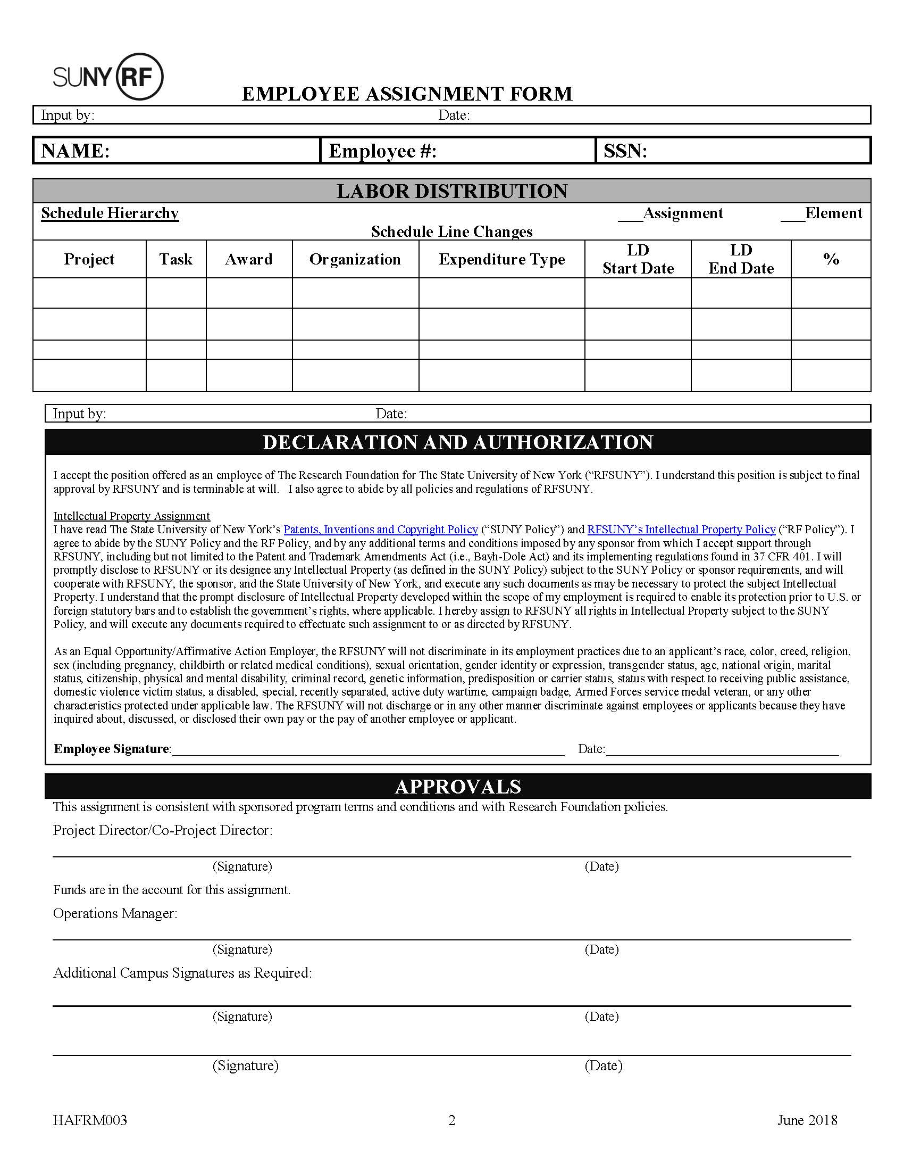
RF EMPLOYEE APPOINTMENT FORM (TMS)
Page 2
The appointment form will pre-populate with the Labor Schedule that was entered in the requisition.
Employee must sign declaration.
Include department contact info.
Ensure that approvals by the Project Director, Co-Project in ERAS, **Operations Manager delegate, and VP Coordinator (if applicable).
Expenditure Types:
*SWR Reg Exempt, SWR Reg Non-Exempt, SWP PostDoc Exempt, SWP PostDoc Non-Exempt
**Operations Manager is the Office of Grants Management for Sponsored Awards and the RF Payroll Office for Campus IDC Projects.
Notes:
This presentation will provide an overview of forms and additional documents that are used for RF Payroll.

Slide 5
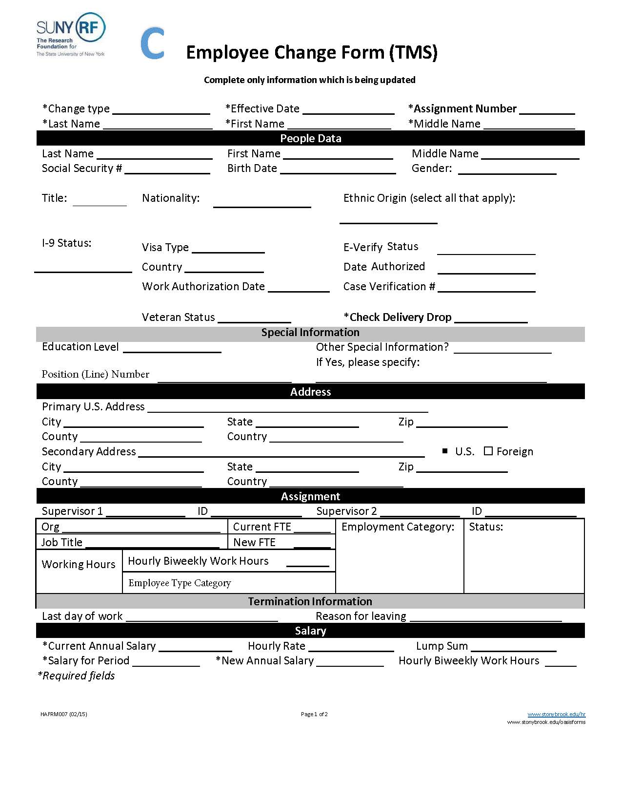
RF EMPLOYEE CHANGE FORM (TMS)
The information on this form is pulled from the requisition in TMS.
This form is used to make changes to existing Employee Appointments.
  Examples:
        Rehire of less than one year of service
        Change in title
        Permanent increased duties
Required fields are marked with an asterisk *
Notes:
This presentation will provide an overview of forms and additional documents that are used for RF Payroll.

Slide 6
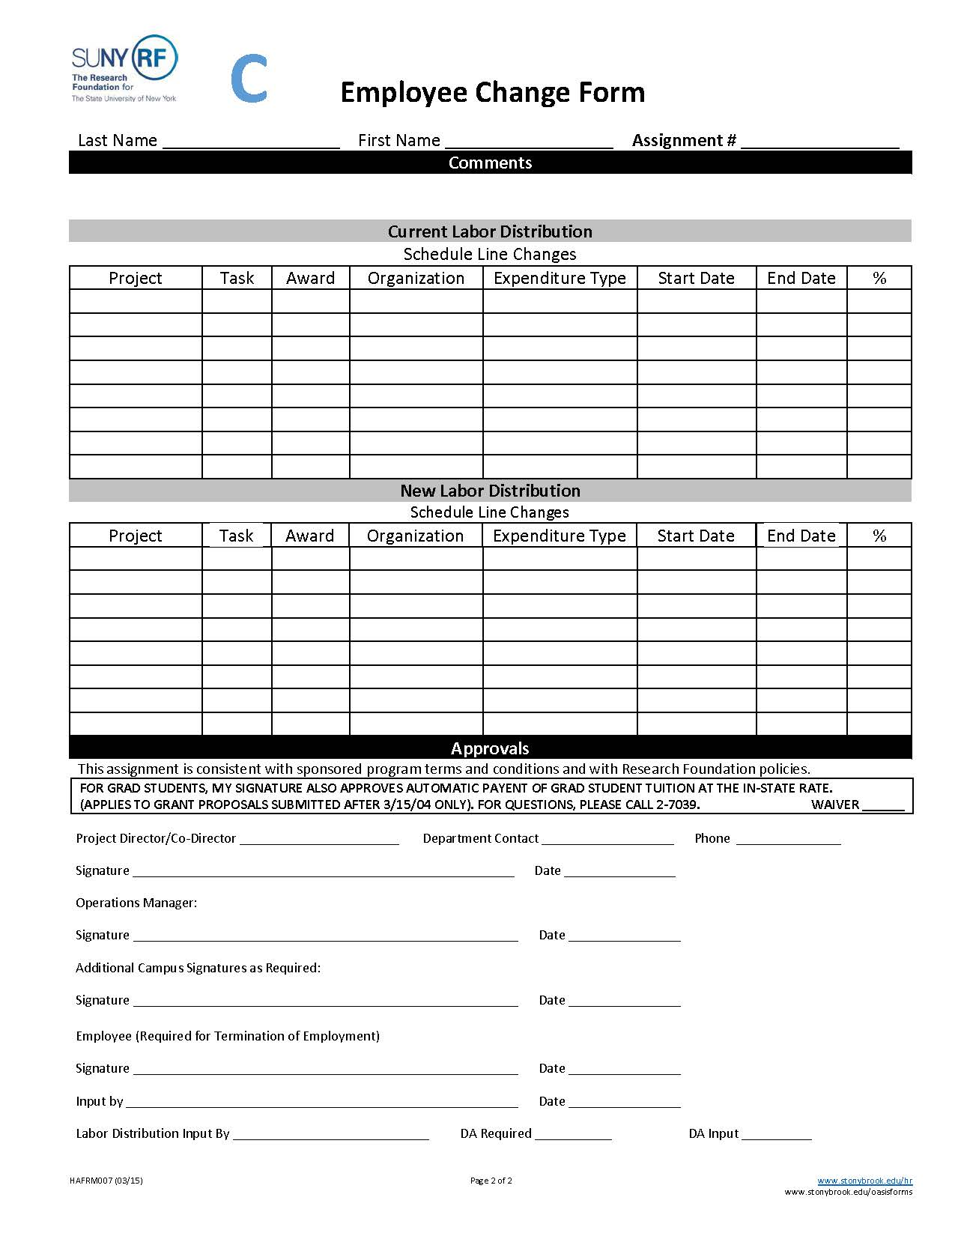
RF EMPLOYEE CHANGE FORM (TMS)
Page 2
The information on this form is pulled from the requisition in TMS.
Ensure that Approvals by the Project Director, Co-Project in ERAS, **Operations Manager delegate, VP Coordinator.
Expenditure Types:
*SWR Reg Exempt, SWR Reg Non-Exempt, SWP Post Doc Exempt, SWP Post Doc Non-Exempt
**Operations Manager is the Office of Grants Management for Sponsored Awards and the RF Payroll Office for Campus IDC Projects.
Notes:
This presentation will provide an overview of forms and additional documents that are used for RF Payroll.

Slide 7
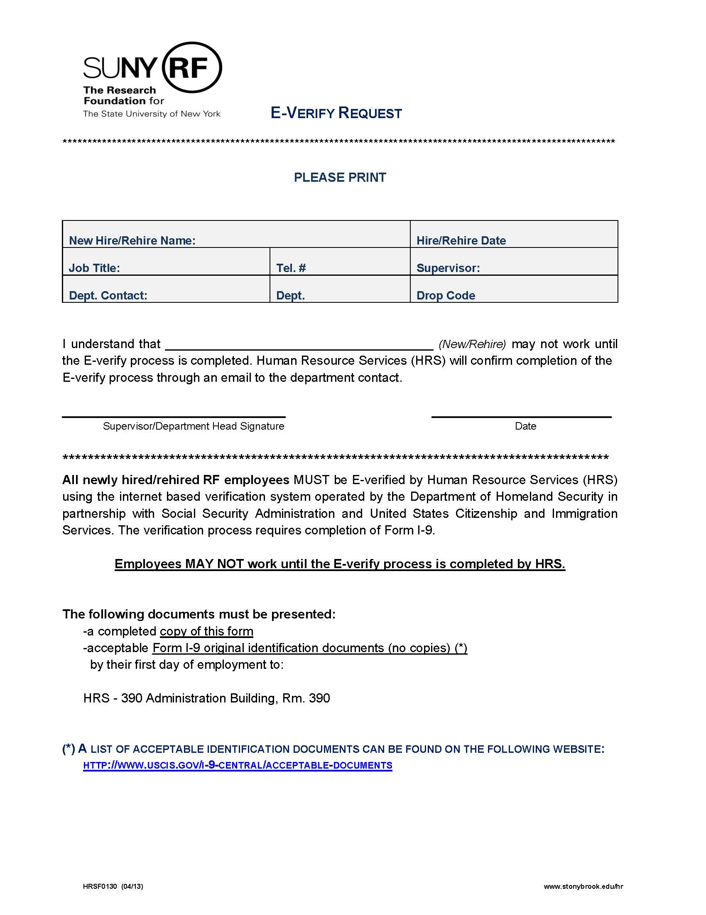
E-VERIFY REQUEST LETTER
All new summer PI’s and hourly student employees must bring the completed form along with their original I-9 supporting documents to HR within three days of hire.
HR is located in the Administration Building, Room 390.
Our hours are 8:30am to 4:00pm.
Notes:
This presentation will provide an overview of forms and additional documents that are used for RF Payroll.

Slide 8
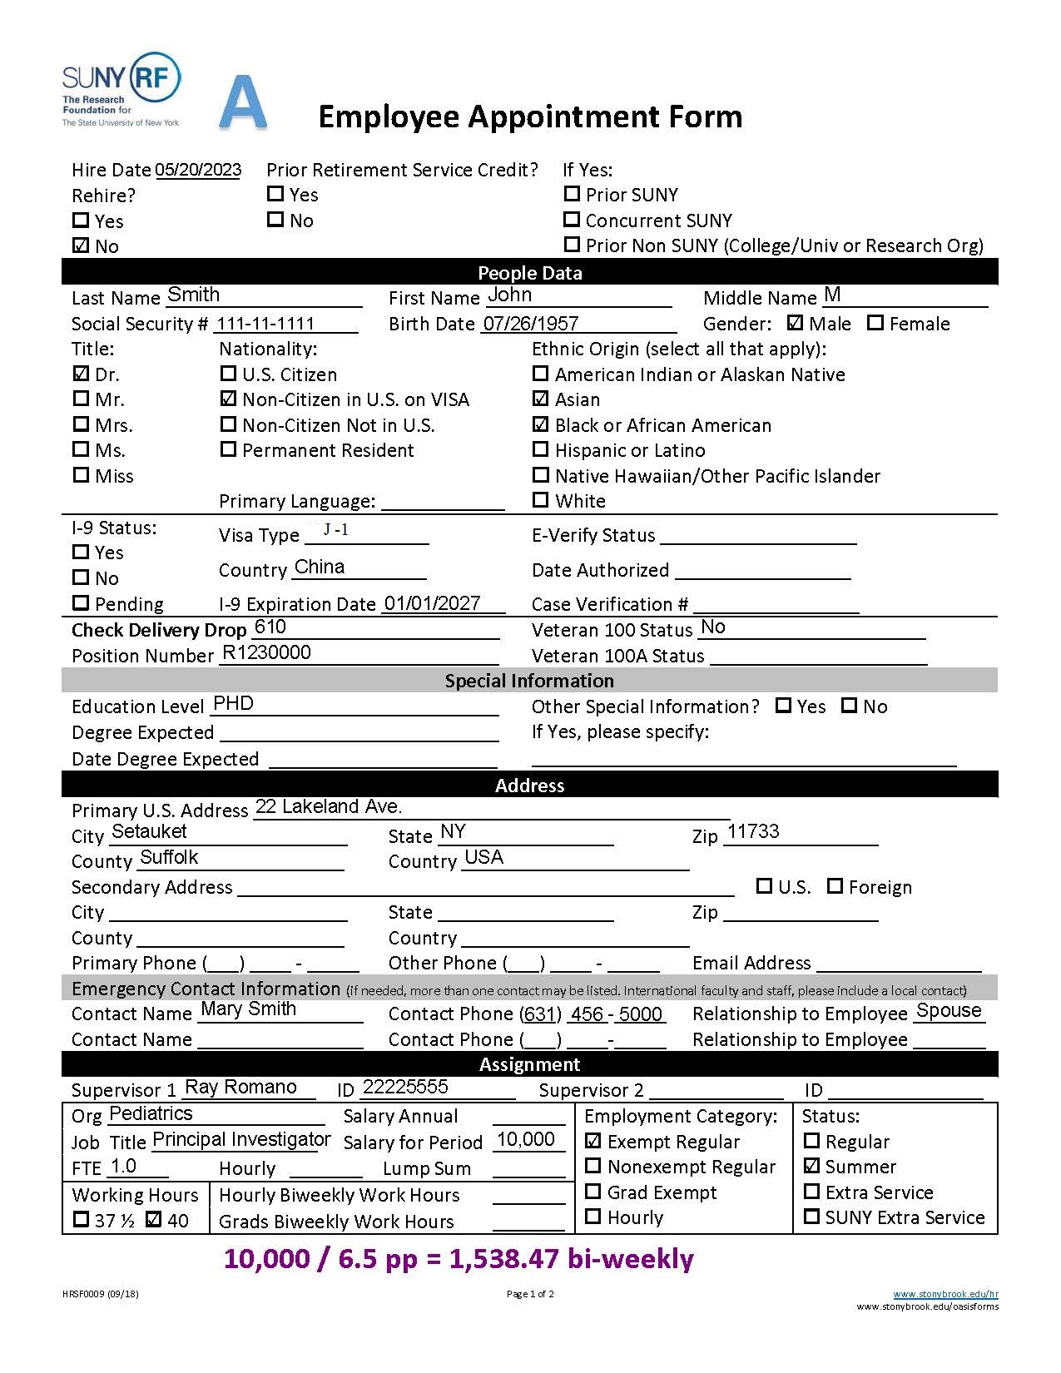
RF EMPLOYEE APPOINTMENT FORM
This form is to appoint summer PI’s and hourly student positions.
All fields must be completed in it’s entirety:
          Hire Date
      Last name, first name, middle name, social security number, birth date, gender, title, nationality, and ethnicity
      Payroll Drop #
      Visa status if applicable
      Address
      Supervisor
      Organization/Department, salary for period/hourly, job title, FTE, and working hours
      Employment category and status
Notes:
This presentation will provide an overview of forms and additional documents that are used for RF Payroll.

Slide 9
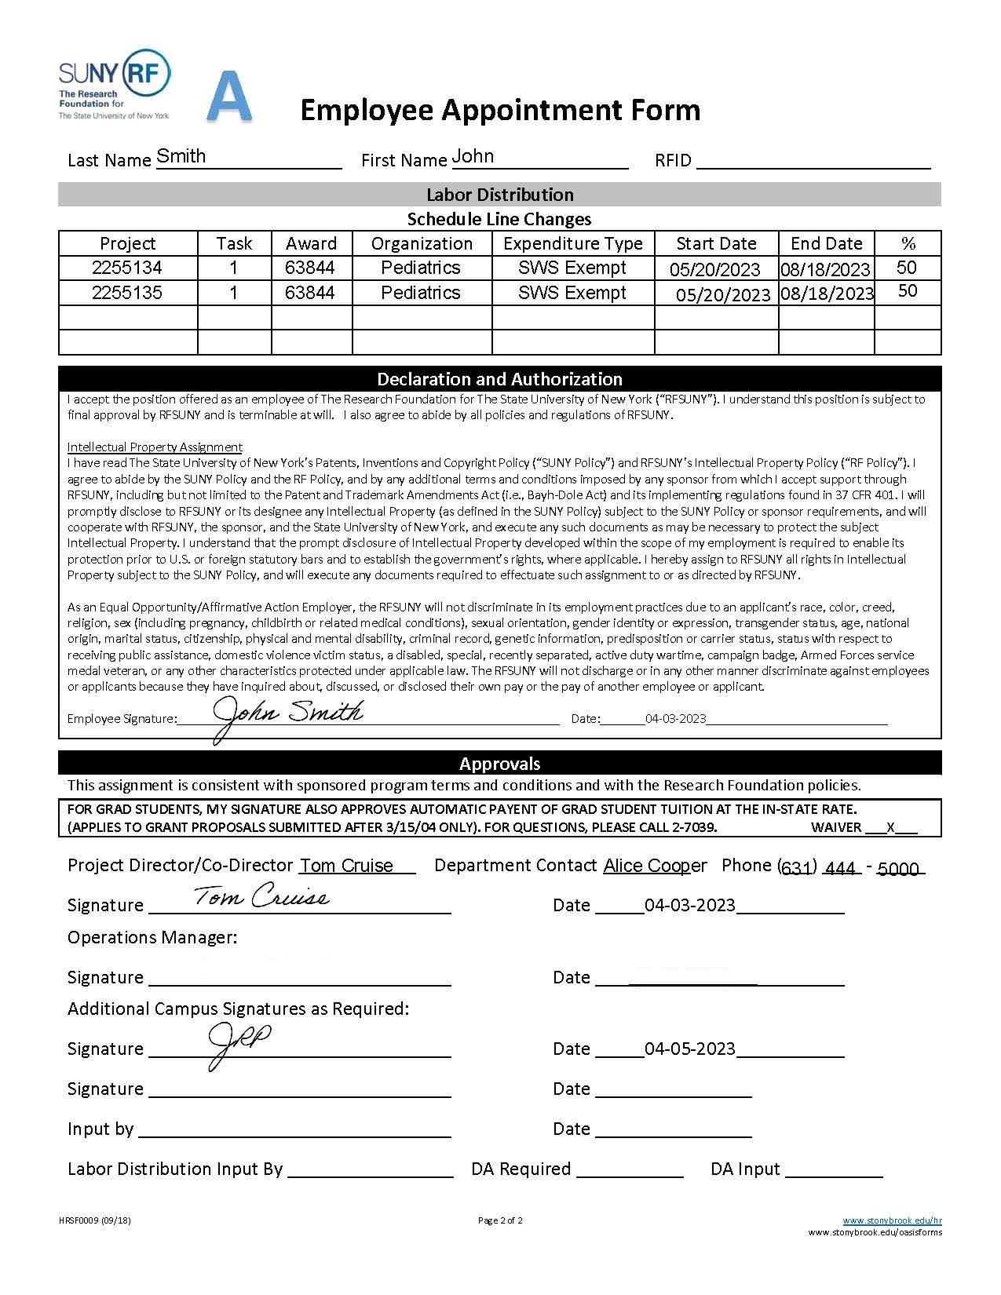
RF EMPLOYEE APPOINTMENT FORM
Page 2
Required:
Last name and first name
Labor Distribution – Project, Task, Award, Organization/Department, Expenditure Type-which is the employee type*, start date, end date, and % Labor Distribution (must equal 100%)
Department contact info.
Approval by the Project Director, Co-Project in ERAS, **Operations Manager delegate, and VP Coordinator
Employee must sign declaration.
Expenditure Types:
*SWG Grad Non-Exempt, SWU Non-Exempt, SWS Summer Exempt, and SWS Summer Non-Exempt
**Operations Manager is the Office of Grants Management for Sponsored Awards and the RF Payroll Office for Campus IDC Projects.
Notes:
This presentation will provide an overview of forms and additional documents that are used for RF Payroll.

Slide 10
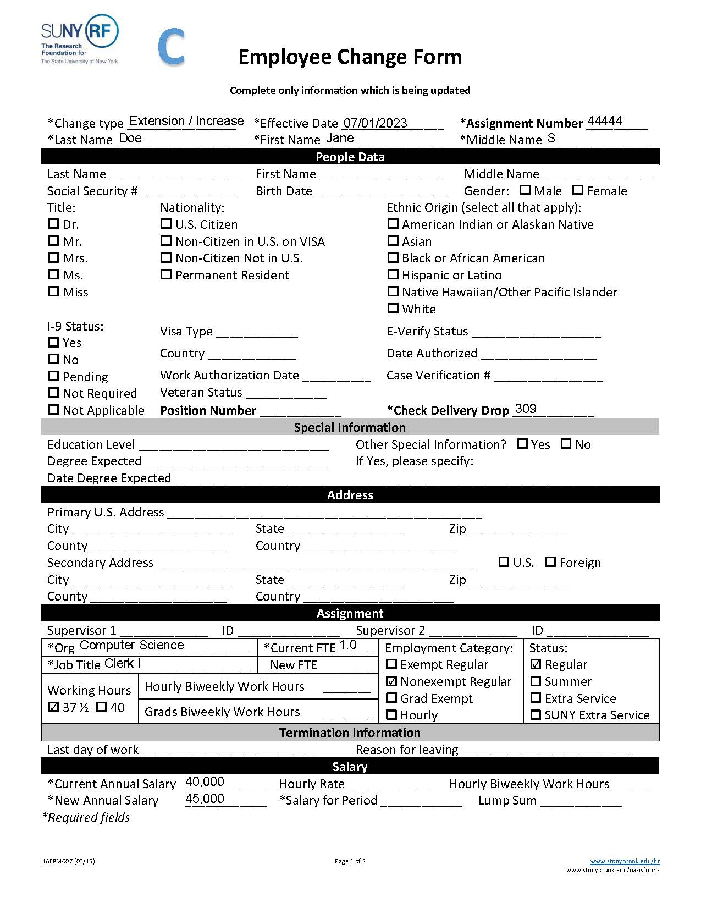
RF EMPLOYEE CHANGE FORM
This form is used to make changes to existing Employee Appointments
  Example:
        Extensions
        Salary increases
        Lump sum payments
        FTE changes
        Labor Distribution changes
        Resignations / Terminations
        Rehire of less than one year of service
Effective date is the date of the change
Required fields are marked with an asterisk *

Slide 11
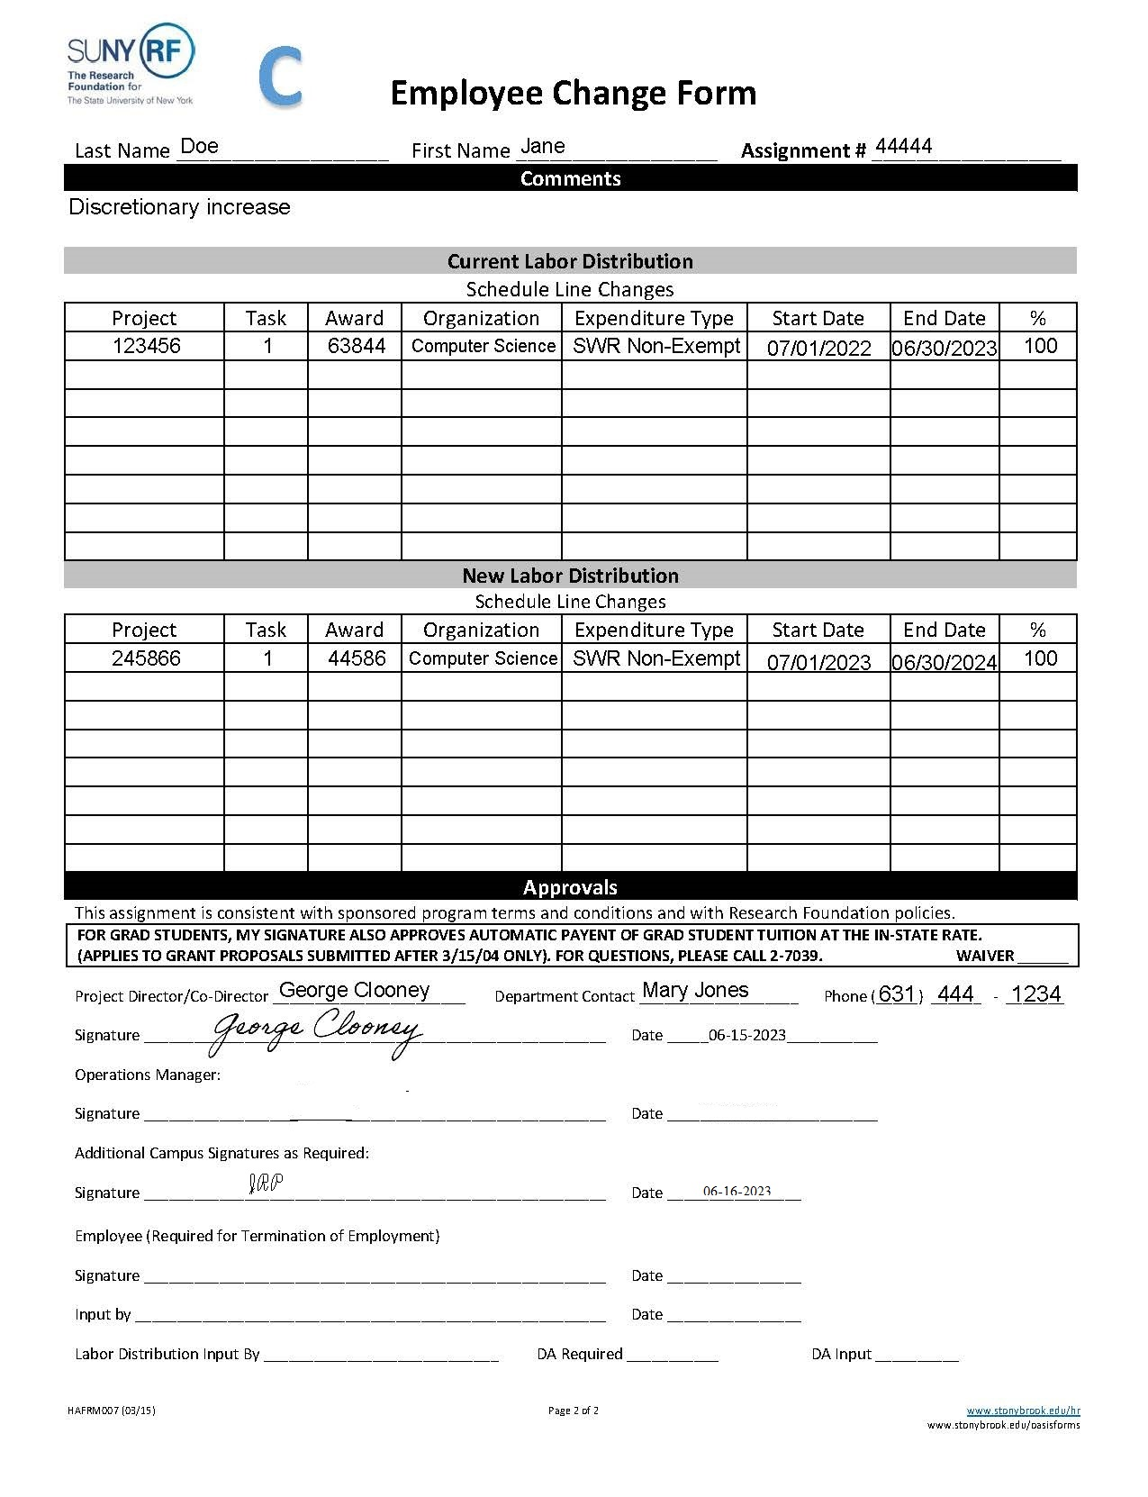
RF EMPLOYEE CHANGE FORM
Page 2
Required:
Name
RF Assignment number
Current and new Labor Distributions
*Current must match the exact active Labor Distribution
Dated signature by the Project Director who is the Account Director in ERAS or an ERAS Delegate
Operations Manager is the Office of Grants Management for Sponsored Awards and the RF Payroll Office for Campus IDC Projects
VP Coordinator should sign as Additional Campus Signature (if applicable)

Slide 12
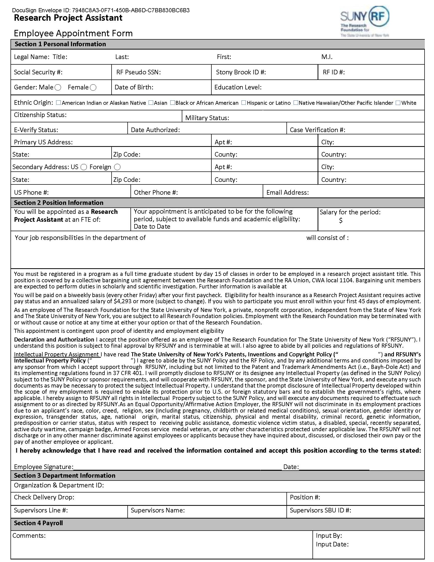
DOCUSIGN
(RESEARCH PROJECT ASSISTANT)
This form is used for the appointment of a Research Project Assistant.
All students must come to HR within 3 days of employment with their original I-9 supporting documentation.
All fields must be completed in DocuSign.
Research Project Assistants are paid on a bi-weekly basis.
The amount for the period is divided by the pay periods indicated on page 1 to determine the bi-weekly amount.

Slide 13
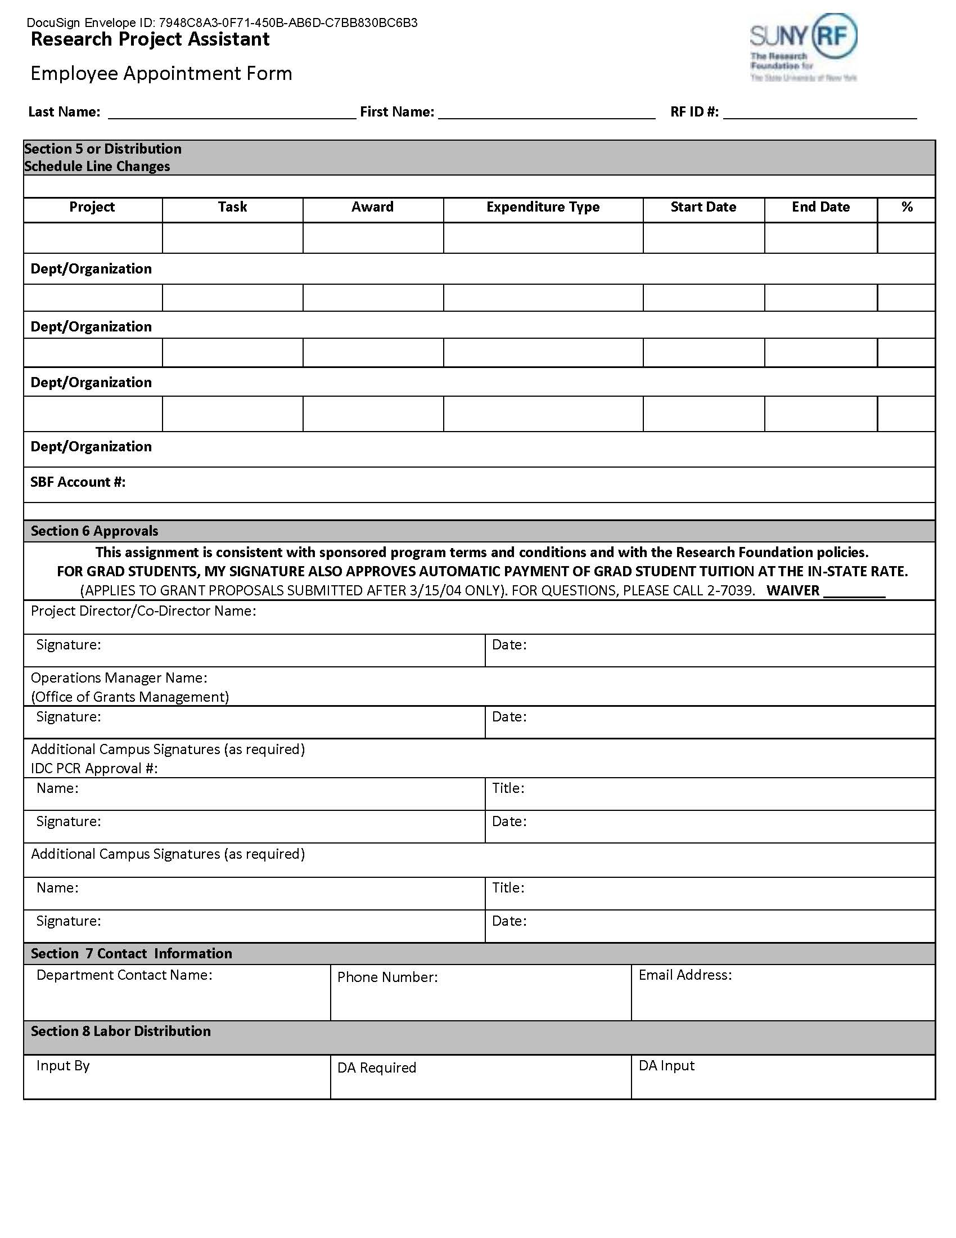
Page 2
-This form is utilized by OGM to generate Tuition Charges in accordance with the ToRG policy.
-Tuition is charged to Awards to match the time of appointment and the Labor Distribution percentages.
-If the Award being charged for the Labor cost the WAIVER must be checked to prevent Tuition charges from being processed.
Tuition on Research Grants | Graduate School (stonybrook.edu)
Operations Manager is Office of Grants Management approval for Sponsored Awards and the RF Payroll Office for Campus IDC Projects.
DOCUSIGN
(RESEARCH PROJECT ASSISTANT)

Slide 14
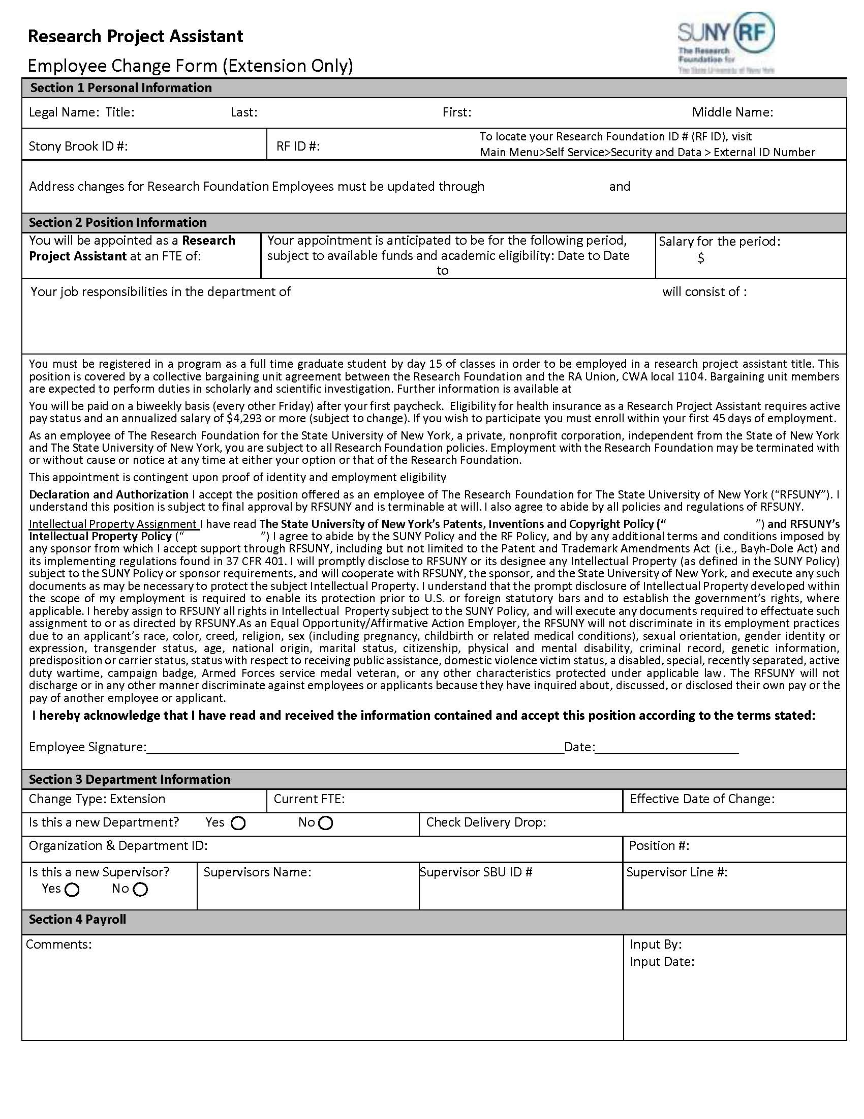
This form is completed through DocuSign System.
DocuSign Login:
DocuSign Resources | Human Resources (stonybrook.edu)
DOCUSIGN
(RESEARCH PROJECT ASSISTANT)
CHANGE FORM

Slide 15
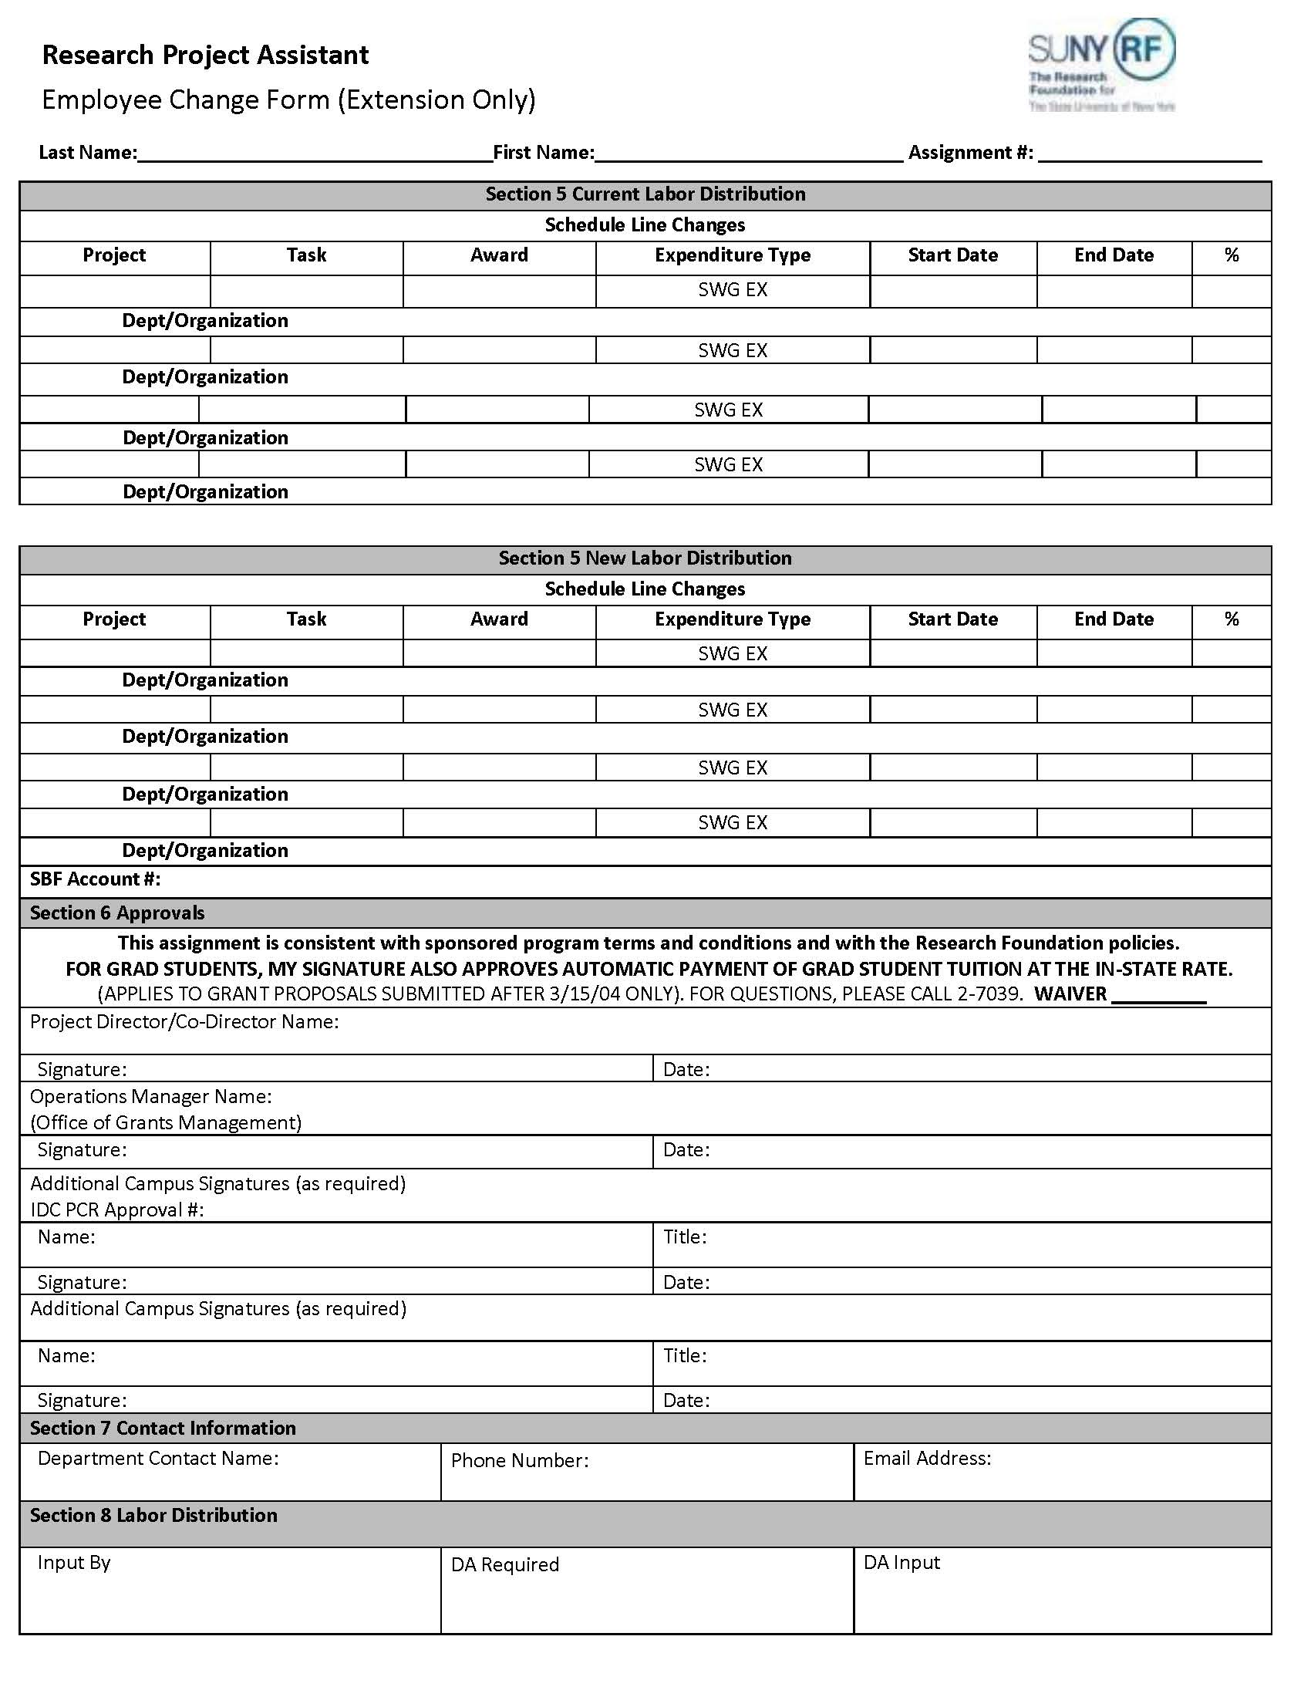
DOCUSIGN
(RESEARCH PROJECT ASSISTANT)
CHANGE FORM
PAGE 2

Slide 16
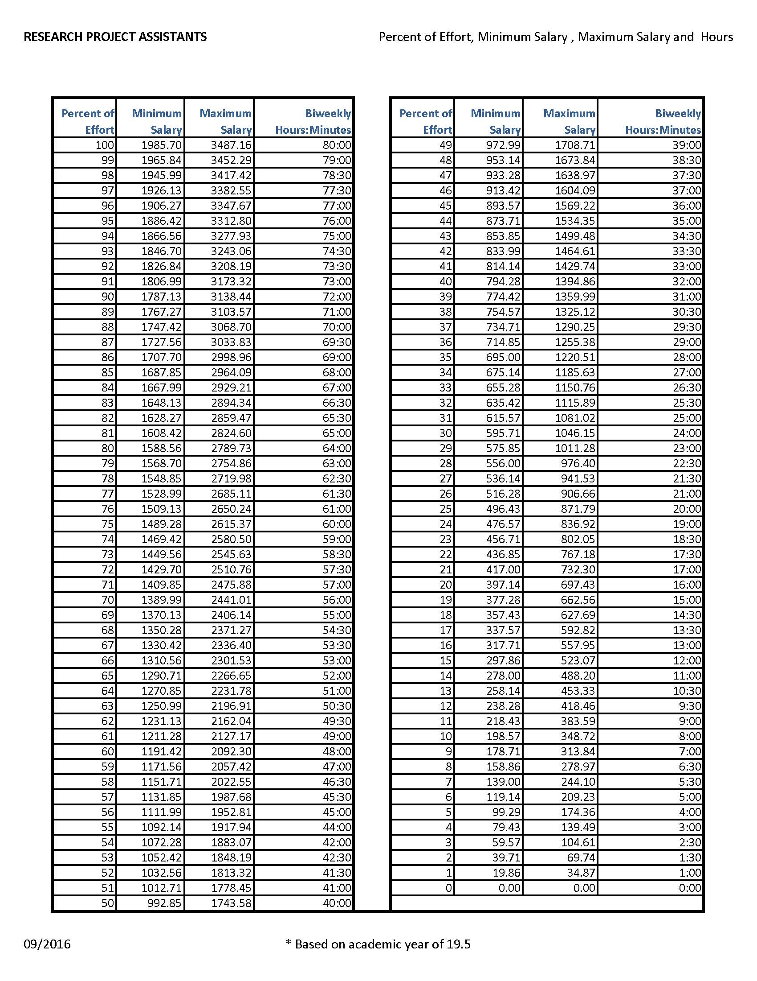
GRAD MIN/MAX SALARY BY EFFORT AND HOURS
Please ensure that the bi-weekly salary falls within the FTE range.
Students can work up to 20 hours per week (50%) while classes are in session and up to 40 hours per week (1.0%) while classes are not in session.

Slide 17
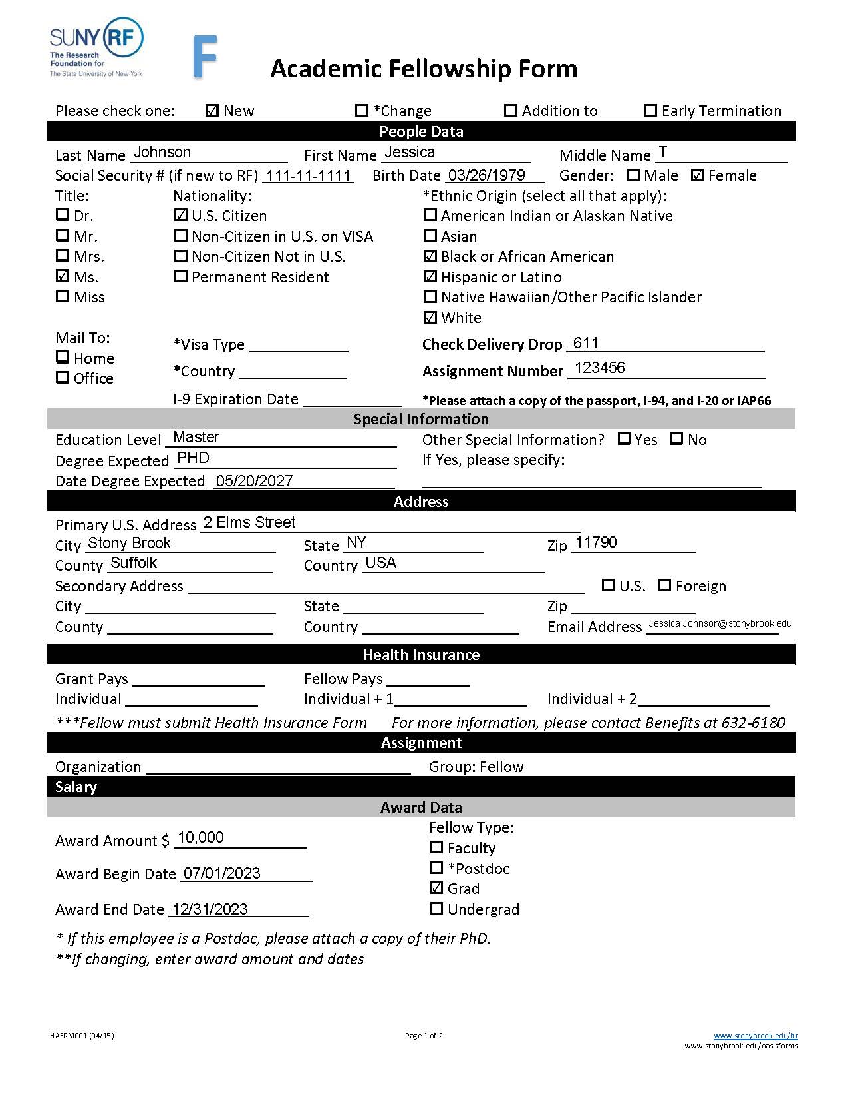
RF ACADEMIC FELLOWSHIP FORM
This form is used to appoint, change, add to, or terminate a Fellow.
Required fields:
              People Data
              Special Information
              Address
              Health Insurance (if Fellow is enrolling)
              Assignment Organization and Group (Fellow)
              Fellowship Award Data - begin and end dates must match the labor distribution start and end dates on the second page.
Award amount is the full Fellowship Stipend Awarded on this form.

Slide 18
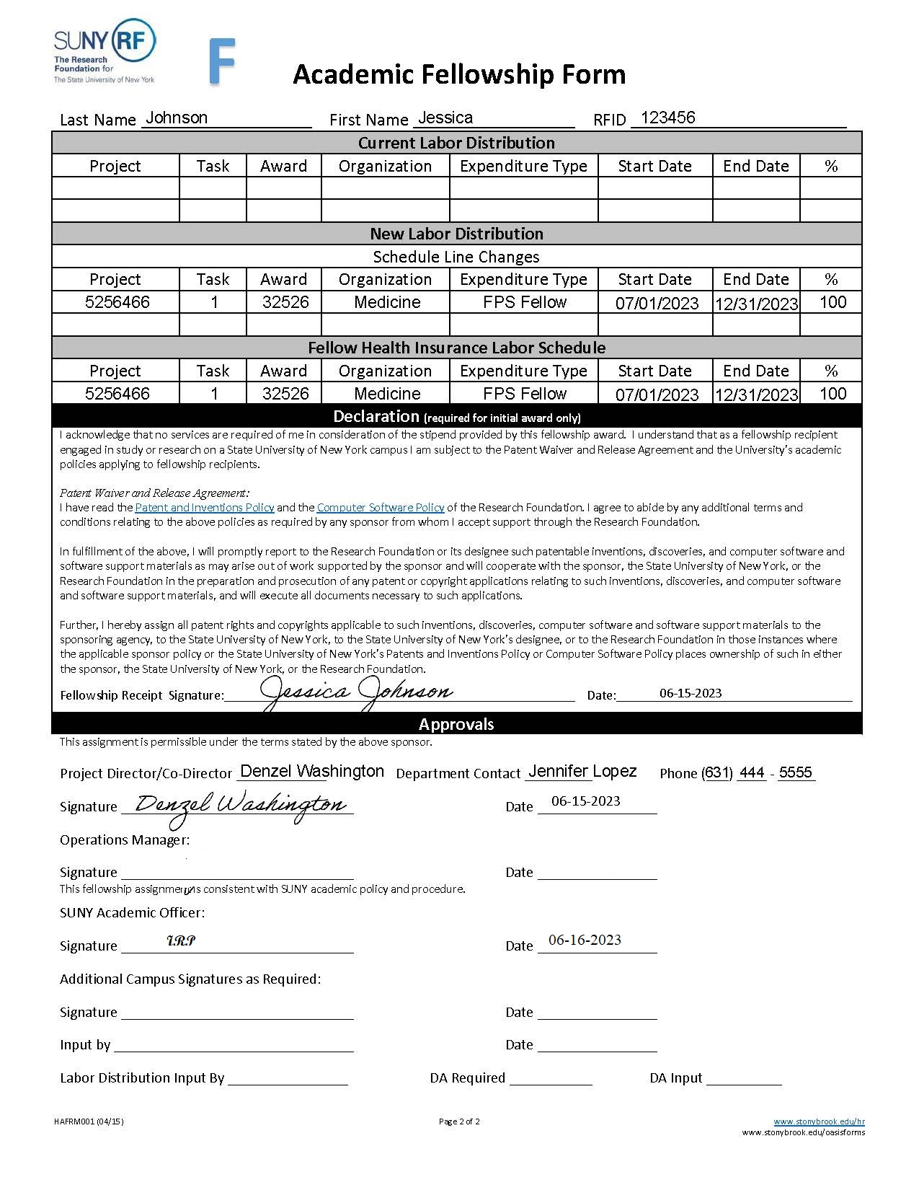
RF ACADEMIC FELLOWSHIP FORM
Page 2
Required:
Name
Research Foundation Assignment number
Signature and date by the Project Director who is the Account Director ERAS or a ERAS Delegate
Operations Manager is Office of Grants Management approval for Sponsored Awards and the RF Payroll Office for Campus IDC Projects
VP Coordinator signs as Additional Campus Signature
Fellow Health Labor schedule when applicable
**OGM must pre-approve all Fellowships on Sponsored Awards and SBF must pre-approve all SBF Fellowships prior to being appointed. NIH T32 Awards completed Statement of Appointment must be attached to Fellowship Form

Slide 19
FELLOWSHIP KEY POINTS
The Fellow must sign for initial Fellowship award only. Changes to same award does not require the Fellow’s signature.
  When a Fellowship ends and a new Fellowship award amount is given, this Fellowship form is considered new and the Fellow must sign it.
Post Doc Fellows must have a PhD Certificate attached to the form.
Fellows do not pay taxes if US citizens or Permanent Residents.
All Non-Resident Alien fellows must have the following documents attached to the form:
Passport
I-94
I-20 or DS-2019
Non-Resident Aliens pay 14% tax on Fellowships.
Do not include tax forms for Fellows.
I-9’s and E-Verify not required for Fellows.

Slide 20
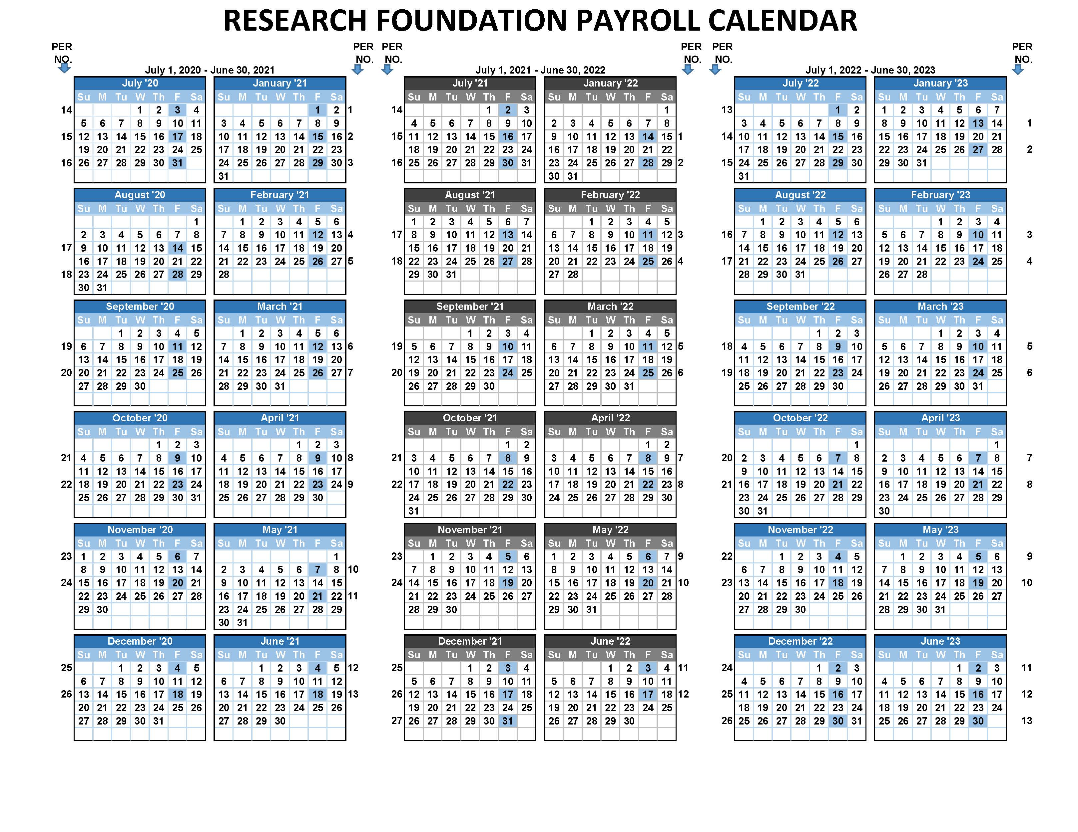
PAYROLL CALENDAR
Page 1

Slide 21
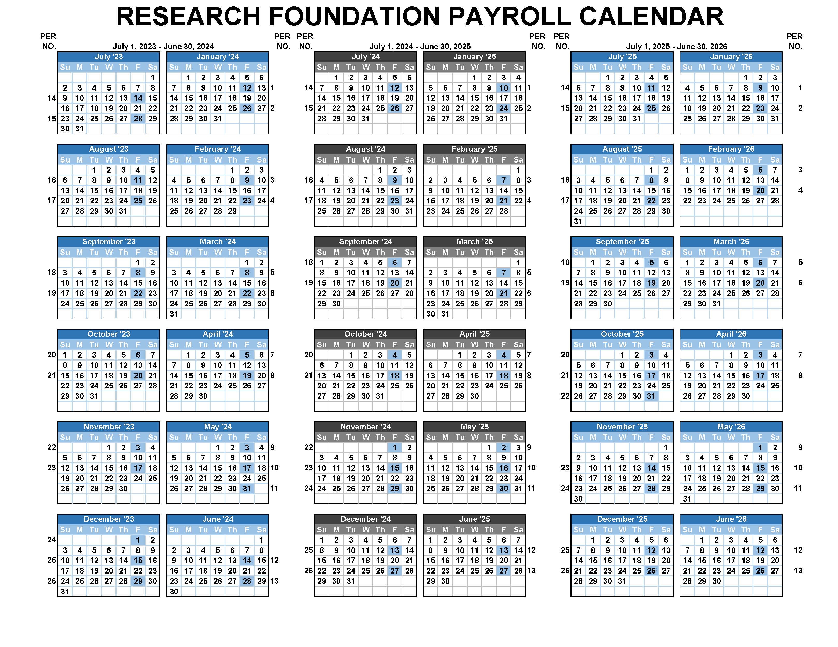
PAYROLL CALENDAR
Page 2

Slide 22
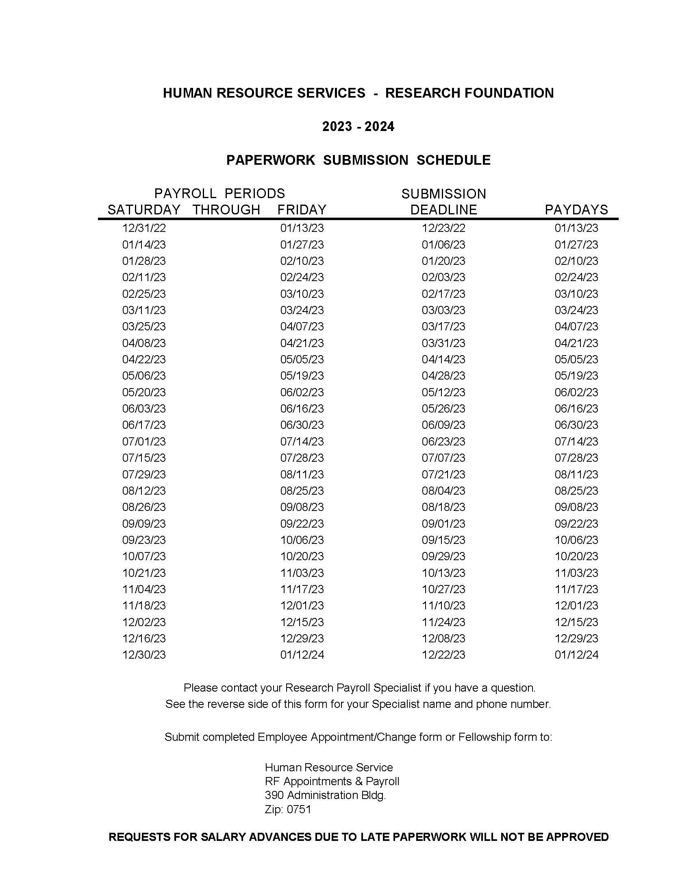
RF PAPERWORK SUBMISSION SCHEDULE 2023
Notes:
Forms must be received in the RF Payroll email by the Submission Schedule in order to receive a check on the pay day.
Appoints through DocuSign will not move forward until the I-9 supporting are received in HR. That will be the date that the forms will be logged as received.

Slide 23
ADDITIONAL INFORMATION
Name changes
Employee must bring new Social Security Card to Human Resources.
Sick Pool
Employees charging sick leave can be placed on the Sick Pool Account after 30 calendar days of being out charging sick accruals. Employee Change form is required.
Vacation Payouts
When an employee separates for the Research Foundation after 6 months of service unused vacation accruals will be paid out. This will be charged to the Vacation Pool Account and not to the departmental funding. The maximum payout for vacation is 30 days.
**2024 is a Leap Year - Please factor this in when creating labor schedules and period salaries.
Notes:
Forms must be received in the RF Payroll email by the Submission Schedule in order to receive a check on the pay day.
Appoints through DocuSign will not move forward until the I-9 supporting are received in HR. That will be the date that the forms will be logged as received.

Slide 24
RF APPOINTMENTS AND PAYROLL CONTACTS
Dianne Newman, Manager Dianne.Newman@stonybrook.edu 632-9314
Beatrice Brownrigg, Asst. Manager Beatrice.Brownrigg@stonybrook.edu 632-6193
Kathy Pugal, Supervisor Kathleen.Pugal@stonybrook.edu 632-6114
Laura Bozzanca Laura.Bozzanca@stonybrook.edu 632-6158
Kataria Denton Kataria.Denton@stonybrook.edu 632-6087
Howard Francis Howard.Francis@stonybrook.edu 632-6192
Agatha Konstantatos Agatha.Konstantatos@stonybrook.edu 632-6197
Office of Grants Management Contact Us | Office of the Vice President for Research (stonybrook.edu)
RF_Payroll@stonybrook.edu

Slide 25
ADDITIONAL INFORMATION
Self Service Website www.rfsuny.org/selfservice
Self-Service Payroll Guide https://www.rfsuny.org/media/rfsuny/documents/self-service/benefits-guide-1.pdf
Payroll forms are located on our website www.stonybrook.edu/HR
Payroll www.stonybrook.edu/human-resources/my-paycheck
E-Verfiy Request Letter Document Details - Forms and Publications - Stony Brook University
I-9 Acceptable Documents Form I-9 Acceptable Documents | USCIS
DocuSign DocuSign Resources | Human Resources (stonybrook.edu)
RF Paperwork Submission Schedule Payroll Paperwork Deadlines | Human Resources (stonybrook.edu)
RF Handbook https://www.rfsuny.org/media/rfsuny/documents/hr/Employee-Handbook.pdf

