Slide 1

Epenthesis in SC Onset Clusters in Persian- English Interlanguage: Linguistic and Extra-linguistic Factors
Marziyeh Yousefi
University of Victoria

Slide 2
Outline
Previous studies
The Question
Background theories
Persian codas
The study
Cluster variation
Pedagogic Implications

Slide 3
Repair Strategies: Mapping Input onto Structure
Deletion
  grandmother -➔ granmother
  mist ➔miss
Epenthesis
  Spanish ➔ espanish
  blond ➔ bəlondə

Slide 4
Production/Perception?
These data are often cited in production tasks
What about perception?

Slide 5
this happens in perception too
When exposed to a string like [ebzo], the Japanese subjects hear [ebuzo] whether or not there is a vowel present (Dupoux, et al. 1999): Japanese (72% illusory vowel); French (10% illusory vowel)
  How can you tell? Behavioral tasks, discrimination tasks, etc.

Slide 6
Perceptual Illusions
Studies from a number of L1s (Japanese (Dupoux; Matthews & Brown), Korean (Kabak & Idsardi) reveal perceptual illusions
Japanese: does not allow obstruent consonantal sequences word medially:
  *ac.tor
  *chap.ter
In production, they insert an epenthetic vowel between the obstruents
  baseball ➔ basubaru

Slide 7
Thai
Thai does not allow onset clusters either
It does allow medial clusters (like ‘ac.tor’)
But Thai (unlike Japanese) L1 subjects (since Thai allows medial obstruent strings) do NOT hear an illusory vowel medially (Matthews & Brown)
When they are presented with [ebzo], they hear [ebzo]

Slide 8
sC Onset Perception
There is a cottage industry looking at sC clusters in SLA
Brazilian Portuguese (Cardoso):
  Does not allow sC clusters
  Allows Obstruent + Liquid clusters (e.g. [br])
  Allows maximally single C codas
Both production and perception studies showed definite differential accuracy effects (and no ceiling effects):
  Production: sl > sn > st
  Perception: st > sl > sn

Slide 9
The BP L1 subjects had difficulty (performing at chance) discriminating accurately between forms which began with:
  sC and isC
(where [i] is the BP epenthetic vowel)

Slide 10
The same is true in Thai (Imsri):
  No sC onsets
  No branching codas
In production, they epenthesize to break up the sC:
  spa ➔ [səpa]
In perception the advanced learners made 60% errors on discriminating sC strings from SəC strings
  Even when correct, there were very long Response Times
  And remember, they did fine on [ebzo]

Slide 11
So, these perception errors are real in that they affect representation and processing (in addition to actual speech)
We see epenthesis in perception and in production

Slide 12
Structural Properties
L1 | sC Onsets | Branching Onsets | Branching codas | Errors
Japanese | No | No | No | 72%
Thai | No | No | No | 60%
Brazilian Portuguese | No | Yes | No | 50%
Persian

Slide 13
The Question
How do Persian ESL speakers perceive and produce English onset consonant clusters when their L1 does not allow branching onsets?
Facts to Consider:
-Persian allows branching codas up to two consonants
-this study deals with sC clusters; specifically /sl/, /sn/,&/st/
-Persian learners add a vowel before these sequences (e.g. ‘snake’ -> ‘esnake’ e.g., Karimi, 1987; Yarmohammadi, 1995) to resolve the difficulty producing these clusters
linguistic factors: sonority and redeployment
extra-linguistic factors: 2nd language proficiency and task formality

Slide 14
Background Theories
Linguistic factors (sonority):
Sonority Sequencing Principle (Clements, 1990)
Minimal Sonority Distance (Broselow & Finer 1991)
Redeployment (Archibald, 2005)
Extra-linguistic factors (proficiency and task formality):
Ontogeny Phylogeny Model (Major, 2001)

Slide 15
Background Theories
Sonority Sequencing Principle (Clements, 1990)
preferred syllables typically display a continuous rise in sonority towards the peak and a decrease in sonority towards the edges, as is illustrated by the syllable structure of the English word ‘plump’ in (1)
dispreferred syllables such as the /st/ sequence in the English word ‘[st]op’ in (2), exhibit a sonority decrease (reversal) from the first member /s/ to the second member /t/ of the onset, as indicated by the dotted circle in (2)
(1) Syllable structure: Sonority Sequencing (2). Syllable structure: Sonority violation

Slide 16
Sonority hierarchy (Selkirk, 1982)
Class | Scale
Stops | 1
Fricatives | 2
Nasals | 3
Liquids | 4
Glides | 5

Slide 17
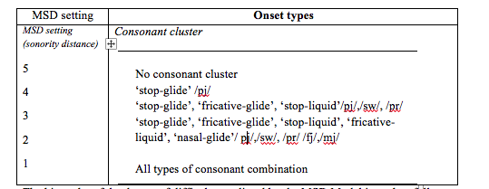
Minimal Sonority Distance (Broselow & Finer 1991)
Markedness relationships with respect to Minimal Sonority Distance Parameter: clusters with a larger sonority distance are easier than those which are relatively close in sonority. Example:
Less marked…..........more marked
Cj...............................Cr
pC.............bC.............fC

Slide 18
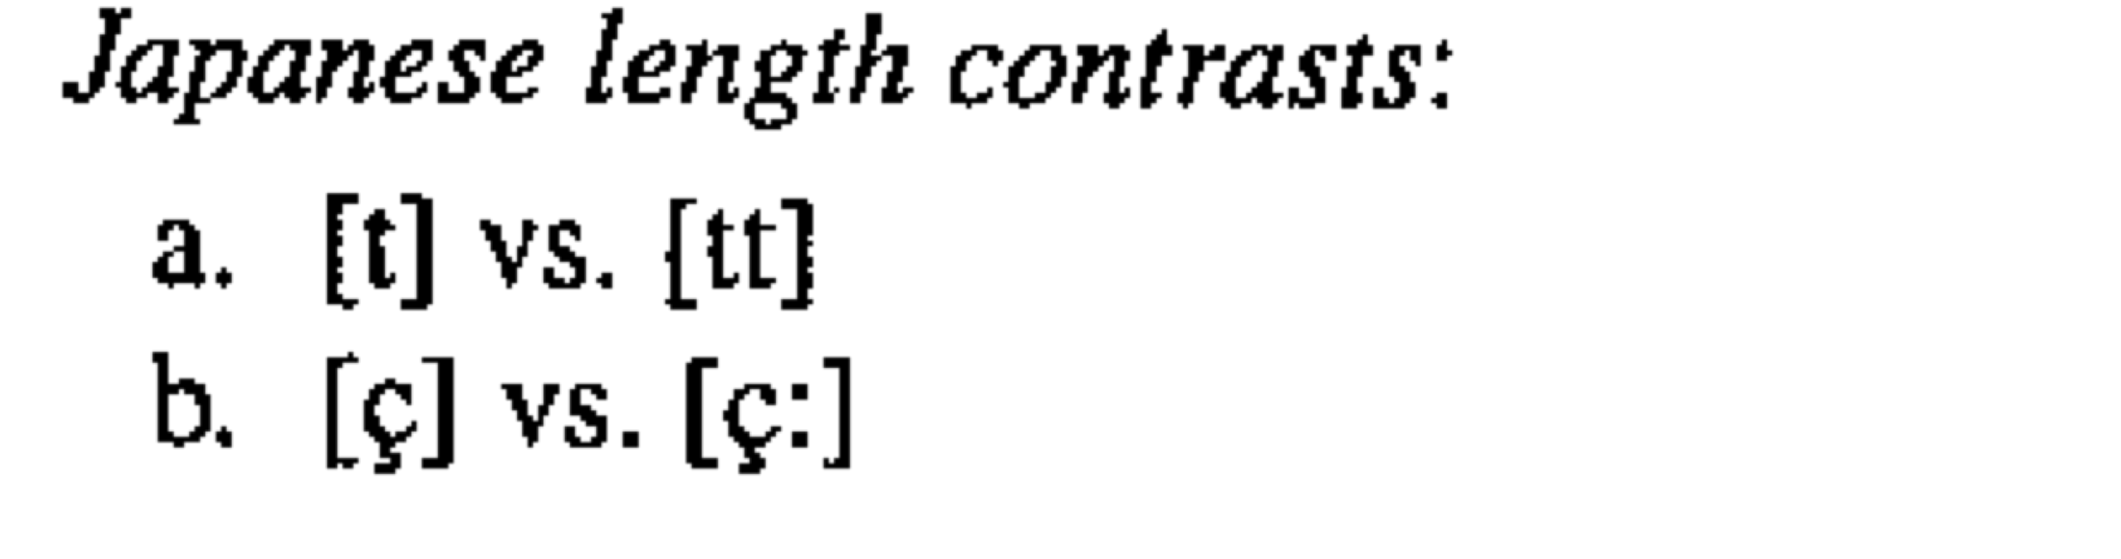
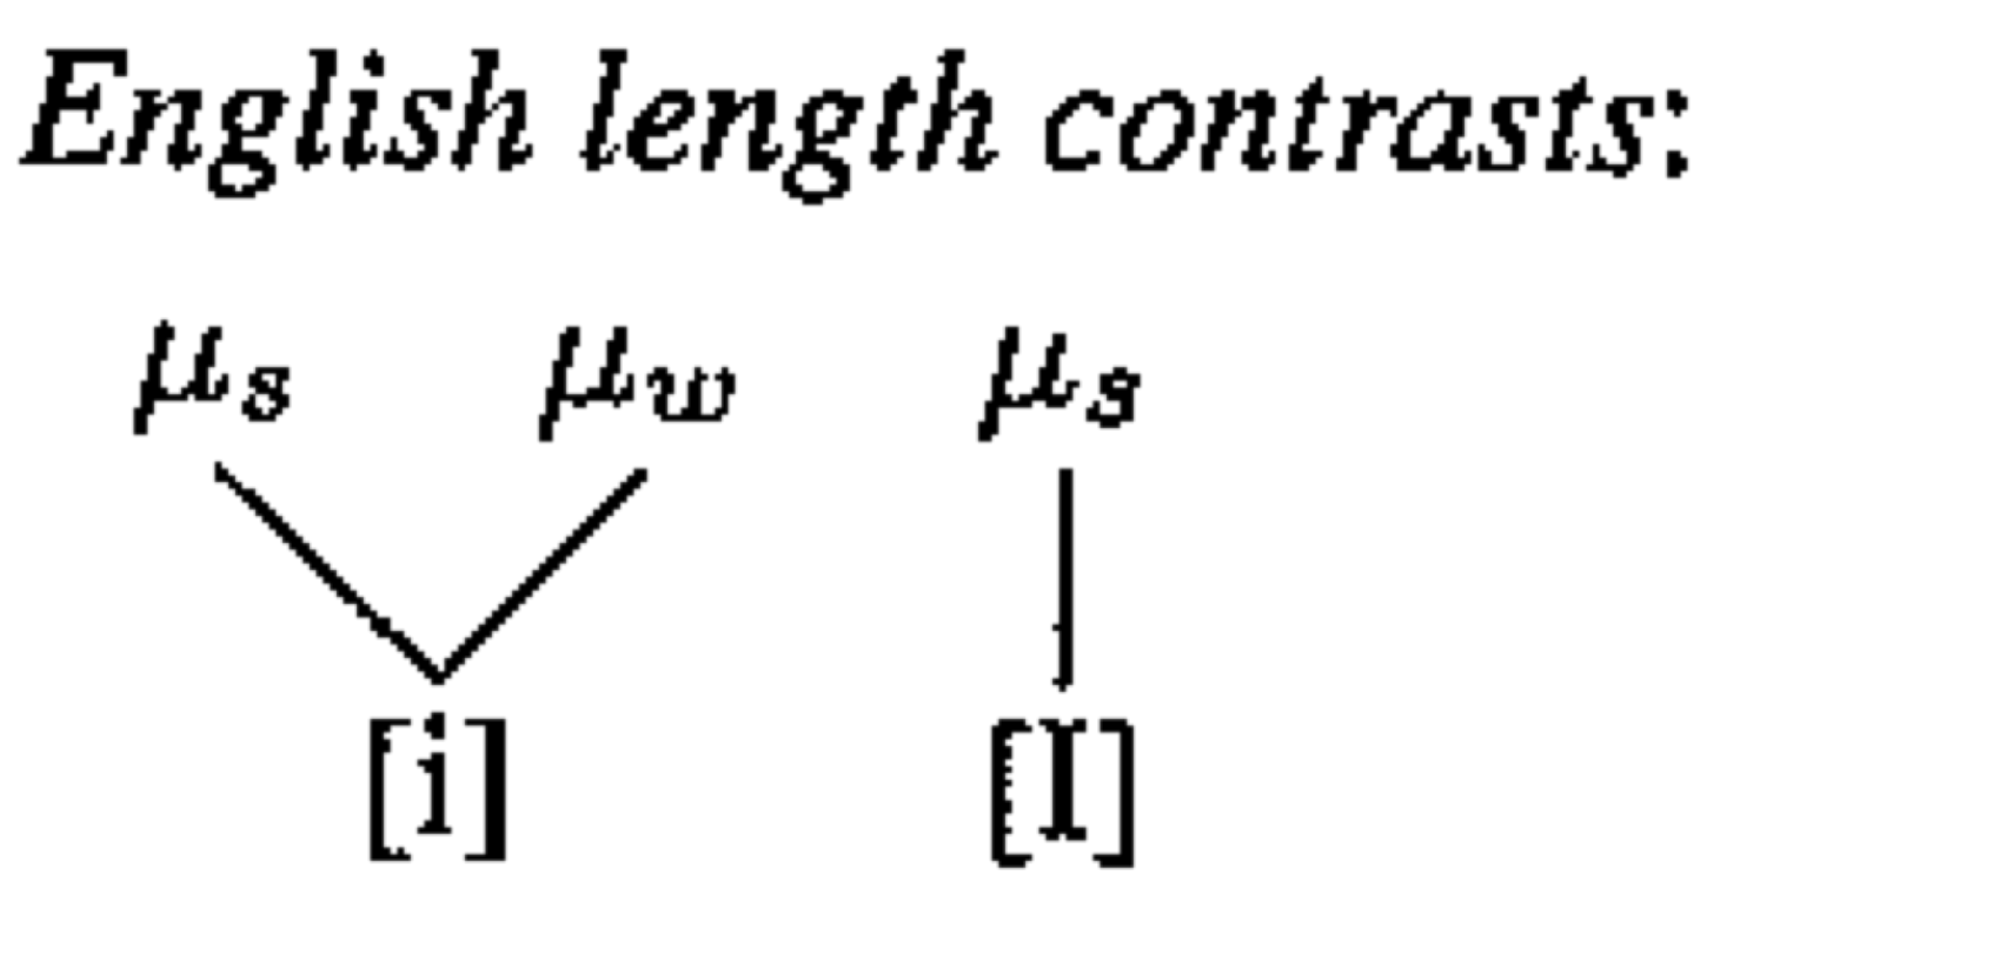
Redeployment (Archibald, 2005)
L2 learners are able to redeploy existing L1 features present in the grammar to acquire L2 contrasts
Example (Mah & Archibald,2003 for production, and Summerell, 2007 for perception): the acquisition of Japanese length contrast by English speakers
English speakers have an L1 grammar where coda clusters are licensed by weak mora for reasons of weight. In Japanese, geminate consonants are licensed by a weak mora.
The feature vowel length is present in English. E.g., beat vs. bit
“English speakers are able to acquire both Japanese vowel length and consonantal length contrasts based on the licensing properties of their L1. They can redeploy the weak mora licensing from their L1 to new uses in the L2.” P.1017

Slide 19
Table 1. Sonority of segments (+ means rising and – means falling sonority)
Stops (1) < Fricatives(2) < Nasals(3) < Liquids(4) < Glides(5) < Vowels(6) (Clements, 1990)
segment | Sonority rank | cluster | Sonority distance
s | 2 | sl | +2
l | 4 | sn | +1
n | 3 | st | -1
t | 1

Slide 20
Persian Codas
Table 2. Persian Sonority Distance in Codas (data from Kambuziya & Zolfaghari 2006, - means fall and + means rise in sonority)
Stop<fricative<nasal<liquid<glide<vowel
SD | -4 | -3 | -2 | -1 | 0 | +1 | +2 | +3
Strings words | yb yd eyb eyd | rk rd lb Xark Kard qalb | nd rs ng Kand Fars rang | St ʃt ft xt nz sk ʃk Rast Daʃt Raft Rixt Tanz usk kuʃk | tb bʔ mn fʃ tk sf sx Sh fv fz ɢotb tæbʔ ʔæmn kæfʃ potk mesf mæsx mæsh | bh bx bʃ ɢʃ dv ds bz mr zm Sn zn ml xm æbx næbʃ hæml zebh Sobh bædv ɢods næbz | zl fl sl xl tn fr sr ʃr km hr fæzl tefl ɢosl boxl mætn kofr mesr ɢeʃr hokm mohr | br dr kl tr bæbr zebr sedr ɢædr ʃekl

Slide 21
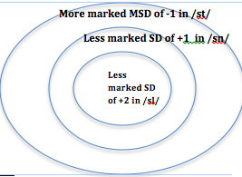
Markedness predictions on the acquisition of sC clusters:
Figure 3. Implicational relations between the three clusters
Hypothesis 1. Predicted developmental path of sC onset sequences based on markedness on sonority: /sl/ > /sn/ > /st/

Slide 22
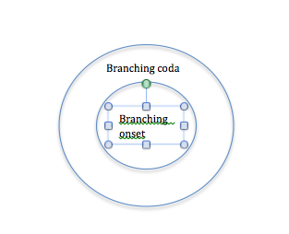
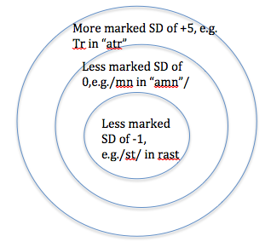
Redeployment predictions on the acquisition of the sC clusters:
Persian learners of English can redeploy their L1 coda MSD knowledge to the L2 onsets where all English onset sequences will be licensed.
Redeployment will predict high accuracy but no differences between strings
Figure 4. Knowledge of Persian MSD and branching codas redeployed in learning English
Hypothesis 2: Predicted path based on redeployment theory: /sl/=/sn/=/st/

Slide 23
Extra-linguistic Factors (Proficiency& Task style)
Ontogeny Phylogeny Model (OPM; Major, 2001)
developing interlanguages are comprised of both L1 and L2 features, which are mediated by universal (developmental) phenomena.
IL develops chronologically such that features from the L2 increase, LI patterns decrease, and developmental phenomena increase and then decrease in the course of L2 development.
initial state will strictly correspond to the phonology of Persian, in which sC clusters will syllabify via e-epenthesis (just like in the L1).
At more advanced stages, however, the frequency of e-epenthesis will decrease

Slide 24
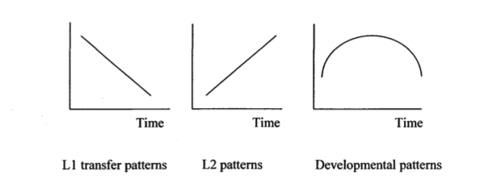
Figure 5. The Ontogeny Phylogeny Model of L2 acquisition (adopted from Boudaoud, 2008)
Table 6. Error patterns in L2 acquisition (Archibald, 1998. p.5)
Level of proficiency | Transfer errors | Developmental errors
Beginner Intermediate Advanced | High Medium low | Low High Low

Slide 25
OPM claims that IL varies stylistically such that in more formal styles, L2 structures increase, LI features decrease, and developmental phenomena increase and then decrease.
L2 learners have more accuracy in pronouncing isolated words (formal style) than in conversation (informal style) because in running speech learners often revert to their L1 patterns, making their foreign accent more prevalent
the more monitoring, the greater the accuracy
“In different situations, an L2 learner has different competencies; an L2 learner may show all indications of being nativelike in an extremely formal style but may show L1 patterns in a more casual style”
Hypothesis 3: The amount of e-epenthesis will decrease as proficiency increases.
Hypothesis 4: There will be more e-epenthesis in less formal tasks.

Slide 26
Research Questions and Hypotheses
Are there any differences between the perception and production of English sC onset clusters in Persian ESL speakers?
What theory markedness or redeployment can best account for sC cluster acquisition in Persian speakers of English?
3. How is accuracy on sC clusters patterned across the three proficiency groups (beginner, intermediate, advanced)?
4. To what extent is e-epenthesis determined by task style?
Hypothesis 1. Predicted developmental path of sC onset sequences based on markedness on sonority: /sl/ > /sn/ > /st/
Hypothesis 2: Predicted path based on redeployment theory: /sl/=/sn/=/st/
Hypothesis 3: The amount of e-epenthesis decreases as proficiency increases.
Hypothesis 4: There is more e-epenthesis in less formal tasks

Slide 27
The study
-Participants
-Materials
-Background Questionnaire
-Production test
-Formal task
-Informal task
-Perception test
-Identification task
-Discrimination task
-Procedure
-Data Collection and Transcription
-Data Analysis

Slide 28
Proficiency
Self rate proficiency scale in background questionnaire.
report any proficiency score from a standardized test (e.g. IELTS, TOEFL, CLB)
native speaker judgment
Participant | Self-rate | Standard score | NS judgment | Final level
1 | Poor | 560TOEFL(PBT) | Beginner | beginner
2 | Poor | 2 CLB | Beginner | beginner
3 | average | 6 IELTS | Beginner | beginner
4 | average | 5 CLB | Beginner | beginner
5 | average | 5 CLB | Beginner | beginner
6 | average | 6.5 IELTS | intermediate | intermediate
7 | Good | 6.5 IELTS | intermediate | intermediate
8 | average | 88 TOEFL(IBT) | intermediate | intermediate
9 | Good | 6.5 IELTS | intermediate | intermediate
10 | Good | 5 CLB | intermediate | intermediate
11 | Good | 105TOEFL(IBT) | Advanced | advanced
12 | Good | - | Advanced | advanced
13 | Good | 99 TOEFL(IBT) | Advanced | advanced
14 | Good | 106TOEFL(IBT) | Advanced | advanced
15 | Very good | 116TOEFL(IBT) | Advanced | advanced

Slide 29


Production Test
Formal Task
29 sentences in all, the target clusters /st/, /sn/, /sl/ occurred 10 times for each cluster
Example: Instructions: Read aloud the following sentences, please.
Dan slept early today
Informal Task
12 pictures consisted of 3 words for each cluster (i.e. 3 /sn/, 3 /st/, and 3/sl/) as well as three distracters
Example: Pictures of the item “slippers” and ‘stars” in the informal production task.

Slide 30
Perception Test
Identification Task
a forced choice identification experiment adapted from Cardoso et al. (2007)
discriminate between sC-initial and vowel-initial clusters .i.e. participants decided whether the stimuli that they heard began with a consonant (i.e., sC) or with a vowel (i.e., [e]sC).
The 30 items selected included 10 /sl/, 10 /st/, and 10/sn/ tokens which in turn included 5 /s/ and 5/es/ combinations.
Example: 1. a. esnip b. snip c. ?
The word participants heard: “snip”. The correct response was b.

Slide 31
Perception Test
Discrimination Task
-discriminate between /s/ and /es/, via an ABX discrimination task.
-This task had 30 items; 10 /sl/, 10 /sn/, and 10 /st/ tokens of pseudowords randomly ordered and took approximately 10 minutes, including a 3-minute training.
Example: 1. A B
The tokens participants heard for this question were: “esnip-snip-esnip”. The correct response was A.

Slide 32
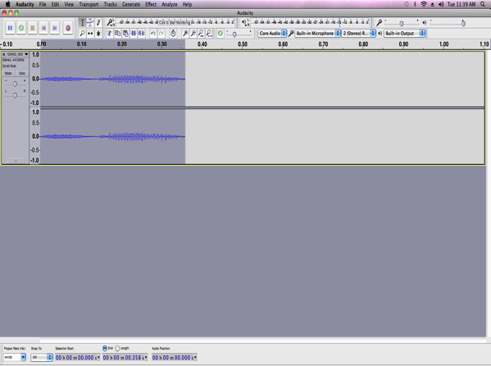
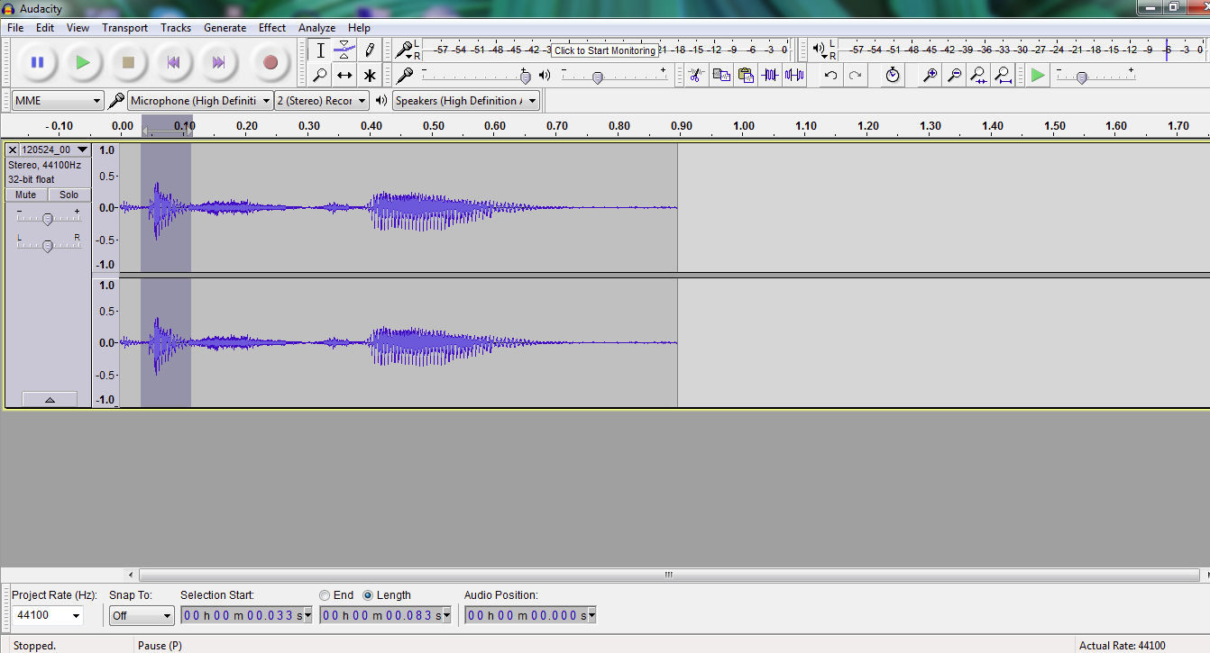
Data Recording and Transcription
Figure 7. Waveform for store
Figure 8. Waveform for [e]store with the epenthesized /e/ highlighted

Slide 33
Procedure
Production: Number of correct productions scored by the first rater; 20% of data scored by the second rater
90% agreement
Perception: Number of correct choices
Each participant and each cluster
a related-sample Friedman’s two-way analysis of variance was performed. Friedman’s test is the non-parametric equivalent of analysis of variance (ANOVA)

Slide 34
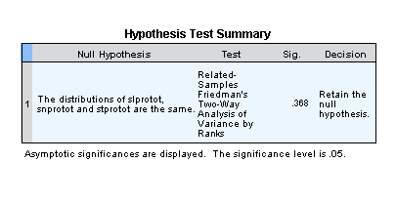
Results
The impact of Markedness on sonority on production
Table 9.Descriptive Statistics of the production of sC clusters
Table 10. Friedman test of significance
 | N | Minimum | Maximum | Mean | Std. Deviation
/sl/ total production | 15 | .00 | 20.00 | 8.8553 | 7.23753
/sn/ total production | 15 | .00 | 20.00 | 9.9420 | 7.61052
/st/ total production | 15 | .00 | 20.00 | 9.7313 | 7.12713
Valid N (listwise) | 15

Slide 35
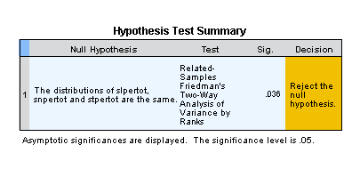
Table 11. The difference between /sl/, /sn/, and /st/ in perception. Descriptive Statistics of the perception of sC clusters
Table 12. Friedman test of significance
 | N | Minimum | Maximum | Mean | Std. Deviation
/sl/* total perception | 15 | 6.00 | 20.00 | 15.6000 | 4.04969
/sn/ total perception | 15 | 9.00 | 20.00 | 17.5333 | 3.54293
/st/ total perception | 15 | 11.00 | 20.00 | 17.1333 | 3.13657
Valid N (listwise) | 15

Slide 36
Graph 13. Accuracy of perception and production of /sl/, /sn/, and /st/

Slide 37
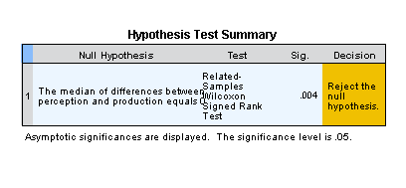
Table 14. Descriptive Statistics of the difference between perception and production.
Table 15. Friedman test of significance
Descriptive Statistics of the difference between perception and production.
 | N | Minimum | Maximum | Mean | Std. Deviation
perception | 15 | 17.50 | 30.00 | 25.4333 | 4.43954
production | 15 | .50 | 30.00 | 14.3290 | 10.90843
Valid N (listwise) | 15

Slide 38
Table 16. Correlation between perception and production
 |  | perception | production
perception | Pearson Correlation | 1 | .536*
 | Sig. (2-tailed) |  | .040
 | N | 15 | 15
production | Pearson Correlation | .536* | 1
 | Sig. (2-tailed) | .040
 | N | 15 | 15
*. Correlation is significant at the 0.05 level (2-tailed).

Slide 39
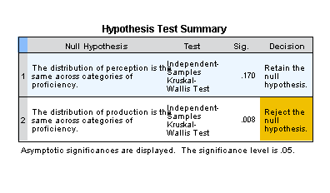
Table 17. Test of significance on the difference between perception & production based on proficiency

Slide 40
18. Proficiency impact on perception and production

Slide 41
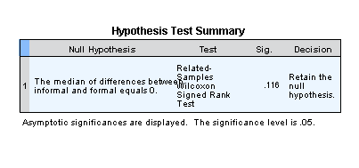
Table 19. Descriptive statistics of formal and informal production tasks
 | informal | formal
Mean | 15.0180 | 13.5333
N | 15 | 15
Std. Deviation | 10.98779 | 11.36327
Table 20. The impact of task formality on production

Slide 42
Figure 21. the difference between formal and informal tasks.

Slide 43
Discussion
difference between the clusters was not statistically significant in production (/sn/ 50%, /st/ 49%, and /sl/ 44%), the following order is noticed: /sn/=/st/=/sl/
difference between the clusters was statistically significant in perception: (88%)>st (86%)>sl (78%). : /st/=/sn/>/sl/
mean averages were much higher in perception: (84% in perception vs. 48% in production). This difference turned out to be significant after running statistical tests (z=-2.919, p=.004)
proficiency had significant impact on production, sig=. 008, p<. 005 (rising from 23% in beginner to 31% in intermediate to 89% in advanced groups)
the effect of proficiency was not significant on the perception(from 75% to 86% to 91%).
no significant difference between the two formal and informal tasks (sentence reading and picture-based interview). Although there was a difference between the mean averages of the two the tasks (45% in formal vs. 57% in informal), this difference was not statistically significant (p=. 116)

Slide 44
Table 22. Comparing predictions and results
Model | Prediction | Results: /sl/=sn/=/st/ in production and sn=st>sl in perception
1.Markdness on sonority | Hyp 1. sl>sn>st | Not confirmed
2.Redeployment | Hyp 3. sl=sn=st | Confirmed in production, partially confirmed in perception
3.OPM proficiency: | beginner<intermediate<advanced | Confirmed in production Rejected in percetion
4.OPM task: | more formal> less formal | rejected in production NA in perception

Slide 45
Table 23. A summary of production study Table 24. A summary of perception study
Hypothesis | Findings | Results
Markedness: sl>sn>st Redeployment:sl=sn=st OPM proficiency: beginner<intermediate<advanced OPM task: more formal> less formal | sl=sn=st sl=sn=st beginner< intermediate< advanced less formal= more formal | rejected confirmed confirmed rejected
Hypothesis | Findings | Results
Markedness: sl>sn>st Redeployment: sl=sn=st OPM proficiency: beginner< intermediate<advanced 4.OPM task: not applicable in perception | sn=st> sl sn=st> sl beginner= Intermediate= advanced NA | rejected partly confirmed rejected NA

Slide 46
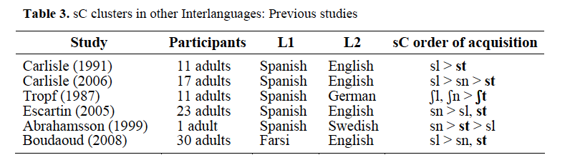
Cluster Variation
Yet the fact that our subjects have [sl] as significantly less accurate is, to say the least, unusual

Slide 47
Summary

Slide 48
Japanese L1
Those who produce [u], hear illusory [u]
Probably [u] is part of the underlying representation

Slide 49
Thai L1
They produce [ə] in initial sC but not in medial C.C
They hear it in initial sC but not in medial C.C
This is mediated by grammar

Slide 50
Implications
redeployment of L1 grammar rather than markedness on sonority is a better explanation for the development of sC clusters in Persian
while perception and production are correlated, Persian learners are better in perception than in production
Production is not an accurate reflection of their underlying knowledge

Slide 51
Implications
  Work on conscious communication strategies to improve intelligibility and comprehensibility (Munro,1999)
  Intelligibility: accurate recovery of the intended message
  Comprehensibility: processing load in doing so
  Neither are highly correlated with accentedness; strong accents can be intelligible
Munro: “Nativelikeness is neither common nor necessary”
Important for both teachers and learners to know

Slide 52
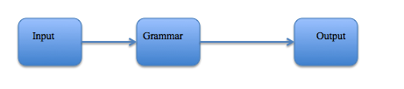
Pedagogic Implications
Instruction should address both production and perception:
  Work on changing perception (e.g. processing instruction (van Patten)) in the learners:

Slide 53
Input Processing (IP) VanPatten (1993):
principles are stated that describe how learners either miss grammatical markers in the input or how they get them wrong (VanPatten, 2002b)
learners process input for meaning before form.
Processing Instruction (PI):
an explicit focus on form that is informed by the model of IP
a practical solution to IP model
The goal of PI is to help L2 learners derive richer intake from input by having them engage in structured input activities that push them away from the strategies they normally use to make form-meaning connections (Wong, 2004).

Slide 54
Teachers can:
be aware of the presence of the same sC sequences in Persian codas. They can explicitly refer to these sequences in Persian.
include a variety of task types in their syllabi while teaching English onset clusters
be more patient with lower proficiency learners.
use Input Processing instruction model (Van Patten, 2002) to address Persian L2 learner.
first identify a potentially problematic processing strategy and then provide activities that push learners away from that strategy

Slide 55
Based on PI basic features, the following guidelines can be suggested for teaching sC onset clusters to Persian ESL learners:
Learners are given information about English sC onset clusters.
2. Learners are informed about a particular PI strategy (e-epenthesis) that may negatively affect their picking up of the form or structure during comprehension or production.
3. Learners are pushed to process the form or structure during activities with structured input: input that is manipulated

Slide 56
Limitations
the number of participants
composition of cluster (comparing two-member CC onsets such as stamp with three-member CCCV such as spring
the effect of preceding phonological environment (clusters being preceded by a vowel, a consonant, or a pause)

Slide 57
Future Studies
the effect of word frequency
Comparing sC clusters with other consonant clusters
-Study coda clusters

Slide 58
Thank you very much!

Slide 59
References
Archibald, J. (2006). Second language phonology as redeployment of phonological
knowledge. Canadian Journal of Linguistics 50 (1/2/3/4). Pp 285-314.
Boudaoud, M. & Cardoso, W. (2009). The variable acquisition of /s/ + consonant onset clusters in Farsi-English interlanguage. In M. Bowles, T. Ionin, S. Montrul, & A. Tremblay (Eds.), Tenth Generative Approaches to Second Language Acquisition Conference (pp. 86-104). Somerville, MA: Cascadilla Proceedings Project.
Cardoso, W., P. John, & L. French (2007).The variable perception of /s/+Coronal onset clusters in Brazilian Portuguese English. In Proceedings of New Sounds 2007. Pp. 86-106.
Cardoso, W. (2007). The development of sC onset clusters in interlanguage: markedness versus frequency effects. In Proceedings of GASLA. Cascadilla Press.
Corder, S.P. (1967). The significance of learners’ errors. International Review of Applied Linguistics 5: 161-170.
Dupoux, E., K. Kakehi, Y. Hirose, C. Pallier, & J. Mehler (1999). Epenthetic vowels in Japanese: a perceptual illusion? Journal of Experimental Psychology: Human Perception and Performance 25: 1568-1578
Enochson, K. (2014).L2 production of English onset sC and CC clusters. Concordia Working Papers in Applied Linguistics; Proceedings of New Sounds 2013. Pp. 171-184.

Slide 60
References
Imsri, P. (1999). Thai speakers’ perception and production of English onset clusters /sC-/. Unpublished manuscript. University of Delaware.
Iwasaki, S. & P. Ingkaphiram (2005). A Reference Grammar of Thai. Cambridge
Kaye, J. (1992). Do you believe in magic? The story of s+C sequences. SOAS Working Papers in Linguistics & Phonetics: 293-313.
Matthews, J. & C. Brown. (2004). When language intake exceeds input: language specific perceptual illusions induced by L1 prosodic constraints. International Journal of Bilingualism 8(1): 5-27.
Munro, M. J., & Derwing, T. M. (1999). Foreign accent, comprehensibility, and intelligibility in the speech of second language learners. Language Learning, 49(supplement 1), 285-310. doi:10.1111/0023-8333.49.s1.8
Summerell, F. (2007). The L2 Acquisition of Japanese Length Contrasts. MA Thesis University of Calgary.
Yousefi, M. (2016). Perception and production of sC onset clusters in Persian speakers of English. PhD candidacy paper. University of Victoria.

Slide 61
Back up slides

Slide 62
Enochson (2014)
L1 Chinese and Japanese (n=8) read from a list of words
She found the following order of accuracy:
[st] 86%
[sn] 79%
[sl] 60%
[sw] 43%
This is consistent with what we would expect if [s] were in the preceding coda (but not in the onset).

Slide 63
What’s Up With [sl]?
Who predicts [sl] should be the hardest?
Markedness: X
L1 frequency: X
L2 frequency: X
Redeployment: X
Inter-constituent Licensing: ✔

Slide 64
Empty-Headed Syllables
Kaye (1992); Goad (2016; 2012); Enochson (2014)
Archibald (2003) – intra-consituent licensing
The [s] is in the coda of an empty-headed syllable and the patterns we see are consistent with syllable contact across syllables (e.g. Vennemann, 1987)
Accounts for both prothesis and epenthesis facts

Slide 65
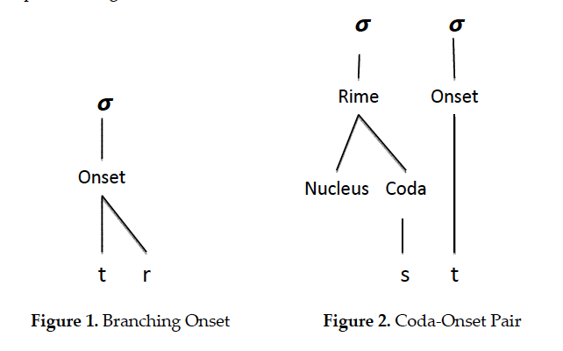

Slide 66
Epenthesis
CC clusters are repaired to CeC
Prothesis
sC clusters are repaired to [esC]
Persian Perception accuracy
sn = st > sl
Syllable Contact
[st]> [sn] > [sl]
Notes:
And remember [fl] strings show epenthesis not prothesis which argues for [s] being special (not just sonority distance explaining the patterns

Slide 67
Why is [sl] the worst for Persian L1 but not for Portuguese or Spanish L1?
Preliminary thoughts: Spanish and Portuguese are treating the [sC] sequences as types of onsets
While the Persian L1ers are treating them as types of codas

Slide 68

Just for our own information, is there a significant difference between the identification and discrimination perception tasks? N o, see the table below.
Notes:
So, this justified merging the scores of the two tasks.

Slide 69
Is there a correlation between the two? Yes, see the following table
.
Correlations
 |  | idnperc | discperc
idnperc | Pearson Correlation | 1 | .660**
 | Sig. (2-tailed) |  | .007
 | N | 15 | 15
discperc | Pearson Correlation | .660** | 1
 | Sig. (2-tailed) | .007
 | N | 15 | 15
**. Correlation is significant at the 0.01 level (2-tailed).

Slide 70
Inter-rater reliability
Correlations
 |  | me | tess
me | Pearson Correlation | 1 | .999*
 | Sig. (2-tailed) |  | .029
 | N | 3 | 3
tess | Pearson Correlation | .999* | 1
 | Sig. (2-tailed) | .029
 | N | 3 | 3
*. Correlation is significant at the 0.05 level (2-tailed).
Notes:
Good to have all these in case anyone asks…

Slide 71
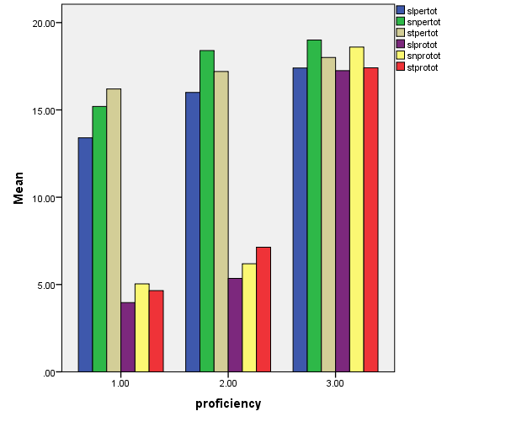

Slide 72
Production gets better; perception doesn’t? Perception doesn’t cause they start out so good (because of L1 transfer of marked MSD) and production gets better which is good news for learners and teachers (and is consistent with this being under executive control)
You gonna have anything to say about the lack of task effects?
Raises the intriguing question of “which clusters to start with”? Beyond our concern today….

