Slide 1
NACIL 2017 Stony Brook Chahar Mahal va Bakhtiari Province in the Atlas of the Languages of Iran
Erik Anonby, Carleton University & Universität Bamberg
Mortaza Taheri-Ardali, Shahrekord University

Slide 2
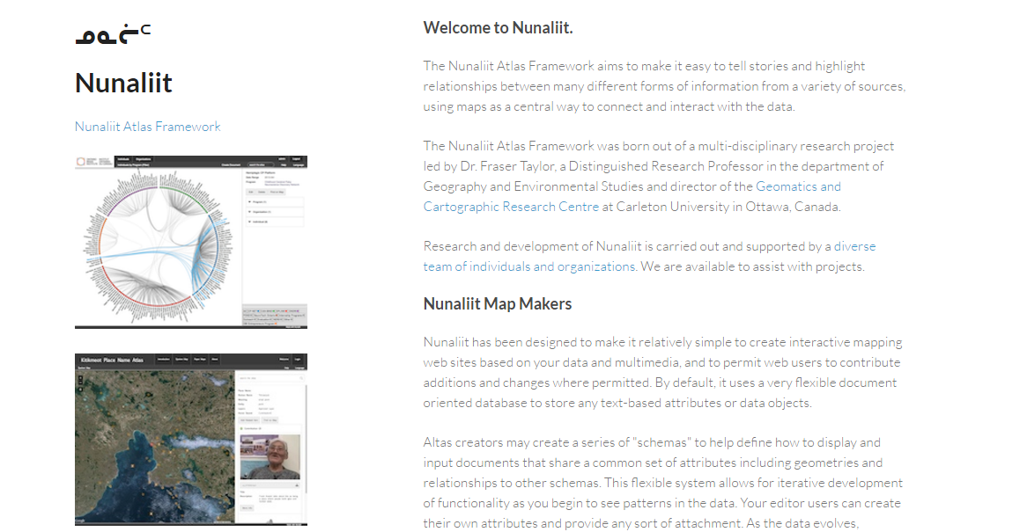
Introduction
The need for a language atlas for Iran
Research project: Atlas of the Languages of Iran (ALI) (test version: http://iranatlas.net)
Choice of Nunaliit Atlas Framework (http://nunaliit.org)

Slide 3
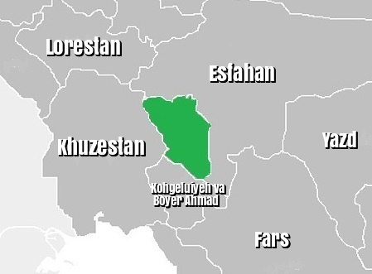
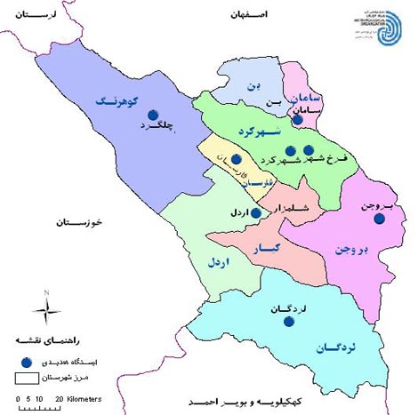
Research process
Chahar Mahal va Bakhtiari Province in its general context
Research goal: detailed, systematic study of language situation
Research team
Erik Anonby (Carleton/GCRC/Bamberg) Project leader, Atlas editor, language data analysis
Mortaza Taheri-Ardali (Shahrekord) Atlas team coordinator, C&B Province team leader, settlement localization, language data collection and analysis, Atlas bibliography
Fraser Taylor (Carleton/GCRC) Project co-investigator
Amos Hayes (GCRC) Geographic information technologist
J.-P. Fiset (GCRC) Atlas programming
Rob Oikle (Carleton/GCRC) Atlas design, map construction
Laura Salisbury (Carleton/GCRC) Background map construction
Mahnaz Talebi-Dastenaee (Alzahra) Settlement localization, language data collection
Maryam Amani-Babadi (Payam-e Noor) Settlement localization, Atlas bibliography
Peyman Pishyar (Allameh Tabataba’i) Language data collection
Fatemeh Shahverdi (Tarbiat Modarres) Language data collection
Reza Rezvani-Borujeni (Khomein Azad) Language data collection
Elham Hasanpour (Esfahan-Khorasgan Azad) Atlas bibliography

Slide 4
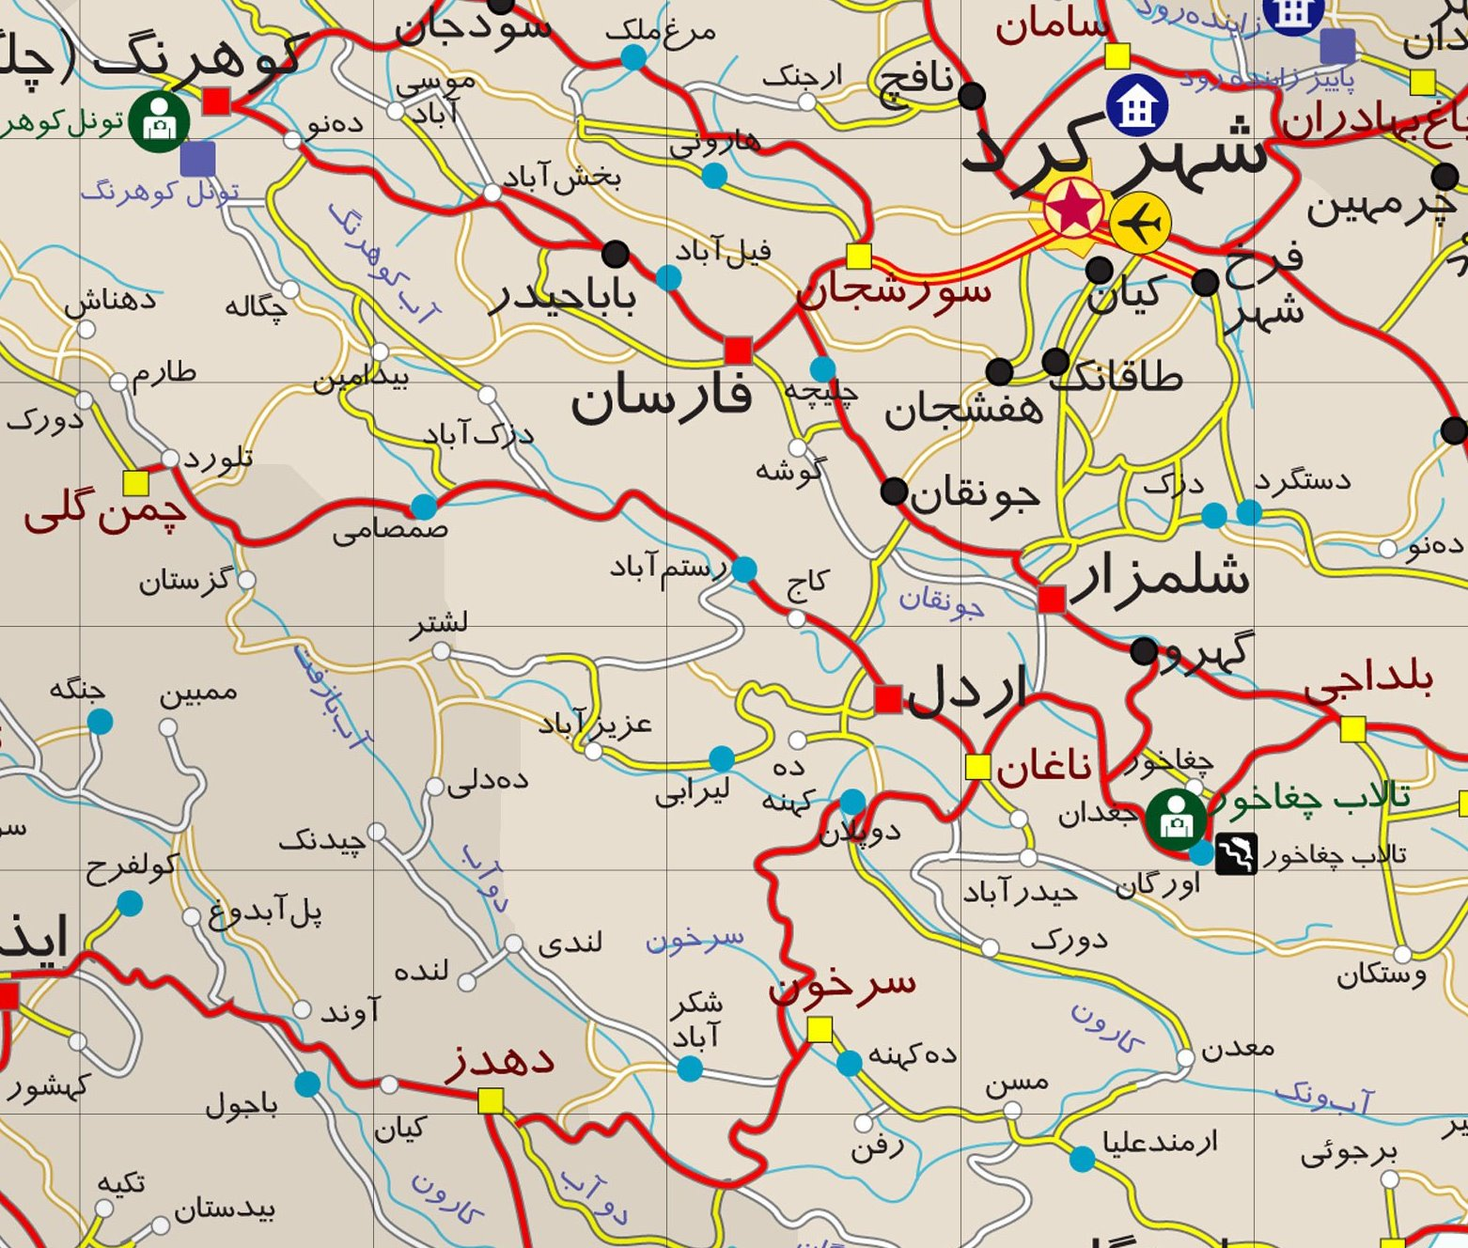
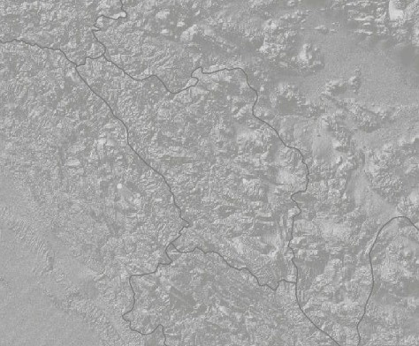
Research process
Chahar Mahal va Bakhtiari Province in its general context
Research goal: detailed, systematic study of language situation
Research team
Bringing together existing data sources

Slide 5
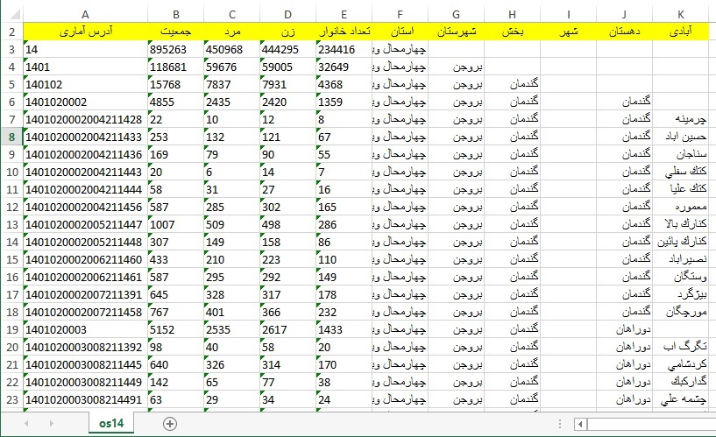
Research process
Chahar Mahal va Bakhtiari Province in its general context
Research goal: detailed, systematic study of language situation
Research team
Bringing together existing data sources
Collecting new data

Slide 6
Research process
Chahar Mahal va Bakhtiari Province in its general context
Research goal: detailed, systematic study of language situation
Research team
Bringing together existing data sources
Collecting new data
Language distribution in each settlement
Local pronunciations of place names
Sources for data collection
Displaying the data
http://iranatlas.net
http://iranatlas.net/index.html?module=module.language-distribution.chahar_mahal_va_bakhtiari
http://iranatlas.net/index.html?module=module.language-distribution.cbtest#

Slide 7
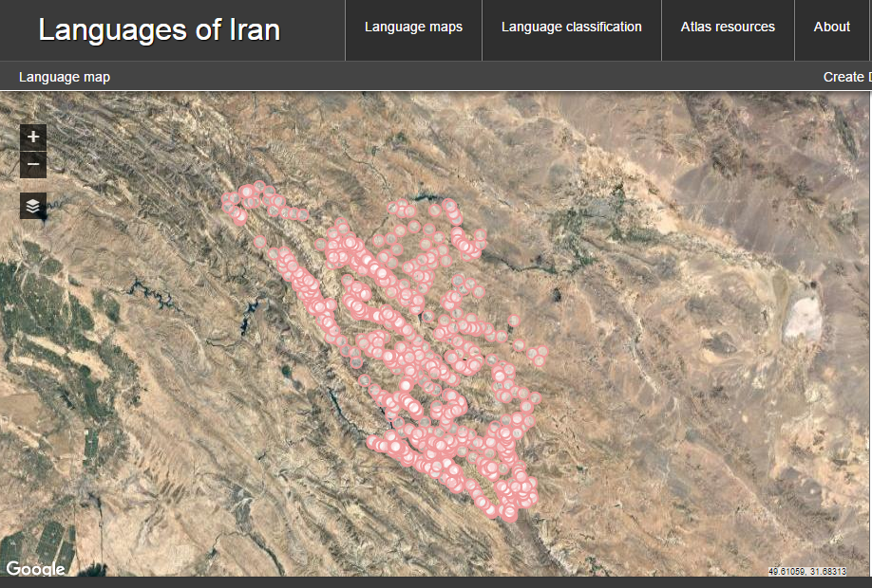
Research process

Slide 9
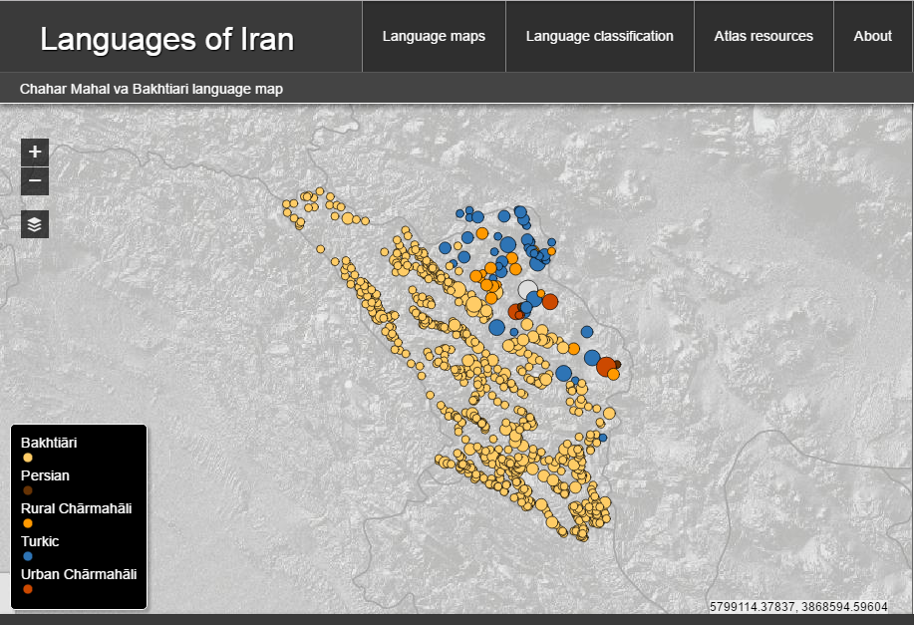

Slide 10
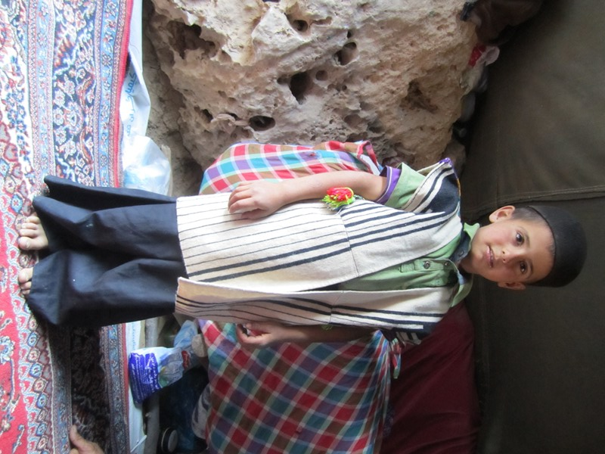
Results and challenges
Geographic distribution of language varieties
Nature of the language situation
Major language groupings
Bakhtiāri
Rural Chārmahāli
Urban Chārmahāli
Turkic
Persian
Toward an account of geographic distribution of linguistic features

Slide 11
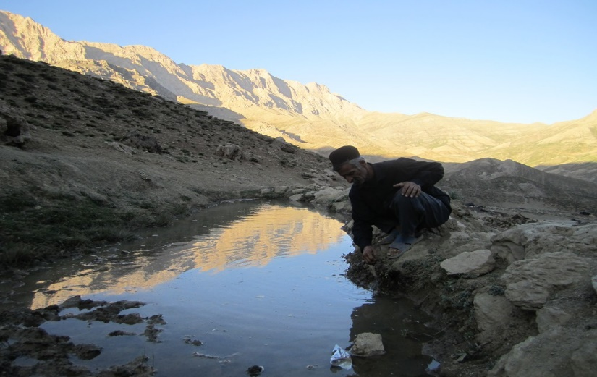
Conclusion
First detailed picture of language distribution in C&B Province
Initial understanding of dialect situation has guided choice of sites for collection of language data
Atlas questionnaire carried out in 25 of 35 locations
Currently analysing language data
Next steps
Return to research sites to collect and analyze longer texts
Prepare Atlas for submissions by scholars and Atlas users
Generate language data maps
Apply research process to other areas of Iran

