Slide 1
Latin Teaching by a Linguist in Ohio
Victoria Kirgesner -
Latin teacher, Cuyahoga Falls High School

Slide 2
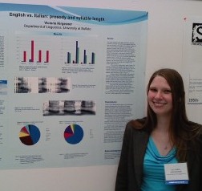

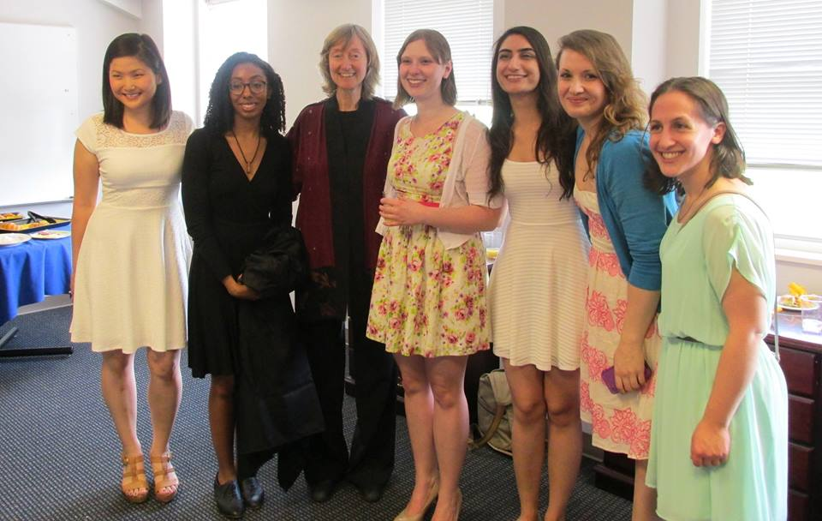
Notes:
Salvete! I’m happy to be here as this conference merges two of my favorite disciplines- Latin and linguistics. I started my love of language as a freshman in high school, taking Spanish because my dad said it would be more useful. The next year I decided to take Latin because, like any high schooler, all my friends were. I fell in love. It was the language and the class where I found my voice and my passion, but I also still loved Spanish. As high school ended, I didn’t want to translate or teach, which seemed to be the only options. After googling what I could do with a love of language, I found linguistics. While I may be from Ohio, I’m no stranger to NY state, as I decided to pursue linguistics at the University at Buffalo. I adored my studies there, but found myself missing Latin, so I added that as a second major. After graduation, I went on to study linguistics at Georgetown University. Even then, I couldn’t abandon my love of Latin. My interest in and knowledge of this “dead” language and its culture helped me to earn an internship at the Smithsonian Natural History museum on the Recovering Voices initiative, which works on language revitalization. After I earned my master’s degree, I worked independently to earn a teaching certificate in the state of Ohio and found myself teaching Latin in the suburb next to my hometown.

Slide 3
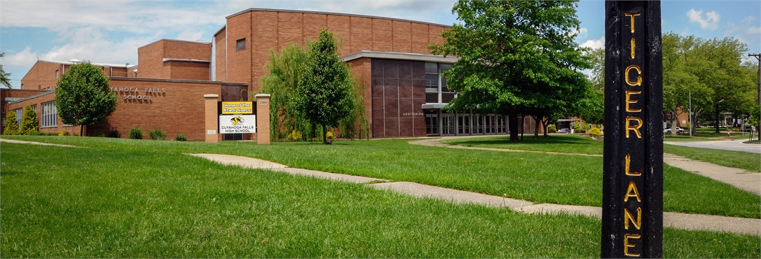


Notes:
I currently am in my second year teaching Latin at Cuyahoga Falls High School in Northeast Ohio, a suburb of Akron and about an hour south of Cleveland. I’m the only Latin teacher for the district and I have students in grades 9-12. We only teach Latin, Spanish, and French at the high school, so it can be a bit of a lonely existence for me. We are classified as a low-income district by the state, which comes with its own unique set of challenges for the students. Many of them do work after school or take care of family members...or simply can’t get to school when a parent is sick because they don’t have a ride. It’s a rather blue-collar community, steeped in tradition. While our students often are looked down on by neighboring more affluent communities, they are eager for Latin and eager to know the “whys” of Latin - why it’s “weird,” why it is the way it is, etc.

Slide 4
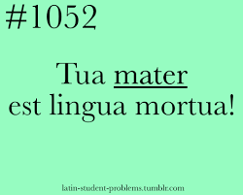
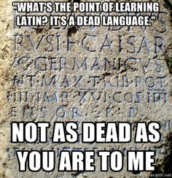

Notes:
When I was asked to speak about using linguistics in my Latin classroom, I really wasn’t sure what to say. It was hard for me to think about specifically when I use linguistics in my Latin teaching. It’s something I use every day and a field that dramatically influences how I approach my pedagogy, my students, and the language. It informs how I think and operate constantly. But one of the best examples I can give of how I use linguistics as a Latin teacher is in my “dead v. extinct” language talk that I give at the very beginning of Latin one. This is a direct product of my first year of teaching (at a different school), where the students could send their former teacher into a tailspin by saying “Latin is a dead language.” So they tried this with me. Having been a linguist and a Latinist for many years, I’m no stranger to being told what I study is useless, so I flipped it onto them. I continue to talk to students in my current school about what the difference is between a dead language and an extinct language. We talk about the privileged position that Latin has held in our society for centuries and how that has helped to define our current culture. This then feeds into a discussion about the Latin they encounter possibly every day, whether in terms of the periodic table or simply everyday English words like “bonus.” This discussion then forms the basis of a project they do where they go out and investigate a few areas of Roman influence in the modern world. I let them choose the influences because I want this to be real for them and I want my students to find the applications of Latin in their own worlds- in part so they can tell people why they’re taking this “dead” language.

Slide 5
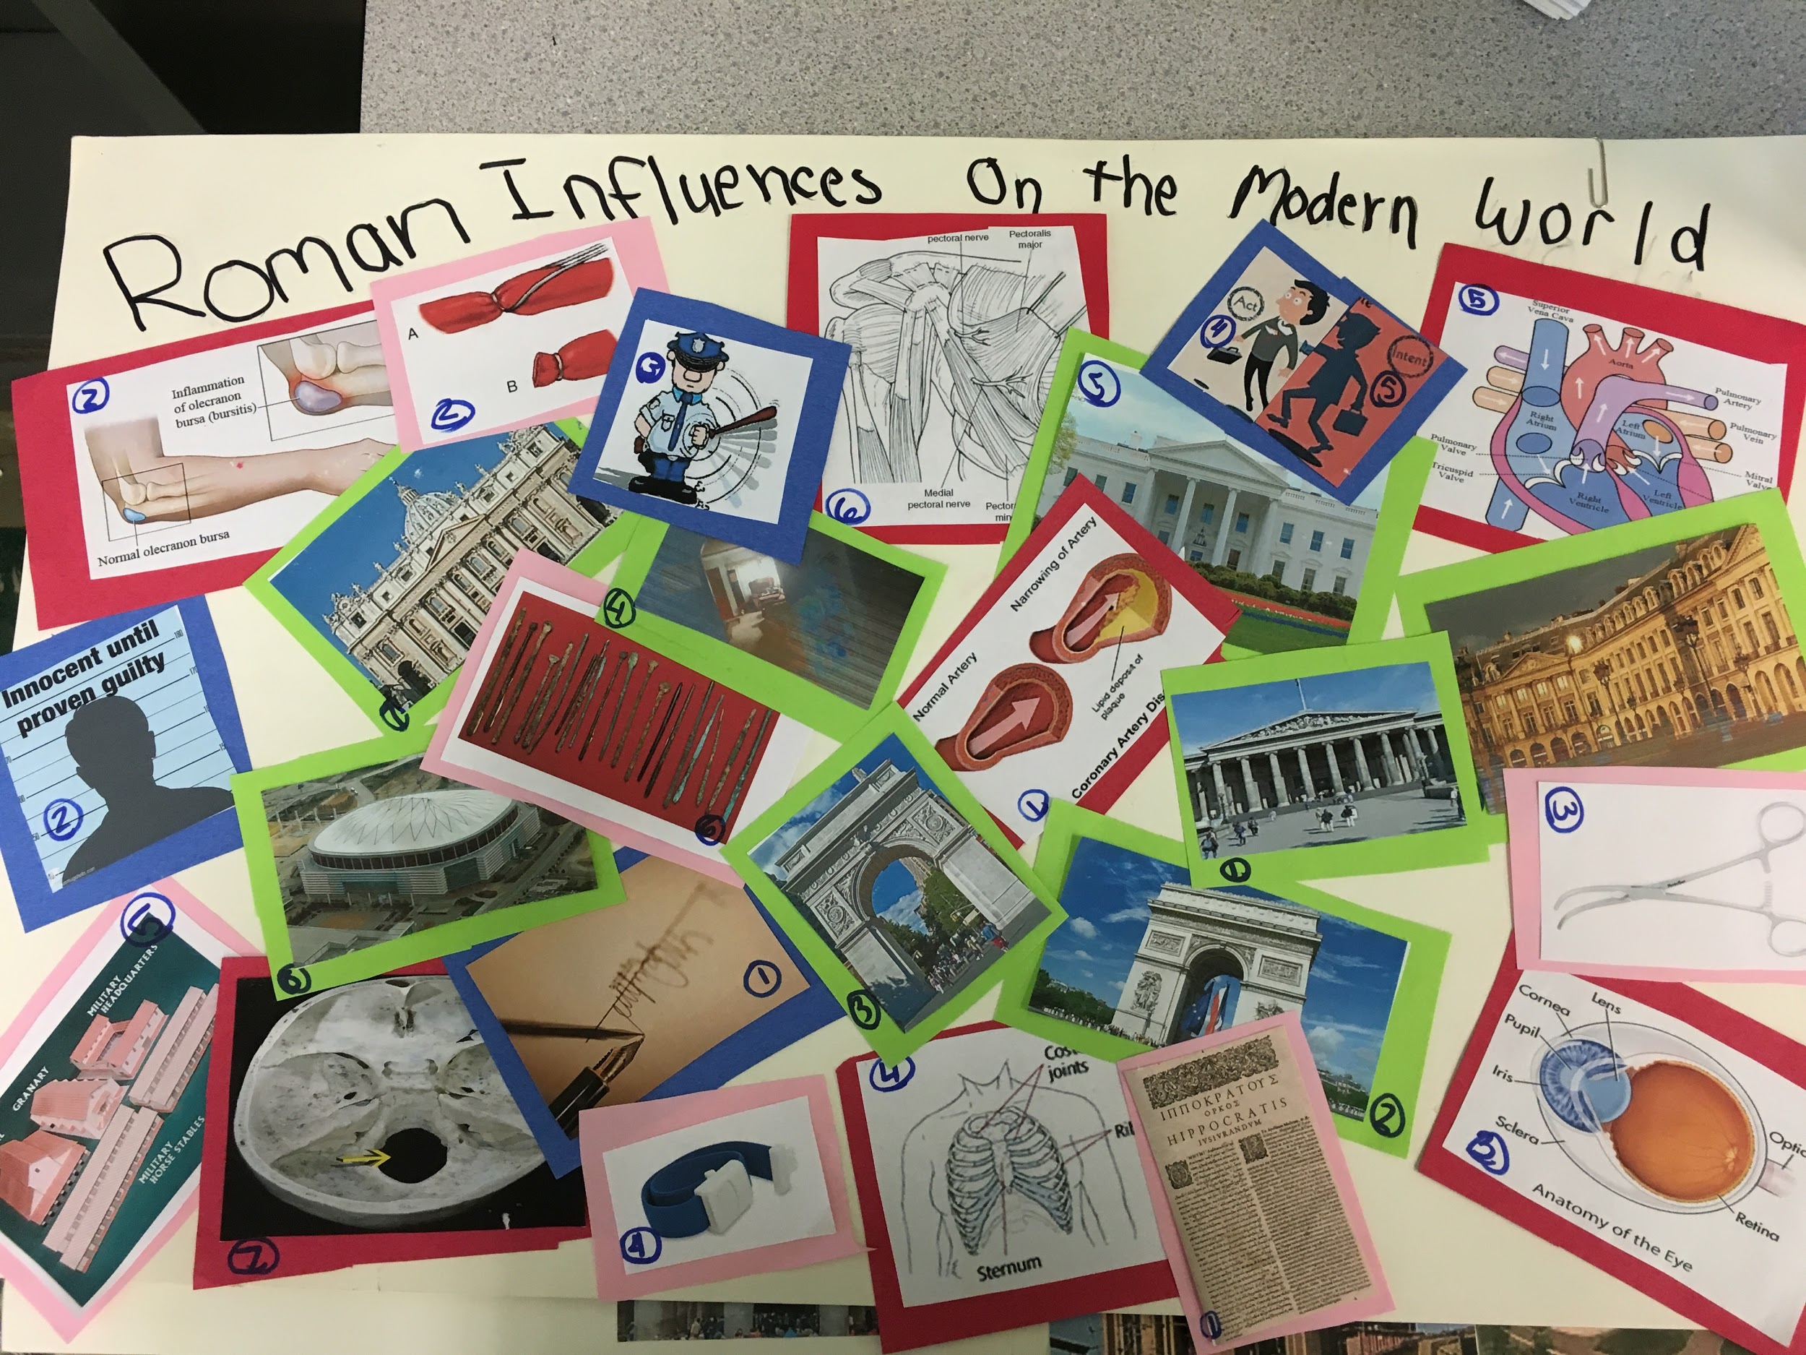

Notes:
This then feeds into a talk about language change as we discuss the difference between living and dead languages. We talk about how the Romance languages developed after the fall of the Roman empire and how the pronunciation of Latin has changed over the years. Inevitably, they want to know how we know that this is what Latin sounded like, so we talk a bit how we can use the clues that modern languages have given us to build the puzzle in a backwards direction. We also talk about how Romans complained about “bad speech” and from these pieces of evidence we can deduce how they spoke Latin. I then connect this to their own lives as they have often heard older people complaining about how kids these days only speak in abbreviations and emojis and how English is in decline. They begin to reach through time and space through the conduit of understanding language.

Slide 6
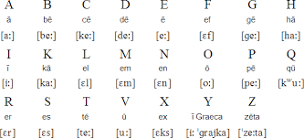
Notes:
As I talk about Latin pronunciation with them, (hitting the highlights), we have to talk about diphthongs. Given my linguistics background and the way I learned how to pronounce sounds, I can explain this to them. When we talk about the diphthong, [ae], I model it for them slowly and then ask them to mimic me. I ask them to think about what their tongues are doing and how the two sounds are distinctly made but work together. In talking about this, we also talk about the lack of /w/ in the Latin alphabet and we discuss a little bit about how the letter /w/ itself displays its legacy, as being two letter v’s smooshed together and the fact that its name is double-you.

Slide 7
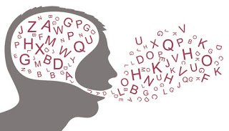
Notes:
Being a linguist has helped in terms of understanding the different ideas surrounding second language pedagogy. I learned as an undergraduate how language works in the brain and this has helped to inform my teaching. I know that students need repetition to learn content and that this needs to be fun and engaging so that they want to learn (and so it doesn’t feel like work). I know that everyone progresses through the stages of language learning at different rates and everyone has that magical moment of clarity at different times (assuming they have it while they study with me). I know that language learning can be a thankless and tedious process, where students sometimes don’t feel like they’re making any progress. I understand that it is a drastically different endeavour in some ways than any other class they’ve ever taken and I can explain why this is the case to them. I celebrate the little moments, like cheering when we finish our very first Latin story, because I know that the encouragement is important. Before I ever heard about VanPatten or Krashen (names that I never discussed in my sociolinguistic or other linguistic theory classes), I understood that students have to want to enjoy the language and that an intense focus on grammar doesn’t usually retain high school students. Don’t get me wrong, I loved Latin grammar. But I know I was the exception not the rule.

Slide 8
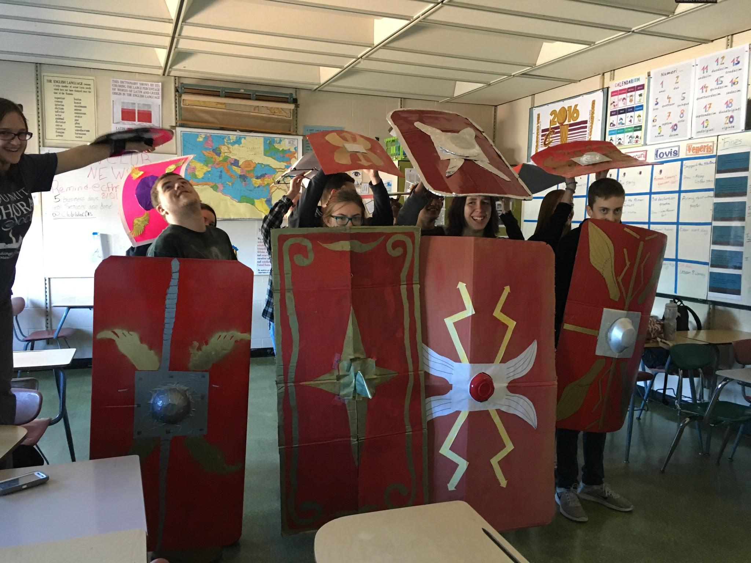
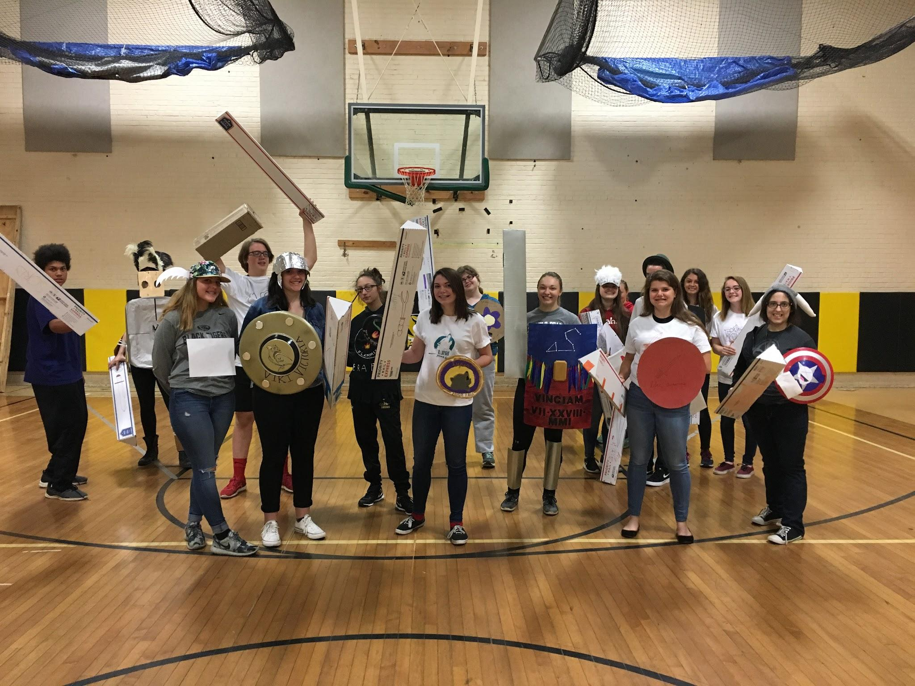
Notes:
So why should a Latin teacher look into linguistics? In my opinion, it’s because through looking at the study of how languages work we can better anticipate the questions our students have about the language. Mine always want to know why something is the way it is in Latin. They want to know why Latin is “weird,” which usually gets the answer from me of “Latin isn’t weird. It’s just different” and then annoyingly bringing up something in English that’s “weird” but that they take for granted. I’m not satisfied with them saying Latin is hard- I know it’s a human language, just like any other, and so I tell them that “if Roman babies could learn this, so can you.” They usually protest this, but read it as my encouragement that it is not beyond their reach. I’m able to help them see why “pot+sum” became “possum” in some situations and to see the case system in English. I’m a sociolinguist, so I’m constantly asking them to hypothesize what the language says about the culture. What do their stories tell us? What do their lexical items tell us? My students all know about the fact that Latin has quite a few words for killing, which they laugh at, but they’re also learning something about the culture as well.

Slide 9
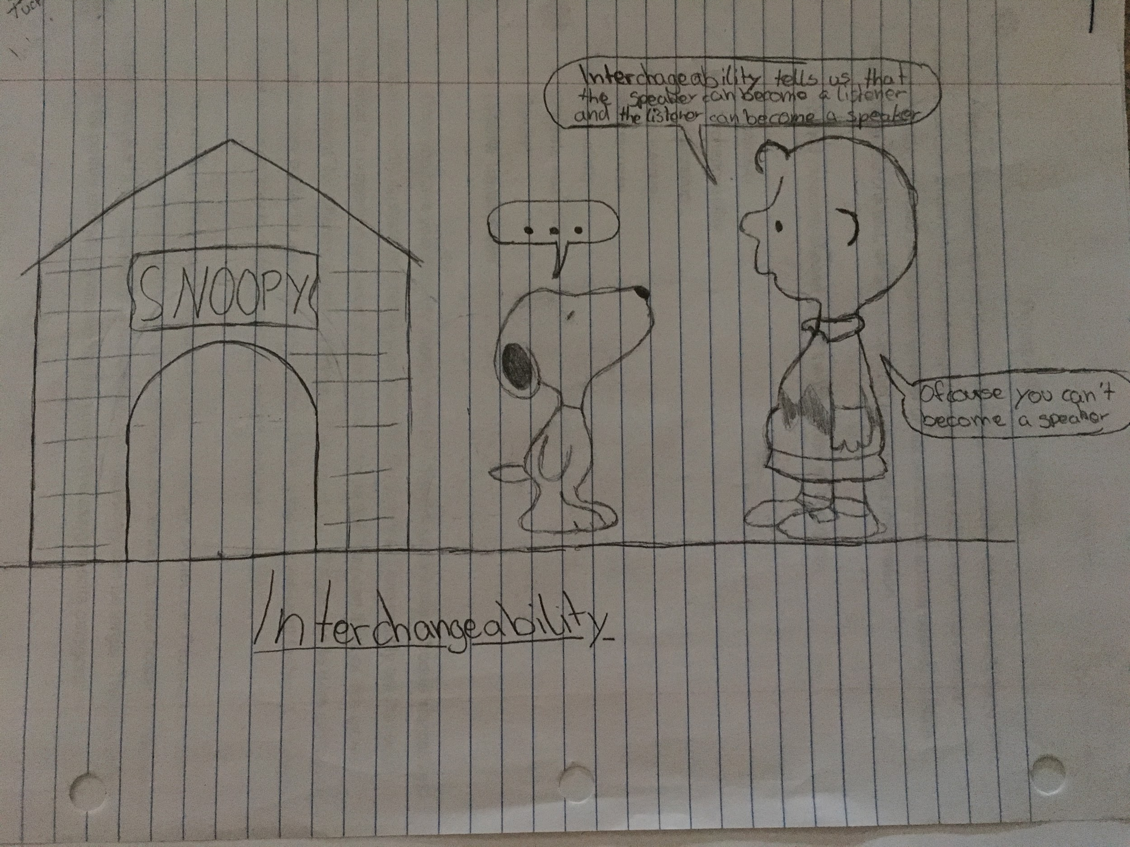
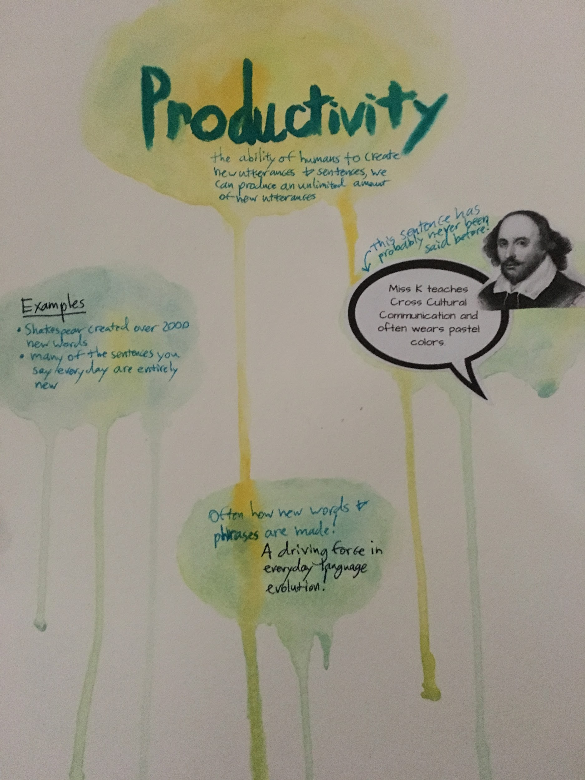
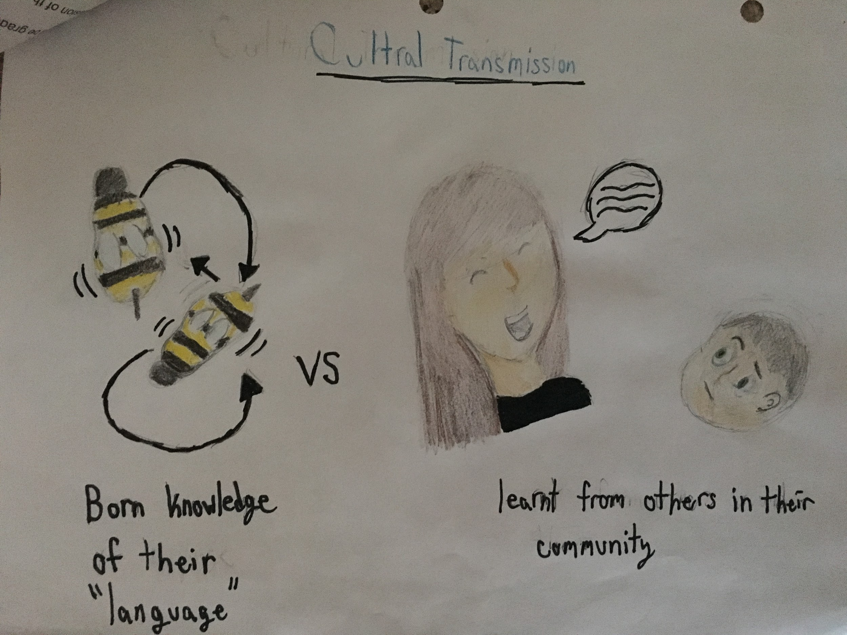
Notes:
Given that my students last year would routinely ask me questions about the why of Latin and language in general, I decided to create an intro level linguistics course myself for the following year. Luckily, my school approved it and I’ve been teaching it this semester. It’s a half credit elective course, housed under the world languages department. Many of the students in there are my Latin students, taking it either because they wanted to learn more (or they just liked me). For its first time being offered, 20 students signed up for the class; over half are current or former Latin students. I plug it often in my Latin classes as well, and have had many that express interest in it. All have an interest in Latin and of the principles of communication. These students are naturally inquisitive and already detail-oriented from their studies of Latin and experience with its system of inflection. These are skills that transfer so well to the linguistics classroom, in terms of logical thinking, attention to detail, cultural awareness, and so much more. I believe it’s a natural fit for us as language educators...but then again, I’m a bit biased. Thank you.

Slide 10
Image Citations
Anderson, L. (2013, January 20). Teaching. Retrieved from https://www.pinterest.com/pin/118289927684787167/
Cuyahoga Falls, Ohio. (n.d.). Retrieved from http://www.city-data.com/city/Cuyahoga-Falls-Ohio.html
Dead language problems. (n.d.). Retrieved from https://www.tumblr.com/search/dead language problems
Kyritsis, A. (2016, December 17). Windows 7 Language Change in Home Premium and Pro. Retrieved from https://www.pcsteps.com/880-windows-7-language-change-any-version/
Latin alphabet. (n.d.). Retrieved from https://www.omniglot.com/writing/latin.htm
Latin student problems. (n.d.). Retrieved from https://www.pinterest.com/elkeeurlings/latin-student-problems/
Marden, K. (2015, October 13). First v. Second Language Acquisition. Retrieved from https://www.linkedin.com/pulse/first-vs-second-language-acquisition-kate-mardon
SchoolPointe, I. (n.d.). Quick Links. Retrieved from http://www.cfalls.summit.k12.oh.us/school_home.aspx?schoolID=1
SchoolPointe, I. (n.d.). QUICK LINKS. Retrieved from http://www.cfalls.org/Content2/ell

