Slide 1
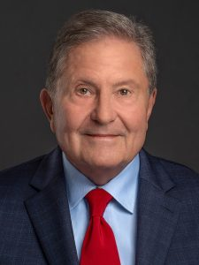
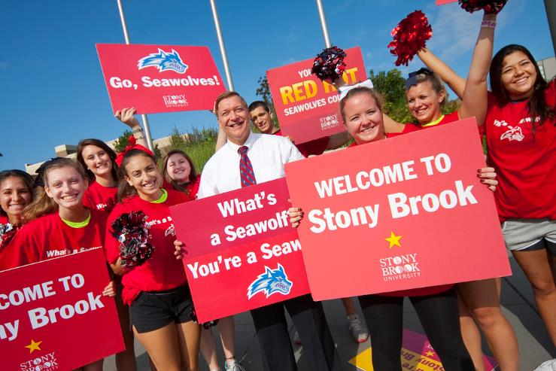
Welcome!

Slide 2
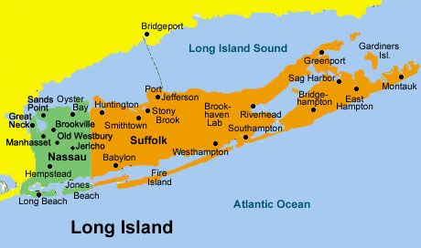
SBU is ~60 miles east of New York City, 3 miles south of West Meadow Beach on the Long Island Sound, and 17 miles north of the Atlantic shore.
The campus is situated on more than 1,000 acres, in the historic ‘Three Village’ area.
There are more than 16,000 undergrads, more than 8,000 grad students, and more than 14,000 employees of the University

Slide 3
The University comprises many Schools and Colleges:
The Graduate School
College of Arts & Sciences
College of Business
School of Dental Medicine
College of Engineering & Applied Sciences
School of Health Technology & Management
School of Journalism
School of Marine & Atmospheric Sciences
School of Medicine
School of Nursing
School of Professional Development
School of Social Welfare
… and many more.

Slide 4
Microbiology &
Immunology Graduate Program
(HBM)
Administered by the School of Medicine
All grad programs are governed by the Graduate School, even if they are in different Schools or Colleges.
Graduate Program in Genetics
(BGE)
Administered by the College of
Arts and Sciences
These two programs share many faculty, but the courses of study are different.

Slide 5
Academic Departments
versus Programs
The University is also organized into academic departments, such as:
        Biochemistry & Cell Biology
        Ecology & Evolution
        Microbiology & Immunology
        Neurobiology & Behavior
        Pharmacological Sciences
        Physiology and Biophysics
        Pathology
        … and more

Slide 6
Faculty (and staff) are assigned to departments for payroll and other administrative reasons,
but most faculty
belong to more than one graduate program.
Students from different graduate programs (Genetics, Micro, MCB, BSB, BME, etc.) often work side-by-side in the same laboratory.

Slide 7
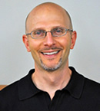
Our Departmental Home
The Department of Microbiology and Immunology:
is the ‘host department’ of first-year Genetics (BGE) students until they join labs.
is the home department of the Microbiology & Immunology (HBM) graduate program.
Dr. David Thanassi, Chairman
The Genetics Program is interdepartmental, with over 100 faculty in more than 12 departments. Genetics students become ‘members’ of their research mentor’s home department when they join labs.

Slide 8
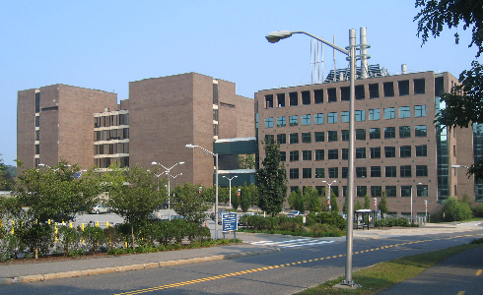
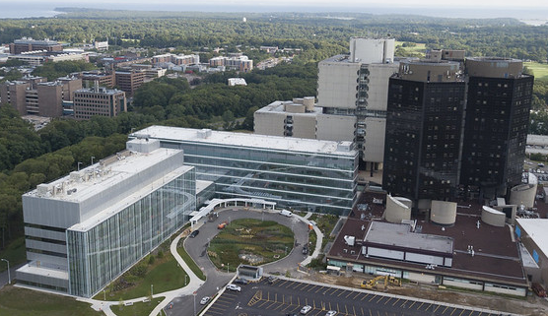
Facilities
Your research may be conducted in the Life Sciences Building, Centers for Molecular Medicine (CMM),
the Basic Science Tower (BST), the Health Sciences Tower, or the MART in the Health Science Center (HSC), or…

Slide 9
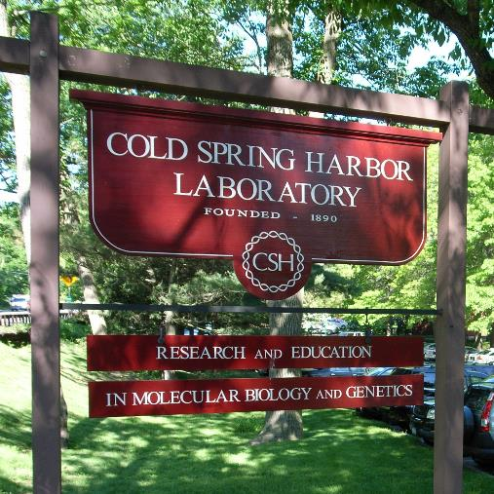
Facilities
…Cold Spring Harbor Laboratory or the Woodbury Genome Center

Slide 10
Cards and Keys
Access Cards and Keys
Your photo ID can be programmed to grant after-hours access to the Life Sciences and CMM complex, and to certain secured facilities.
Special keys may be needed for specific areas; your mentor will need to request such keys for you.
All keys must be returned when you leave the University (or no longer need them).
Jen will arrange for your key to the ‘Fishbowl’ student office (Rm 040 Life Sciences).

Slide 11
Finding Your ID Information
For your Direct Deposit form, you need your NYS Employee ID number:
  Look on your first paycheck.
  Find it in SOLAR:
    Click on ‘Find My NYS Emplid’ under ‘Student Employment Service.’

Slide 12
Registration

Slide 13
Grad Student Classifications
G3
G3 - First year PhD graduate student who has completed less than twenty-four graduate credits. G3 students must register for 9 credits per semester.
G4
G4 - Advanced PhD graduate student who has completed twenty-four or more graduate credits. G4 students must register for 9 credits per semester.
G5
G5 - Advanced PhD graduate student enrolled in a doctoral who has been formally advanced to candidacy. G5 students must register for 9 credits.
To remain a full-time student, you must register for
zero credits of summer research – every summer.

Slide 14
Registration Deadlines
Critical Deadlines
To avoid a late registration fee ($50) you must be registered for at least one credit before the first day of classes – e.g., by AUGUST 25, 2024.
You should complete your registration during the first week of classes.
If you need to ‘swap’ one course for another, you may do so on SOLAR no later than Day 10 of classes. Be careful to ensure your total number of credits is exactly 9. You will need to petition to make changes after that date and pay a processing fee.
‘Drop Dead’ Deadline– You must complete all changes and be fully registered by the end of late registration (Day 10 of classes) or you will lose your tuition and fee scholarship.
Similar deadlines apply EVERY SEMESTER, including the SUMMER.

Slide 15

Don’t worry
we’ll remind you
But it is YOUR RESPONSIBILITY to meet all the deadlines, every semester.

Slide 16
Removing Blocks
What if I am blocked from registering?
Check your SOLAR account for messages. You may be blocked if:
You have not yet acknowledged SOLAR messages.
You need to waive the default student health insurance.
You have not turned in necessary documents (medical records, transcripts).
You have unpaid student fees.
You have an unpaid parking ticket!

Slide 17
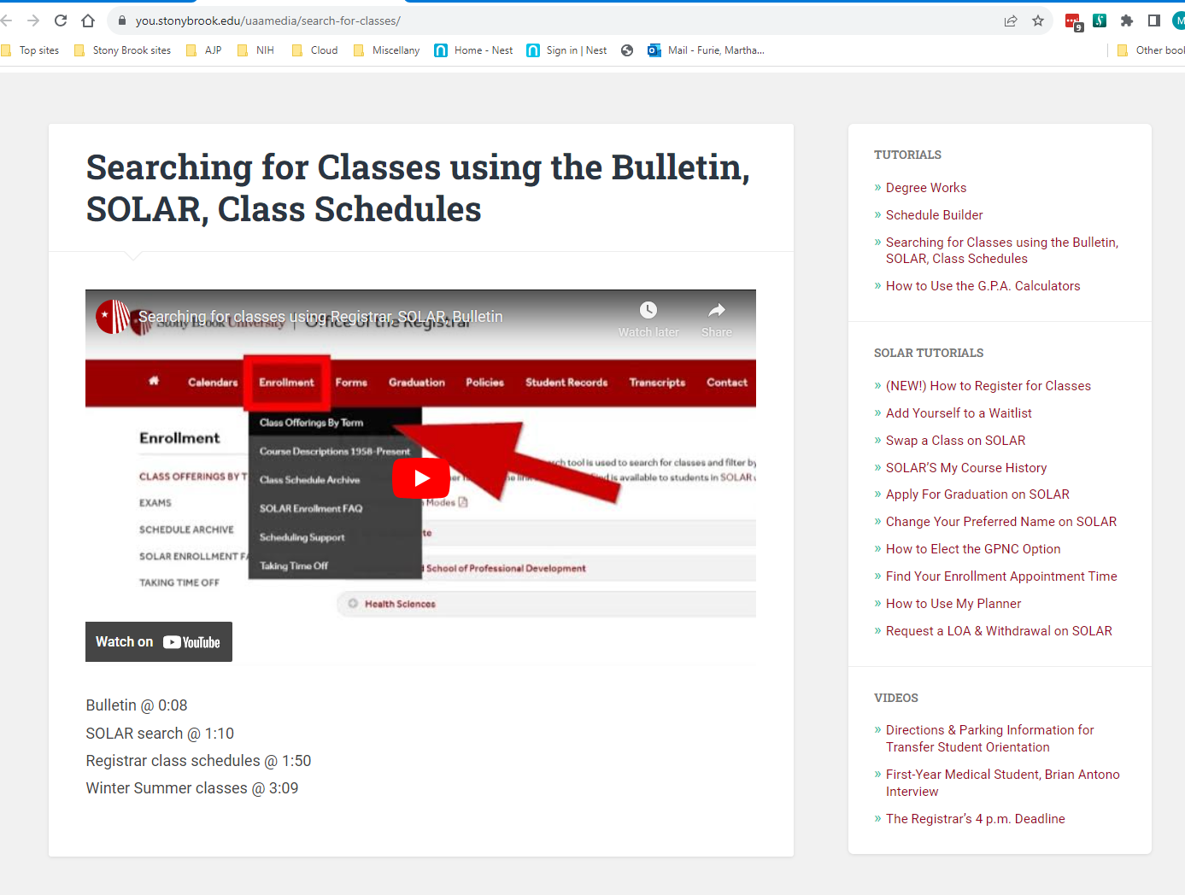
Finding Classes
Clicking on a course will pop up scheduling and room information.
https://you.stonybrook.edu/uaamedia/search-for-classes/

Slide 18
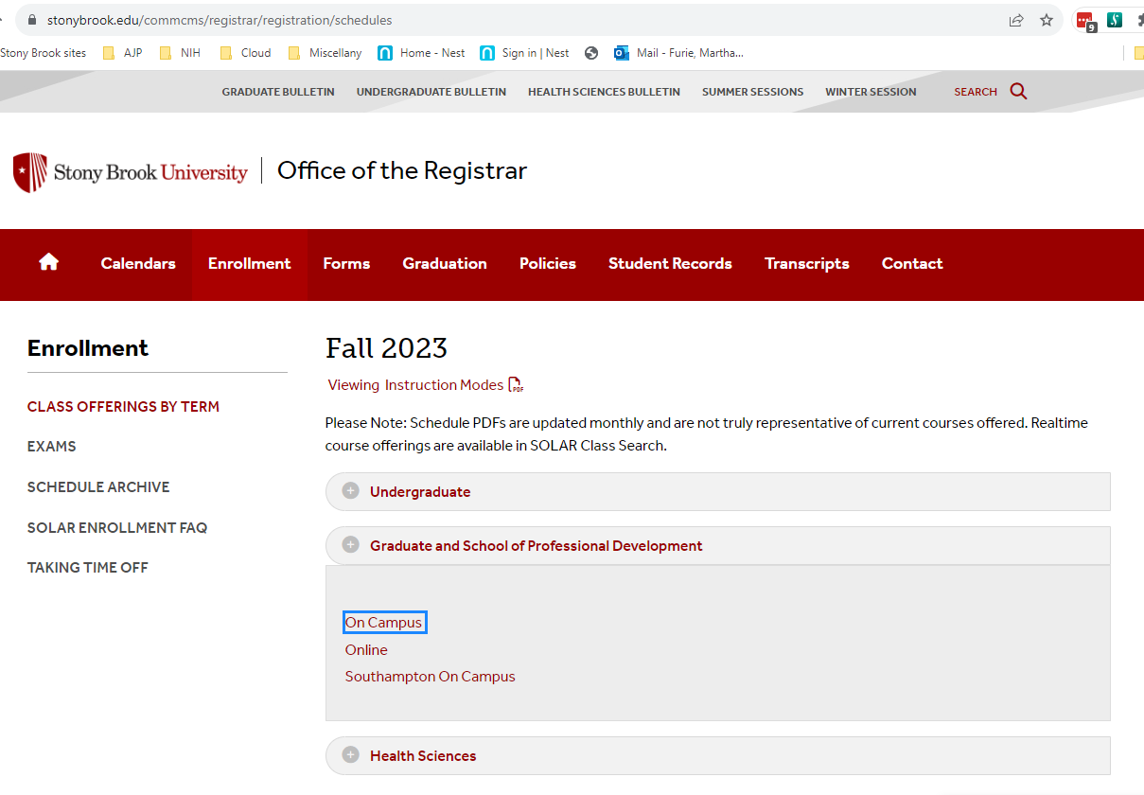
Searching for Class Schedules
Another way to find schedule information:
‘West Campus’ classes, including Genetics (BGE) and Molecular & Cellular Biology (MCB), are listed on the Registrar’s site.
They are listed alphabetically by the three letter course code (BGE, BSB, JRN, etc.)
Health Sciences course information (HBX) is incomplete.
http://www.stonybrook.edu/commcms/registrar/registration/schedules.html

Slide 19
Student Fees
Student Financial Services
PhD students with stipend support receive a full tuition scholarship and a scholarship that covers all ‘broad-based’ fees
  Not graduate activity fee ($45 per semester)
You receive employer-sponsored health insurance, so the Required Student Health Insurance fee does not apply.
Note that you must enroll in the appropriate plan for TAs/GAs or RAs, and the required plan on SOLAR must be waived each semester. The required plan also can be waived if you are covered on your family’s health plan.
https://www.stonybrook.edu/commcms/sfs/tuition/broad-based-fee/

Slide 20
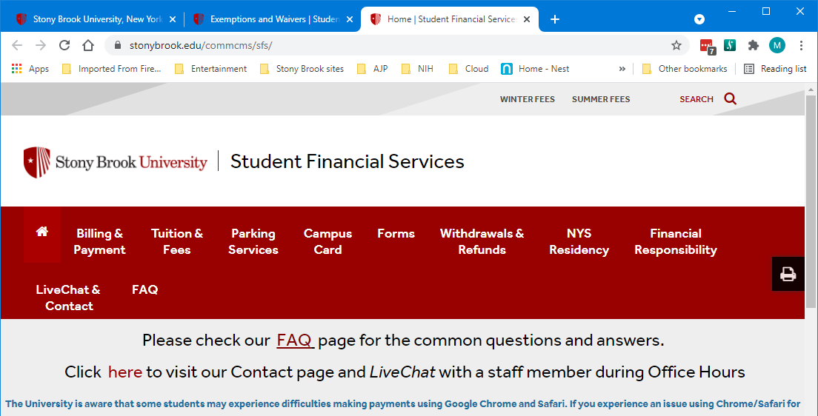
New York State Residency
US citizens and permanent residents must establish NY State residency before the start of the Fall 2025 semester (August 17 deadline)
https://www.stonybrook.edu/commcms/sfs/residency/index.php

Slide 21
Sources of Funding
PAYROLL:
State versus Research
Grad students may be paid from one or both sources of funds.

Slide 22
Sources of Funding
Students paid with State funds are classified as Teaching Assistants (TAs) or Graduate Assistants (GAs).
Students paid with Research funds are classified as Research Project Assistants (RPAs).
Some ‘Fellows’ receive stipends from the State (Turner, Bridge to PhD), while others (Training Grant Fellows) receive a combination of Research and State funds.
So… What’s the difference?

Slide 23
Sources of Funding
TAs, GAs and recipients of State fellowships:
Receive paychecks bi-weekly on Wednesdays.
Enroll in the NYSHIP SEHP health insurance plan.
Receive the first paycheck two weeks after the completed pay period (one month after your start date), but your final check arrives two weeks after your payroll end date.
Are members of the Graduate Student Employee Union (GSEU).

Slide 24
Sources of Funding
RAs and research-funded fellows:
Receive paychecks bi-weekly on Fridays.
Enroll in the Anthem Blue Cross insurance plan.
Are paid ‘to the day’ (no waiting period), and paychecks terminate on the day that the research appointment ends.
Are members of the RA Union.
Students with advisors at CSHL are paid by and receive benefits through CSHL.

Slide 25
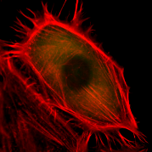
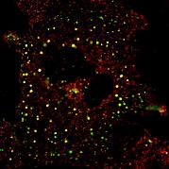
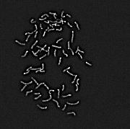
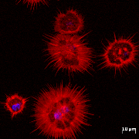
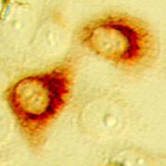
Rotations
Rotating at Cold Spring Harbor
Cold Spring Harbor Laboratory requires students to sign a Graduate Student Rotation Form and complete certain procedures detailed on a Rotation Checklist.
See Jen for the forms.

Slide 26
How to Succeed in
Graduate School:
The Hidden Curriculum
Succeeding in Graduate School
(with thanks to Dr. Janet Hearing)

Slide 27
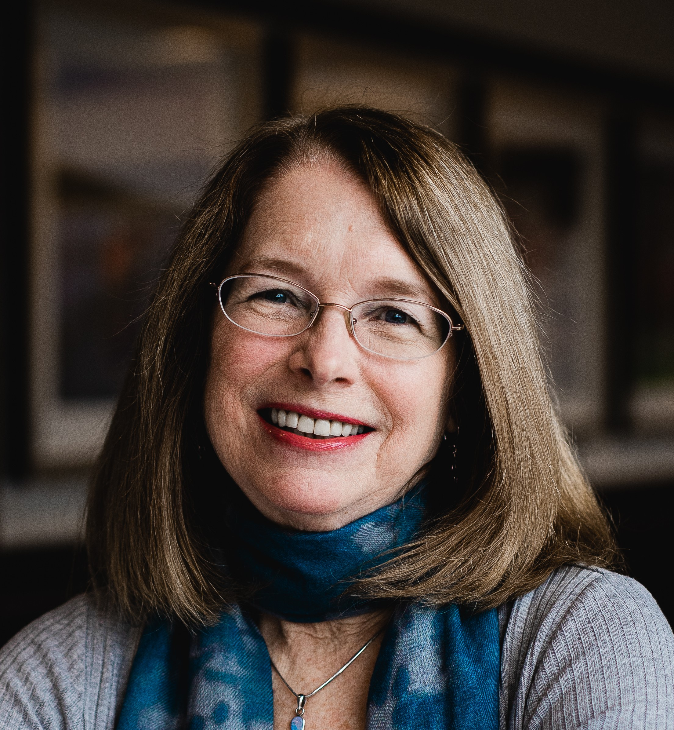

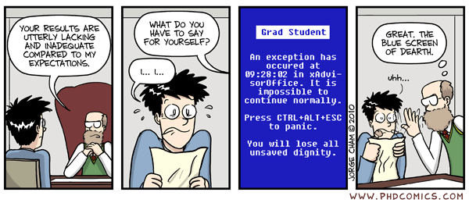
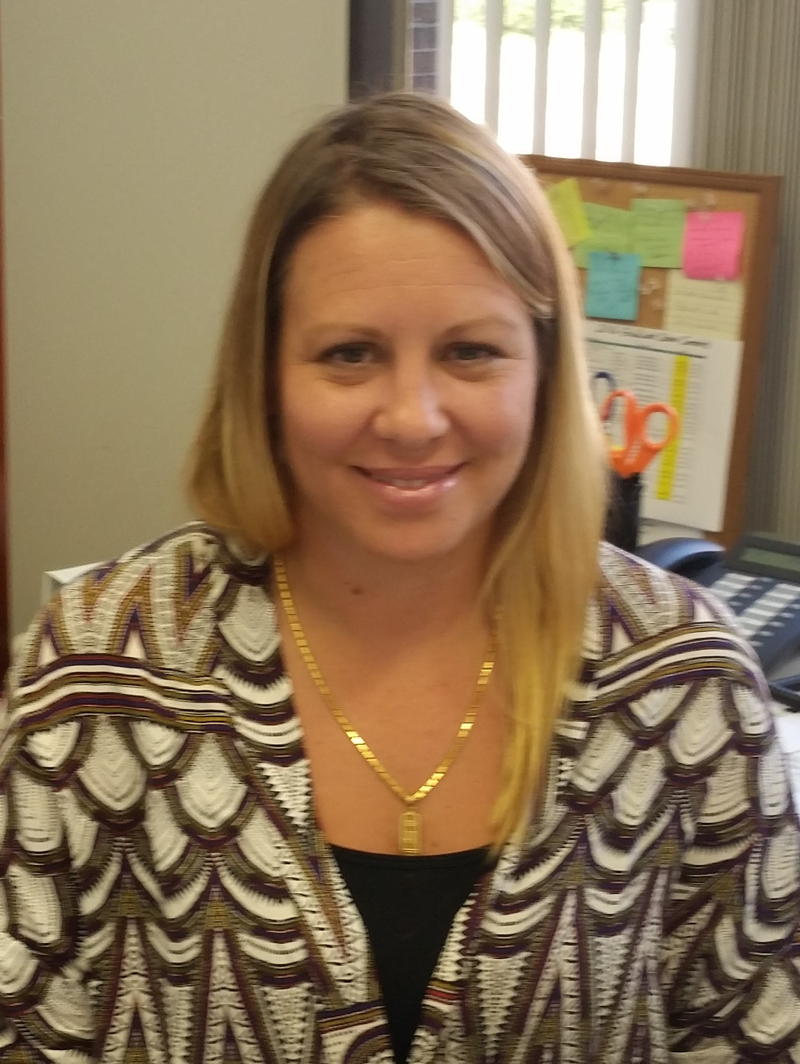
You have support!
Graduate Program
Director
(Academics)
Research Advisory Committee
Graduate Program
Coordinator
(Administrative)
Advisor
Let us know about little problems before they become big ones!
University resources for support: https://justsbu20.wixsite.com/just/blank-page
Notes:
Mention peers, JUST

Slide 28
Student Support Team
https://www.stonybrook.edu/commcms/studentaffairs/studentsupport/
timelycare.com/stonybrook
‘Around the clock virtual medical and mental health care’
Remember, everyone in graduate school experiences self-doubts and sometimes feels like they don’t belong. Talking to other students, faculty, your program director, and professional staff at Stony Brook can help.

Slide 29
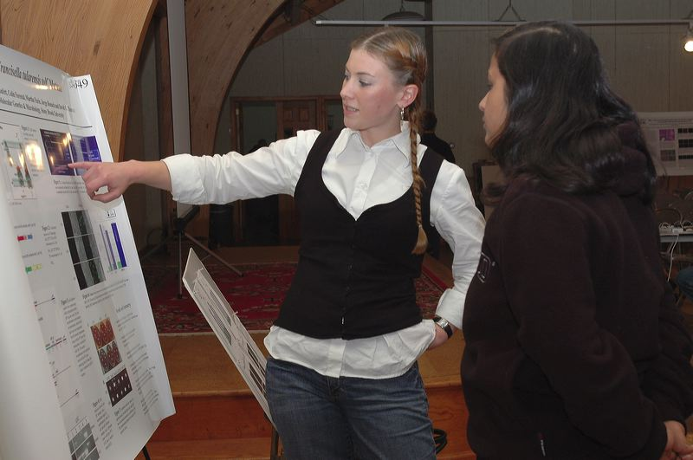
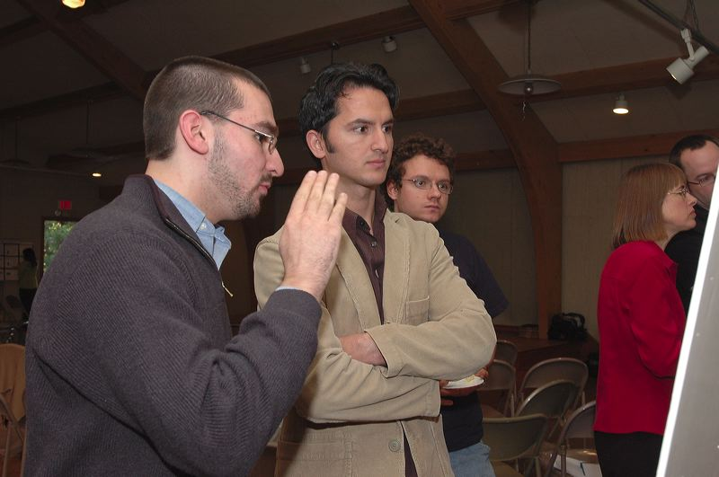
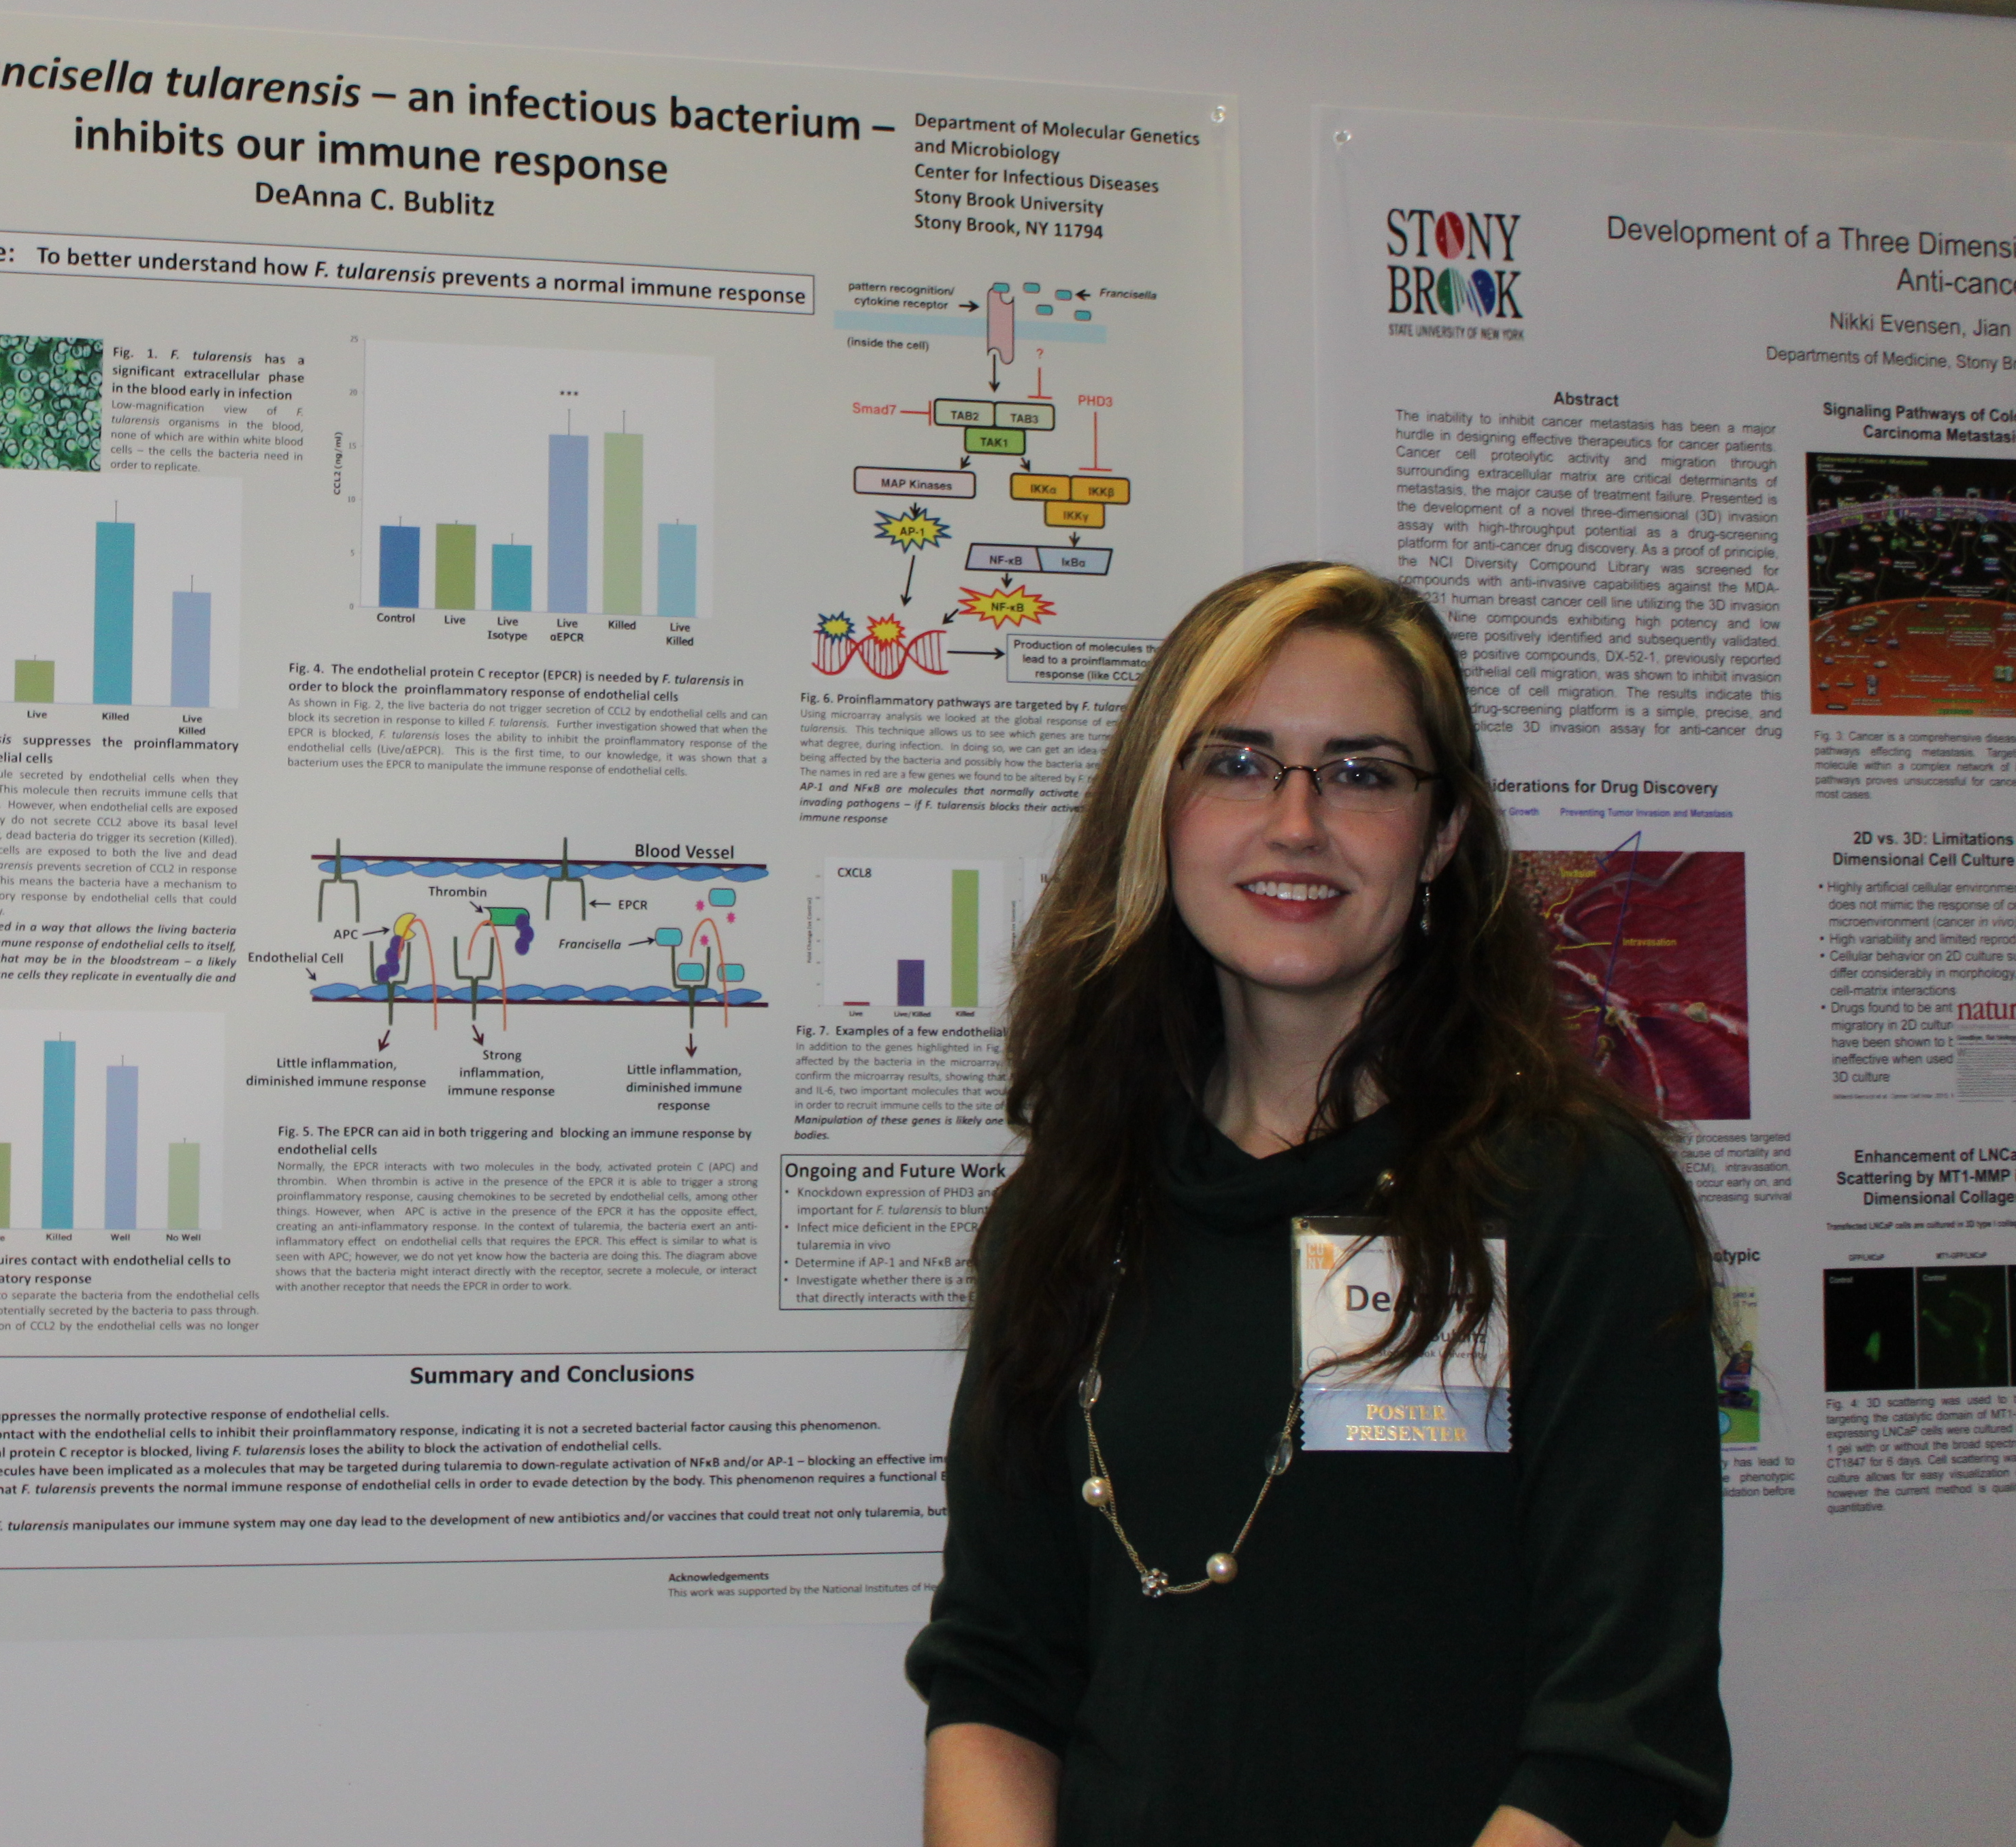
BUT…you should take charge of your education!

Slide 30
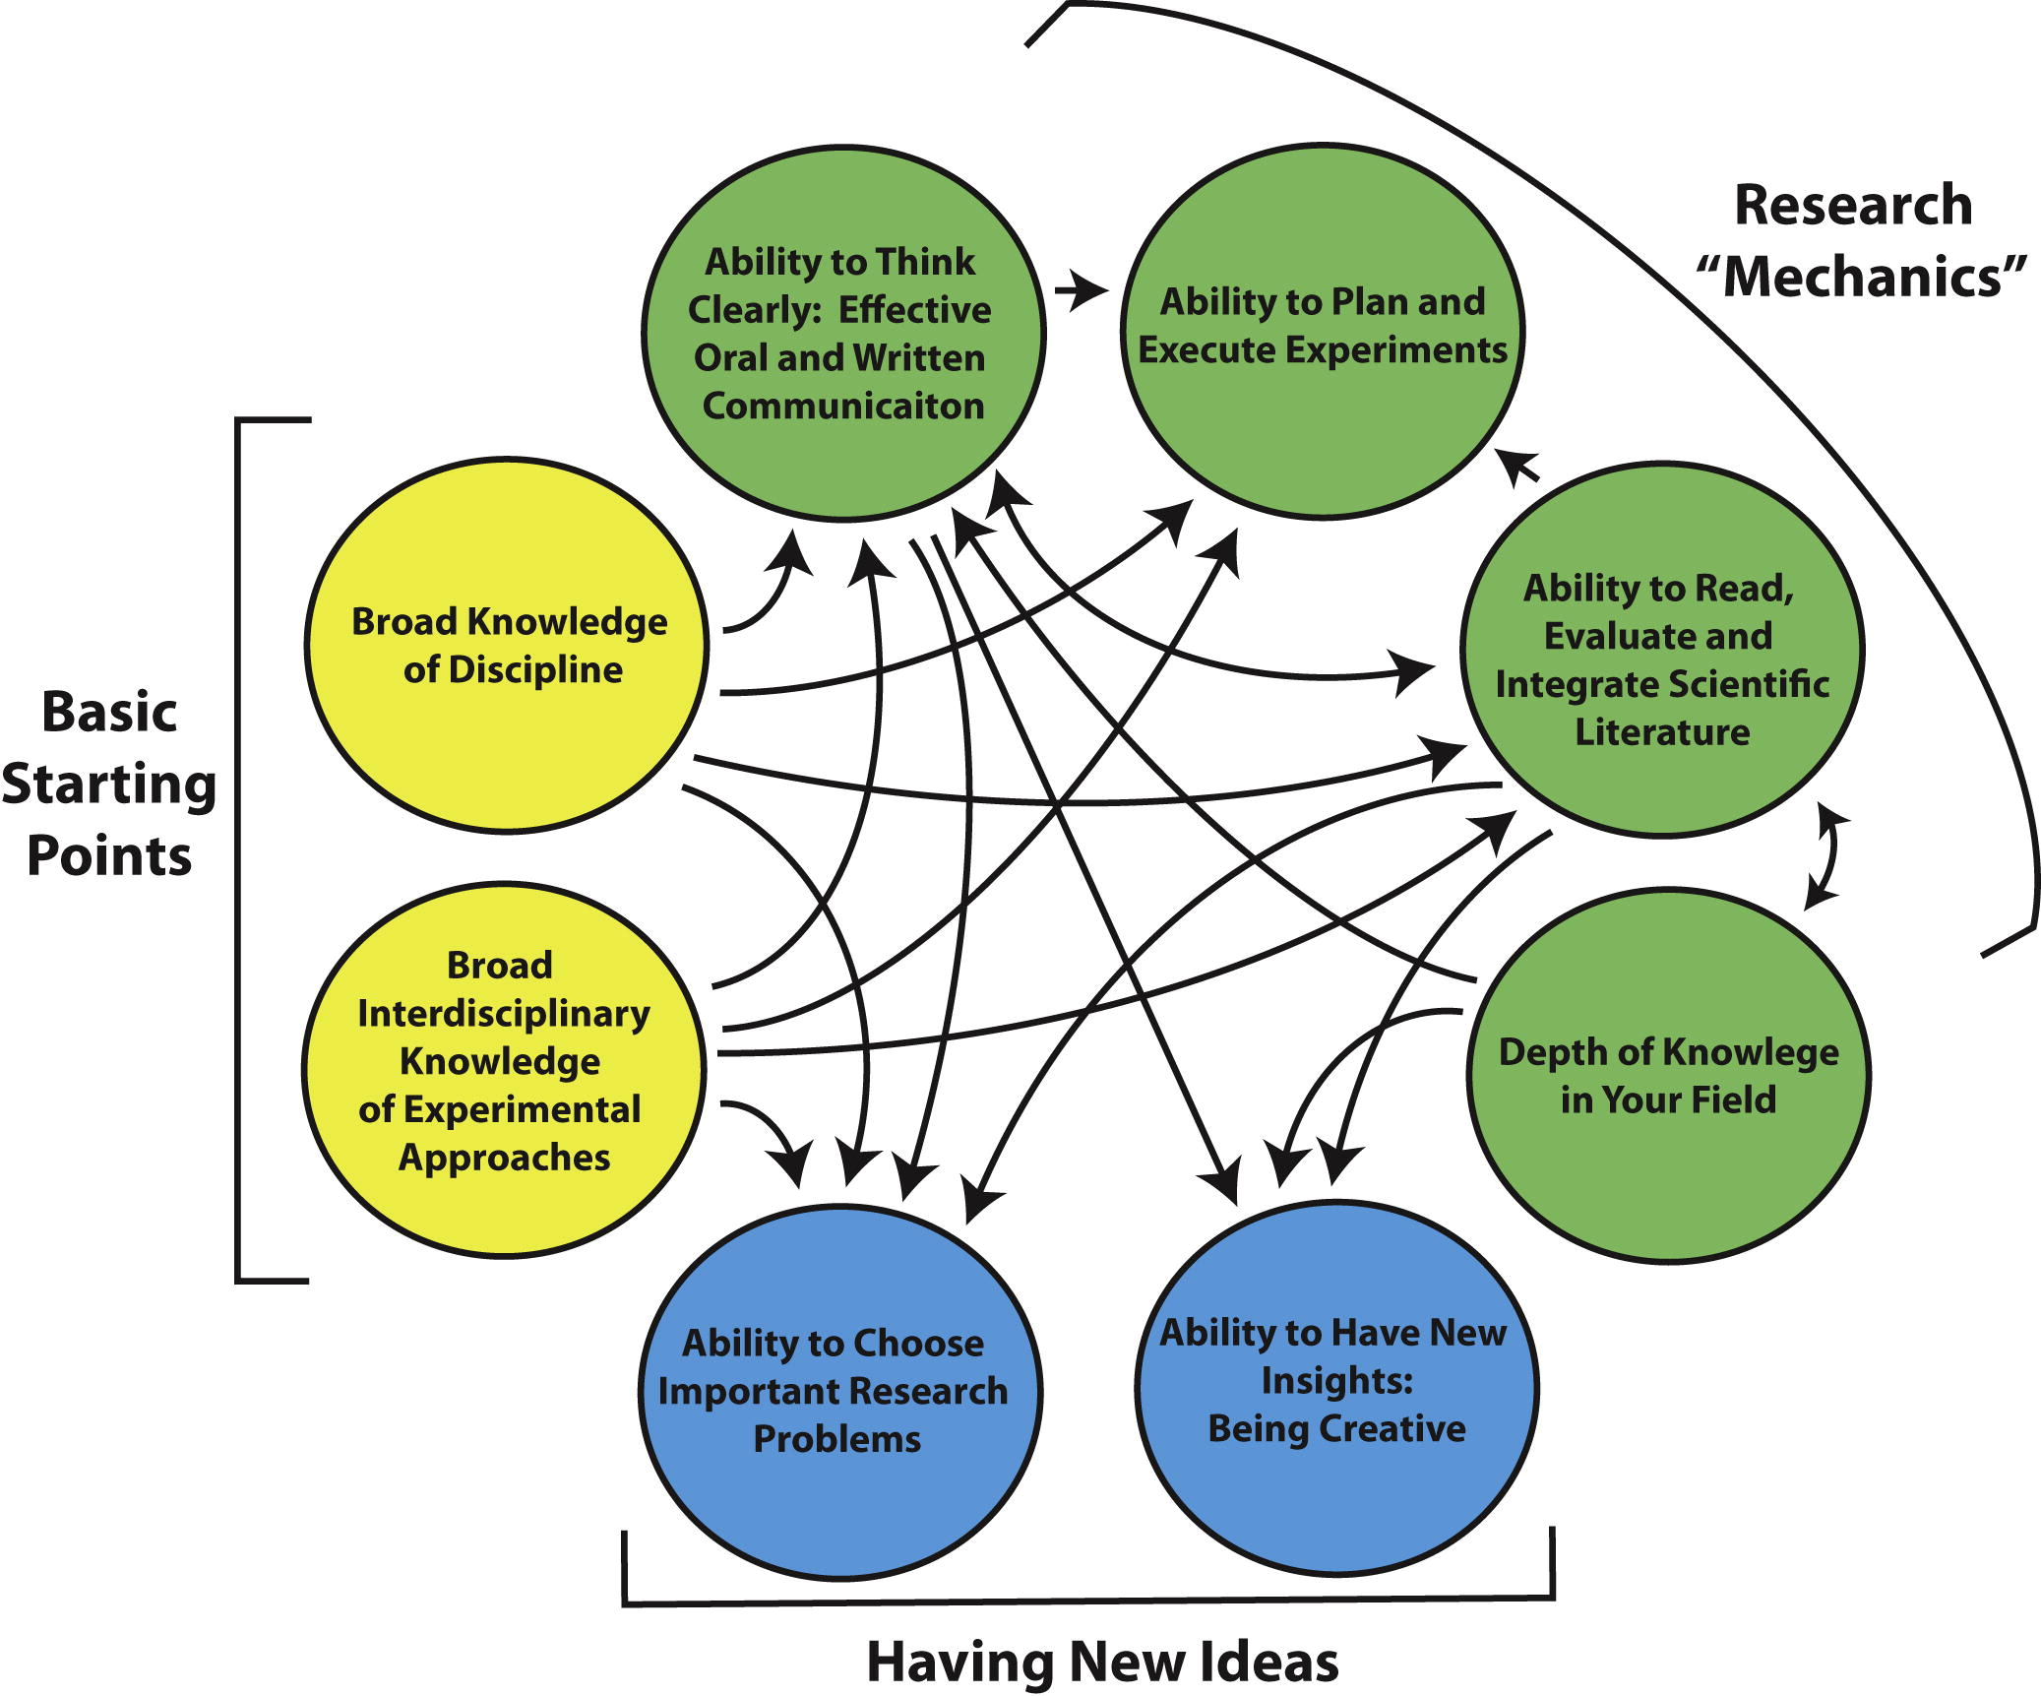
Scientific Skills and the
“Hidden Curriculum”
Parker, R. 2012. Skill development in graduate education. Mol. Cell 46: 377-381.

Slide 31
Basic Starting Points
Broad knowledge of discipline
Broad interdisciplinary knowledge of experimental approaches
    Required courses
    Electives
    Seminars
    Symposia, scientific meetings
      CSHL meetings – no cost!
    Journal clubs
    Reading the literature
Parker, R. 2012. Skill development in graduate education. Mol. Cell 46: 377-381.

Slide 32
Research “Mechanics”
Effective oral and written communication
  Alda Center for Communicating Science
  University workshops
  Student seminar
  Journal clubs
  Lab meetings
  Qualifying exam
  Meeting presentations
  Manuscript preparation
  Dissertation
Parker, R. 2012. Skill development in graduate education. Mol. Cell 46: 377-381.

Slide 33
Increase depth of knowledge in field
  Seminars
  Scientific meetings
Read, evaluate and integrate literature
  Journal clubs
  Qualifying exam
  Proposal exam
Plan and execute experiments
  Methods courses
  Journal clubs
  Mentor
  Research advisory committee
  Lab meetings
Parker, R. 2012. Skill development in graduate education. Mol. Cell 46: 377-381.

Slide 34
Having New Ideas
Choose important research problems
Reflect on the careers of other scientists
Be aware of directions in science, societal needs
Have new insights – be creative!
Be aware of technological developments
“Chance favors the prepared mind.” – Louis Pasteur
Recommended readings:
McKnight, S.L. 2009. Unconventional wisdom. Cell 138: 817-819
Scheffer, M. 2014. The forgotten half of scientific thinking. PNAS 111: 6119
Parker, R. 2012. Skill development in graduate education. Mol. Cell 46: 377-381.

Slide 35
Choosing a Research Mentor
Rotations, rotations, rotations!
Two ‘shoppers’
Communication
Recommended reading:
Alberts, B. 2009. On becoming a scientist. Science 326: 916.
Notes:
GRD 500 session on Mentoring

Slide 36
Career Development:
Don’t Leave it to the End!
Individual Development Plans
University workshops
  PhD Career Ladder
Center for Excellence in Learning and Teaching
Career Center
Networking
Reflect on career goals and update CV often
https://www.stonybrook.edu/commcms/grad/professional_development/index.php
Notes:
GRD 500 session on Mentoring

Slide 37
Useful Listservs
Campus Announcements
Departmental Seminars
  Furie listserv
Notes:
GRD 500 session on Mentoring

Slide 38
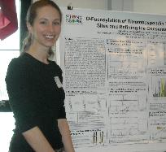
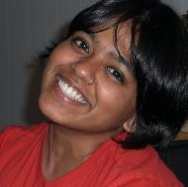
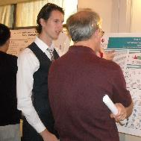
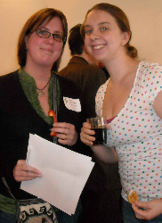
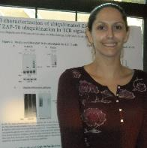
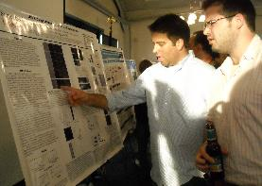
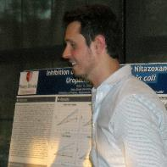
We all hope you enjoy your graduate studies!

