Slide 1
Stony Brook University Health Sciences Library
Check out the Services & resources available to you

Slide 2

The SBU Health Sciences Library serves the Schools of Dentistry, Health Technology & Management, Medicine, Nursing, Social Welfare and the biomedical/life sciences as well as Stony Brook Hospital and the Long Island State Veterans Home. Library study spaces are open to the entire SBU community and the public.
Online: library.stonybrook.edu/health-sciences-library In person: HSC Level 3 By email: refhsclib@stonybrook.edu
Resources
Research
Instruction
Full text access to +4,200 books, +10,000 journals, and 100’s of online databases through our website
Mobile apps
Any article or book available in the US, through Interlibrary Loan, at no cost to you
Collaborative and quiet study spaces
One-on-one literature review and search consultations
Bioinformatics consultations
NIH Public Access Policy Compliance support
Systematic review training and collaborations
Scholarly Communications support
Workshops for students, staff, and faculty on many topics
  Literature searching & evaluation
  Citation Management
  Bioinformatics Resources
Customized research and subject guides
Videos and interactive training modules
Health Sciences Library
Fall 2015

Slide 3
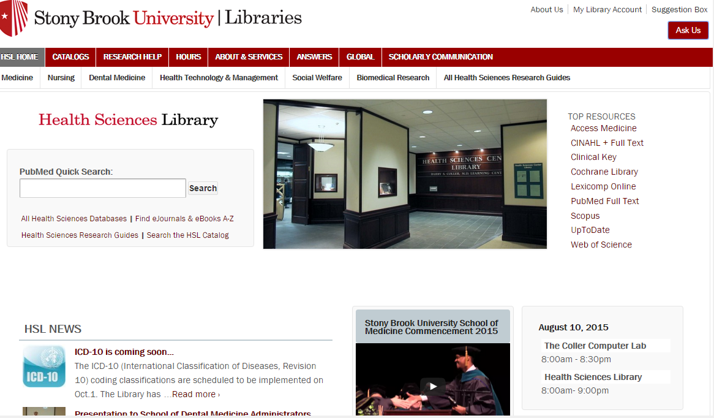
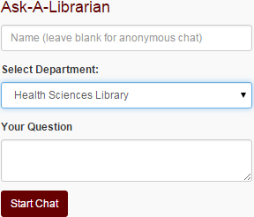
Have a ? - CHAT With us!
Start at HSL homepage http://library.stonybrook.edu/health-sciences-library/
Click on ‘Ask Us’ in the upper right corner
Fill out the Chat request form, select Health Sciences Library as department.

Slide 4
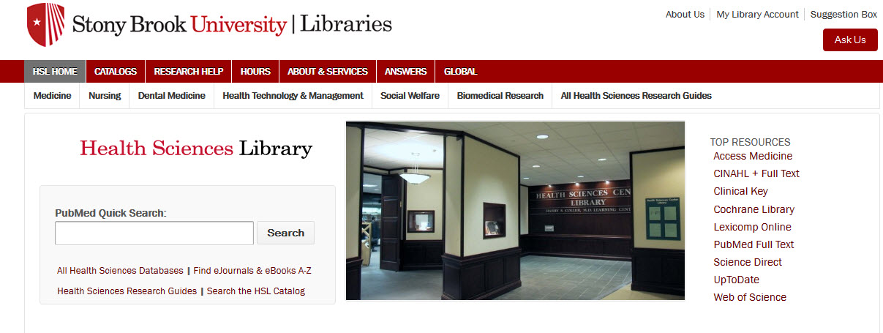
Subject Guides
Subject specific lists of e-books, databases and other electronic resources
http://library.stonybrook.edu/health-sciences-library/

Slide 5
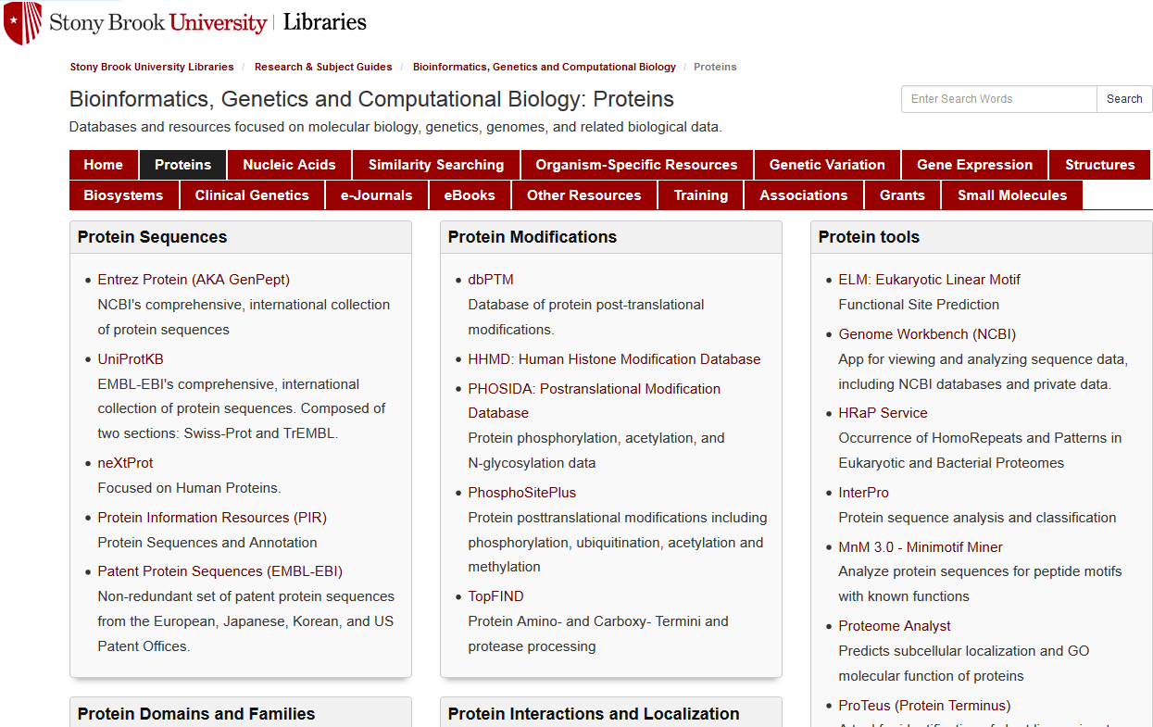
http://guides.library.stonybrook.edu/bioinformatics

Slide 6
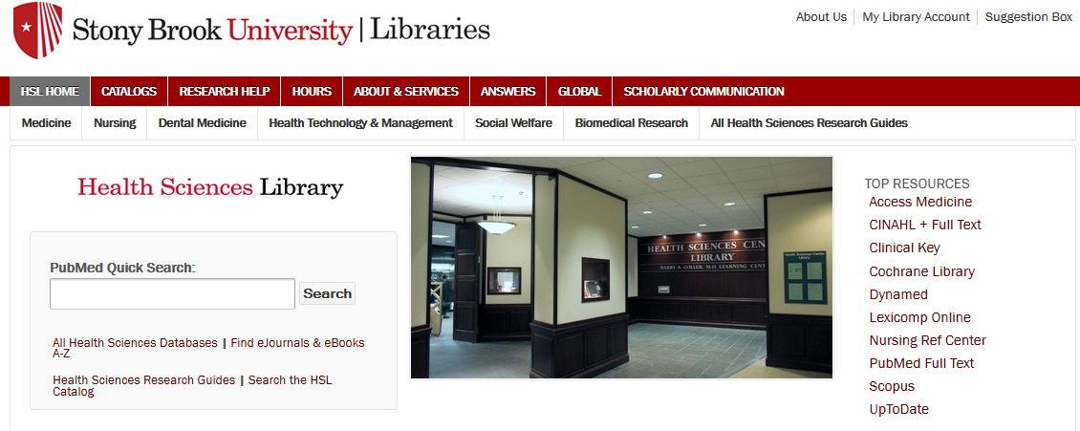
http://library.stonybrook.edu/health-sciences-library/

Slide 7
MANY Databases
Bibliographic
PubMed
Biomolecular
GenBank (Entrez Nucl.)
Scopus
Web of Science
Biological Abstracts
Biosis Citations Index
PubMed Central
1000Genomes Browser
Protein Databank (PDB)
OMIM
Gene Expression Omnibus (GEO)
http://guides.library.stonybrook.edu/az.php?s=10890
http://guides.library.stonybrook.edu/bioinformatics/home

Slide 8
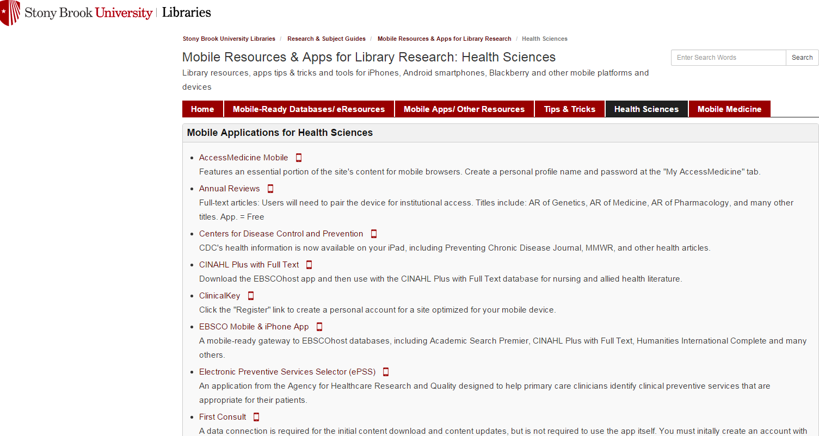
Free apps for download!
http://guides.library.stonybrook.edu/mobile/health_sciences

Slide 9

Off campus Access to our Resources
3 simple steps to access library resources from
off-campus:
1- Pick your favorite place.
2- Go to the Library website to start your search.
3- When prompted, enter your NetID and password.
Photo courtesy of: danisabella via Flickr https://flic.kr/p/73B2gT
https://creativecommons.org/licenses/by/2.0/
For help with your NetID visit http://it.stonybrook.edu

Slide 10

Need Help with Citations?
Free Endnote downloads
ENDNOTE is available for download through DoIT using your NetID & password.
What can ENDNOTE do for me?
Add citations in selected style format from most major databases.
Attach full-text pdf’s to citations for organization and easy retrieval.
Create bibliographies quickly and easily!!
For more information, help and tutorials go to - http://guides.library.stonybrook.edu/endnotehs

Slide 11
Don’t see what you’re looking for? We’ll Request it!
Interlibrary Loan &
Document Delivery now available FREE to Stony Brook students, faculty and staff!
Interlibrary Loan:
A service through which you can obtain journal articles and loans of material not available at the Stony Brook University Libraries.
Document Delivery:
A service that provides PDF files of book chapters and journal articles from material available at the Stony Brook University Libraries
For more about these services; http://library.stonybrook.edu/services/access-services/interlibrary-loan/

Slide 12
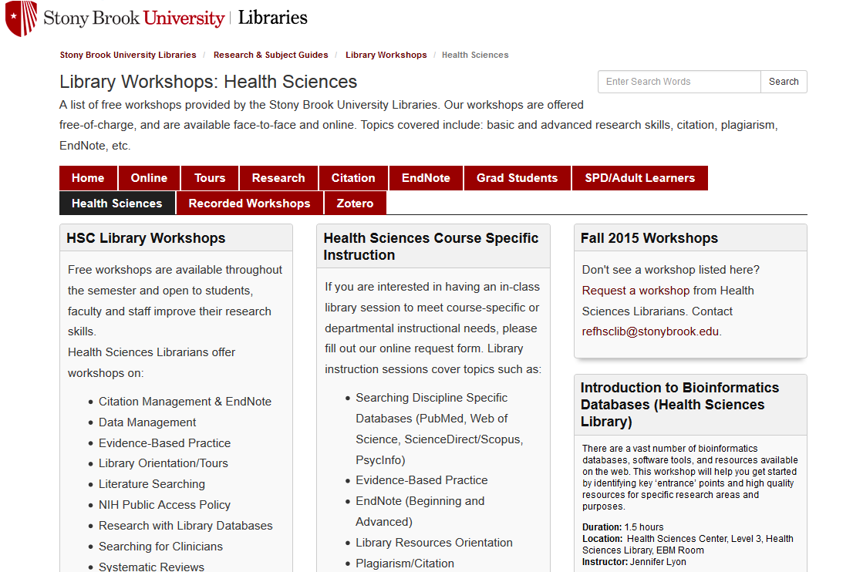
Free Library Workshops
http://guides.library.stonybrook.edu/workshops/HSLibraryWorkshops

Slide 13
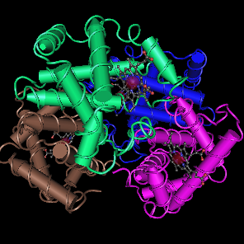
Fall 2015 Bioinformatics Workshops
Introduction to Bioinformatics Resources
  HSL – Thursday, September 24, 1pm - 2:30pm, EBM Room
  Melville – Friday, September 25, 3-4:30pm, Classroom A
Introduction to BLAST – Sequence Similarity Searching
  HSL – Monday, October 19, 9am – 11am, EBM Room
  Melville - Tuesday, Oct 20, 9:30-11:30am, Classroom A
Introduction to Molecular Structures - Using Cn3D
  HSL – Tuesday, November 17, 1pm - 3pm, EBM Room
  Melville - Monday, November 16, 1-3pm, Classroom A
Introduction to Genetic Variation Resources – SNPs, Indels, & More
  HSL – Friday, December 4, 9am - 11am, EBM Room
  Melville - Thursday, December 3, 9:30-11:30am, Classroom A
Human
Hemoglobin
PDB ID: 1LFL
Register at:
http://guides.library.stonybrook.edu/workshops/HSLibraryWorkshops

Slide 14

your LIAISON LIBRARIAN:
Jennifer Lyon
Subject Specialties:
Basic Biological Sciences
  Genetics, Molecular and Cell Biology, Biochemistry, Microbiology
Clinical & Translational Research
Clinical Support
  Emergency Medicine, Surgery, Pathology
Systematic Reviews
Research Interests:
Bioinformatics & Clinical Skills Training for Librarians
Embedded Librarianship, Particularly at the Clinical ‘Point-of-Care’
Health Literacy
Contact Jennifer
jennifer.a.lyon@stonybrook.edu
631-444-3102
For more information: http://guides.library.stonybrook.edu/lyon

